Slide 2
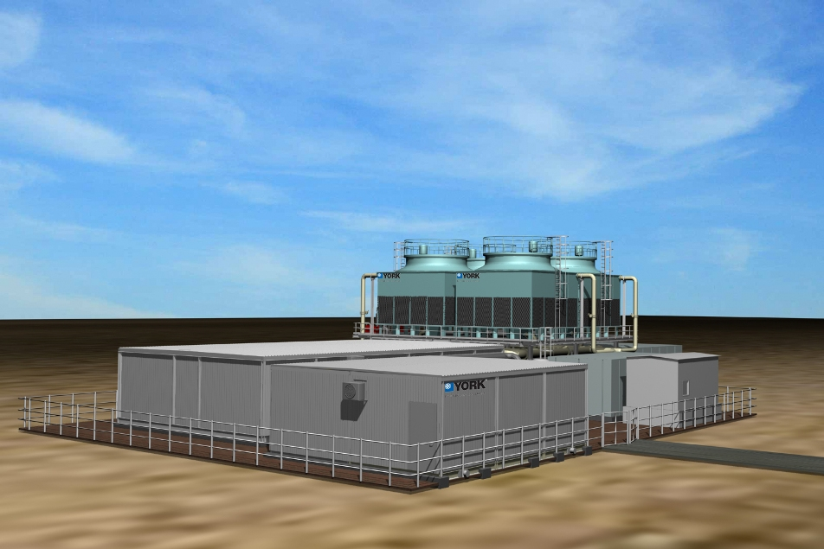
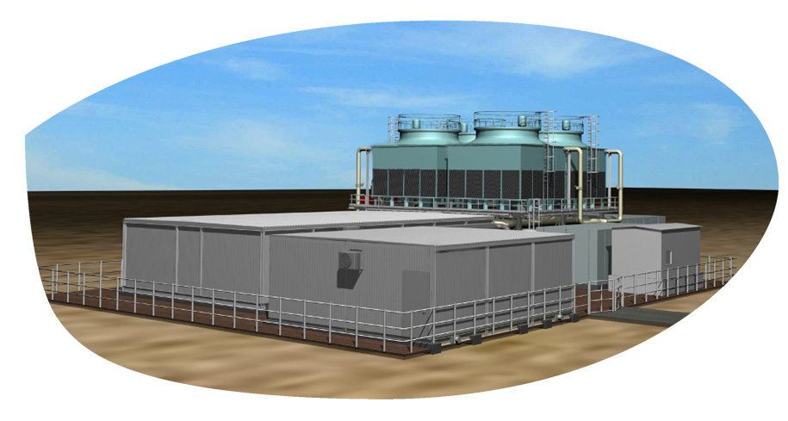
Flo Fab Modular chilling package

Slide 3
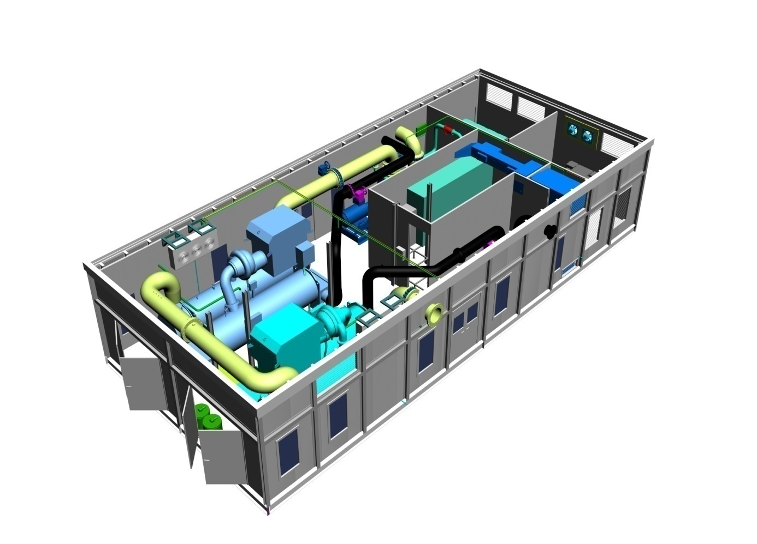
Agenda
What is a Packaged Plant ?
Benefits to Customer
The Flo Fab Advantage
The Manufacturing Facility in Canada
What we DON’T Offer

Slide 4
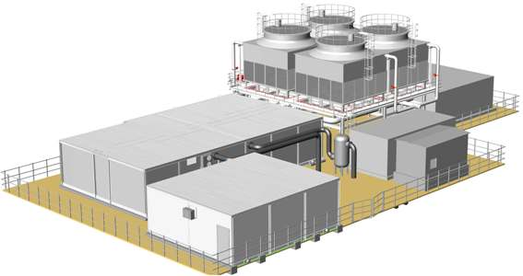
What is a Packaged Plant ?
A ‘packaged’ plant is a pre-designed factory assembled self-contained system shipped in modules for assembly at site.
It contains chillers, cooling towers, instrumentation, controls, pumps, pipework, electrics and all that is necessary for
producing chilled water.
Packaged plants can be
pre-engineered for the
majority of chiller plant applications to
customer specification.

Slide 5
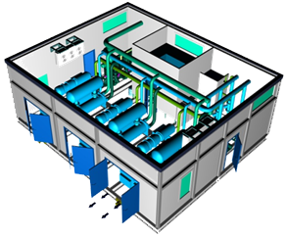
Benefits to Customer
Complete self-contained factory built Chiller Plant inclusive of all components necessary for reliable and efficient operation
Single point of responsibility - design, assembly & commissioning of packaged plant by Flo Fab. Helps avoid coordination issues - improves project management
High system energy efficiency – smaller carbon footprint / "green" performance.
Standard high quality as plant is manufactured in controlled factory environment by a well trained team working to standard work procedures

Slide 6
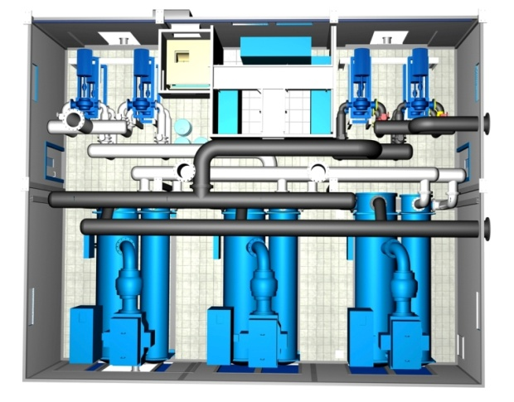
Benefits to Customer
Guaranteed performance - engineered, manufactured & commissioned by same agency
Greater flexibility – affords scalability in case of phased construction
Reduced job site risk & EHS problems due to greatly reduced site work
Significantly smaller space requirement
Reduced construction schedules – improved project management. Manufacture of plant can continue in the factory while site approvals are still underway

Slide 7
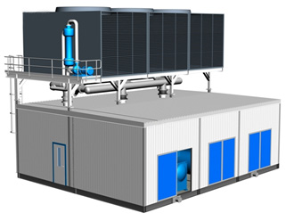
Benefits to Customer
Reduced contingency costs due to lesser site exposure & better project management
Minimum & simple site tie -ins such as chilled water piping connections, cooling tower make-up & drain connections, incoming electric power, earthing etc
Possible to relocate in case of future site development
In short – it is a WINNING PROPOSITION !!!

Slide 8
The Flo Fab Advantage
Company’s Brand Equity
Engineering & Manufacturing Setup in North America
Optimized Equipment and Controls Selection & Design
Different options Centrifugal/Screw /Absorption Chillers
Different options Air handling Units, Cooling Towers, Blower Coils & Split Units (in-house products)
Global Sourcing Agreement with reputed suppliers for other major components
Excellent After Market Service & Spares Setup

Slide 9
– Certification Certified
Notes:
9

Slide 10
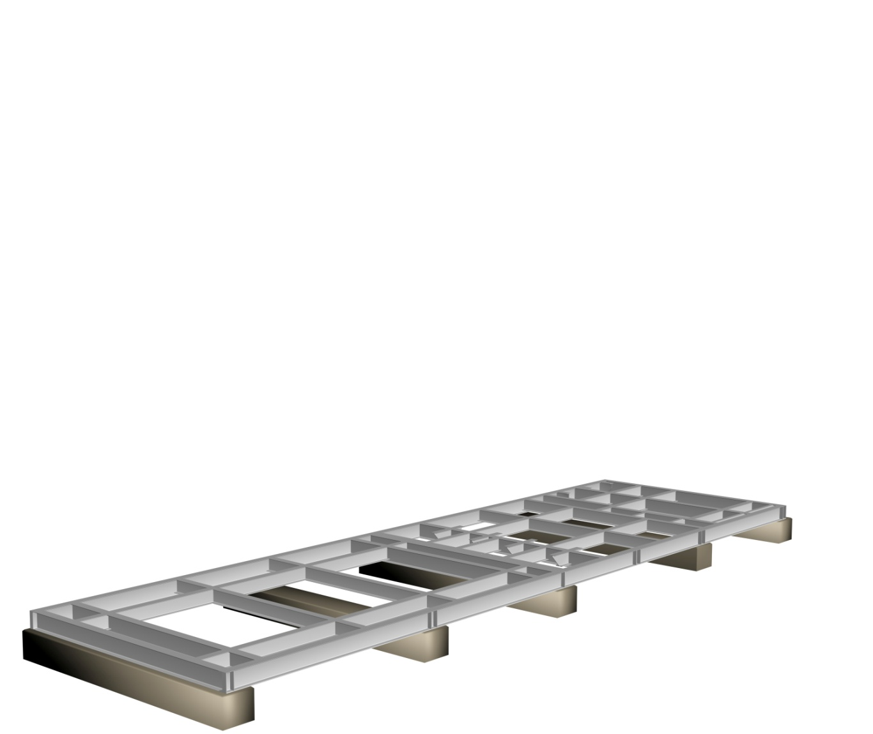
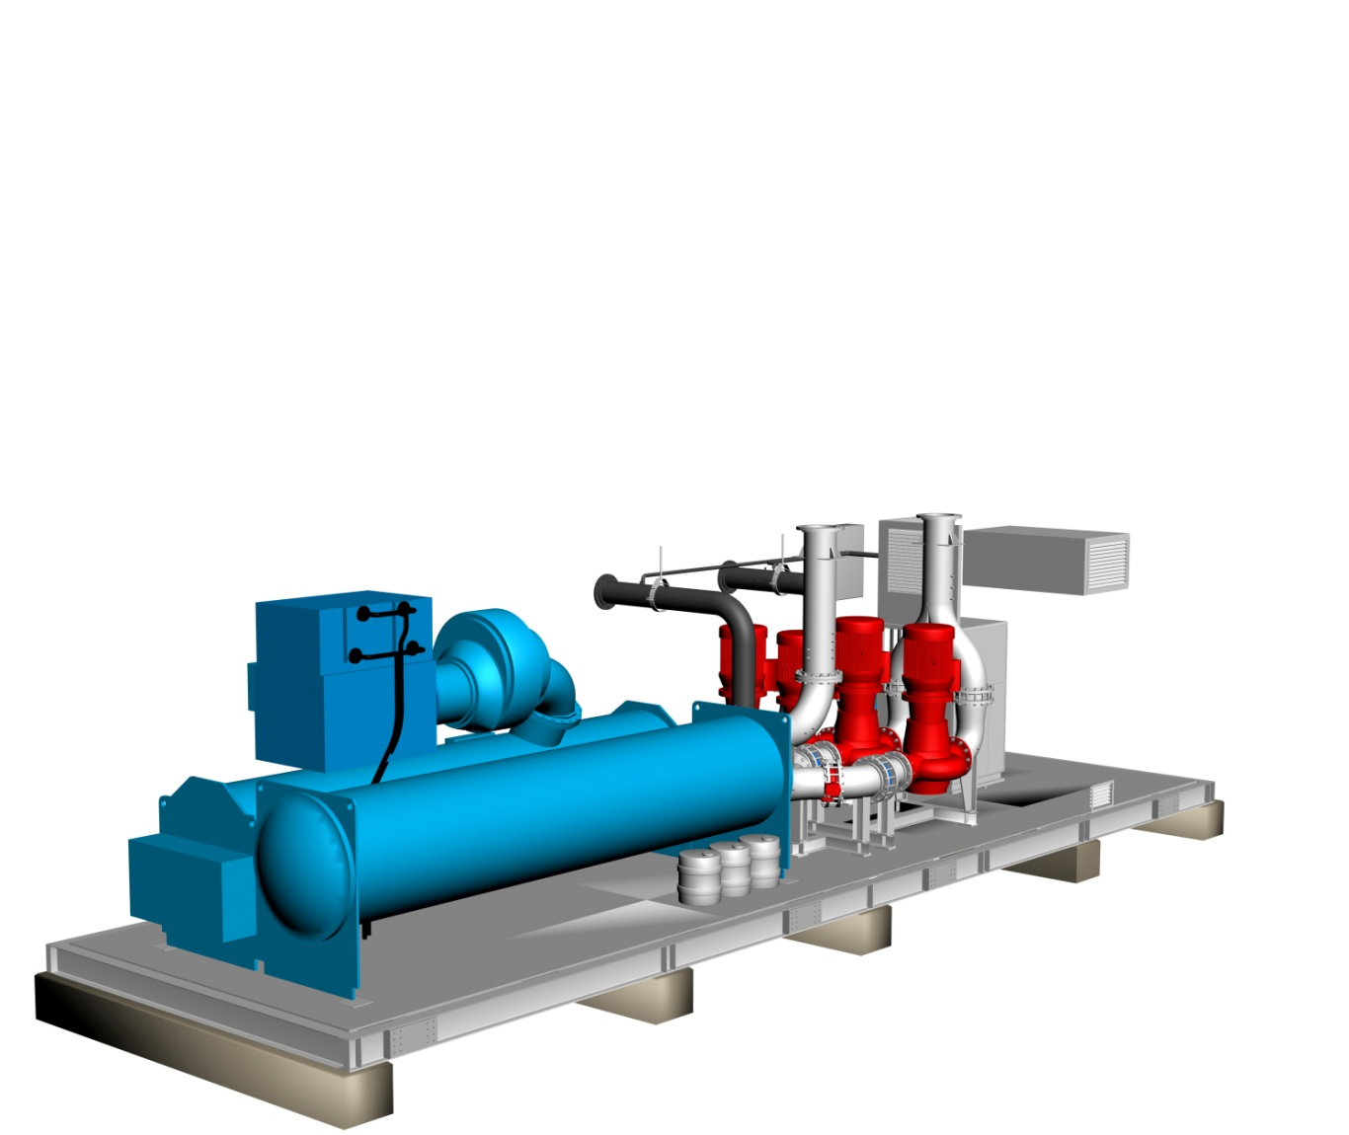
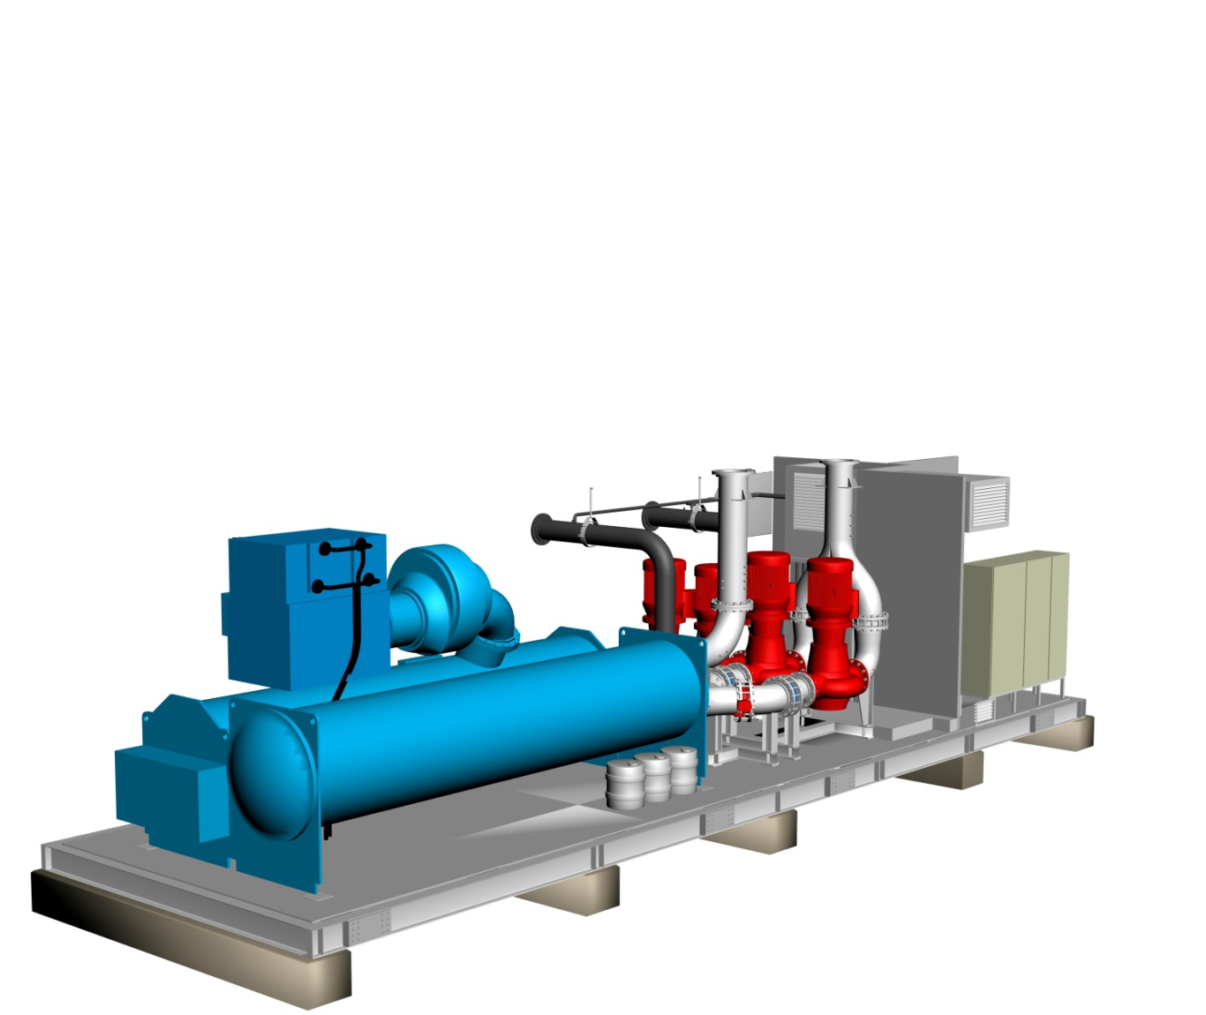
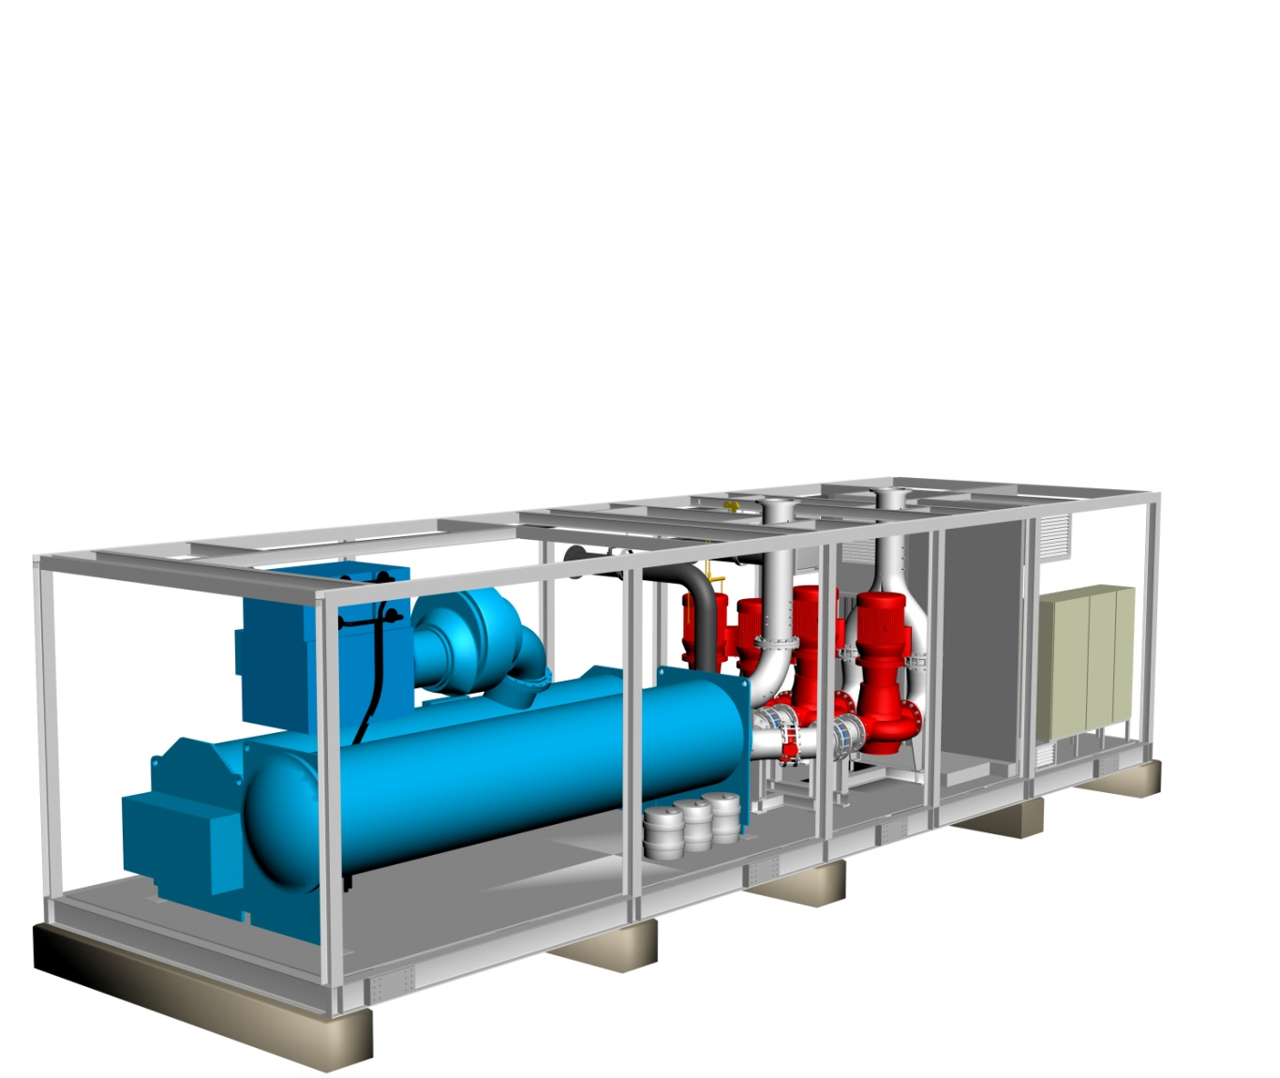
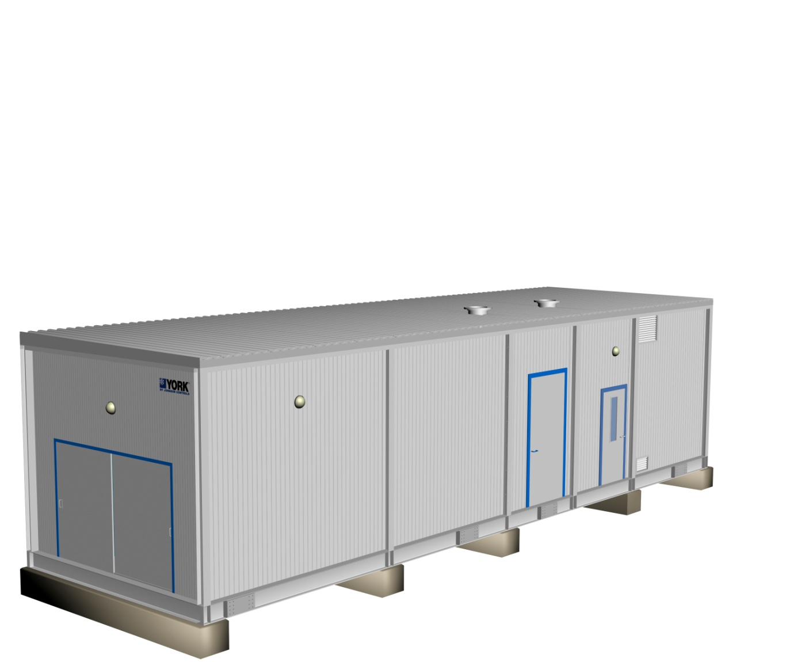
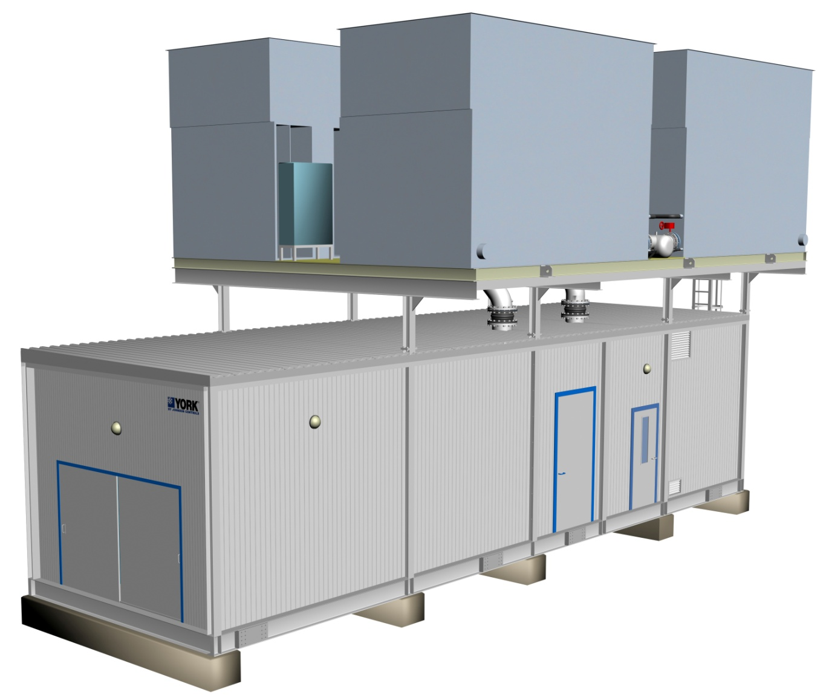
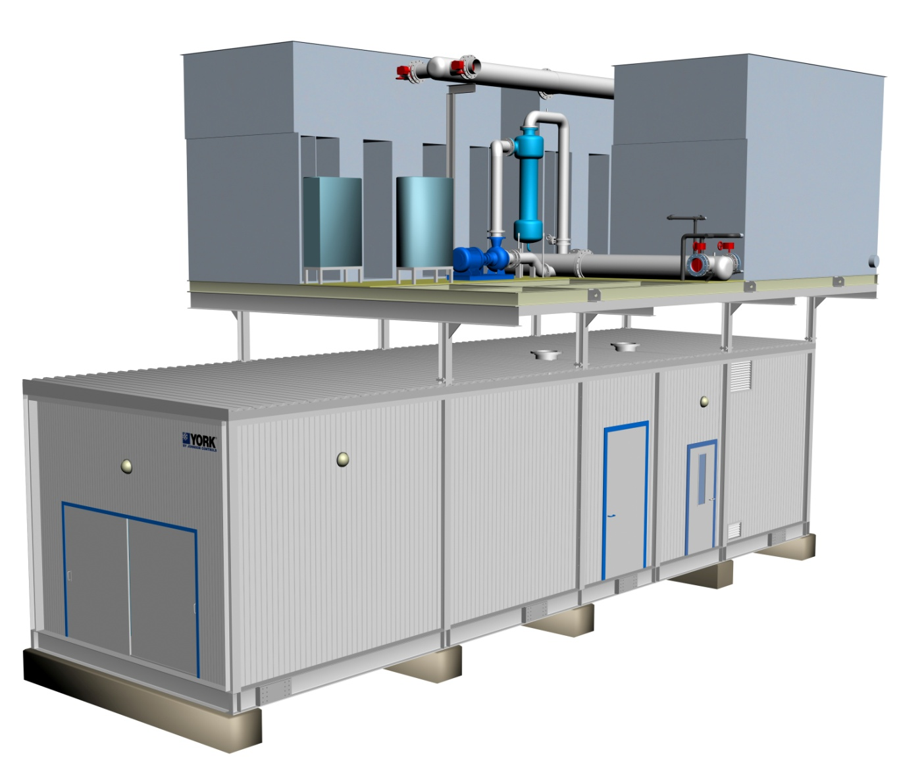
Modularized Packaged Chilling System
Produced within Controlled Environment :
Manufactured, Not Constructed
Proven Engineered Design and Fabrication Standards
Strict Quality Control
Controlled Environment with High Safety Standards
Established Knowledgeable Skilled Workforce
Job Site Progress / Conditions Irrelevant to Production
Notes:
10

Slide 11
Applications
Constant Volume Chilled Water Circuits
Primary-Secondary
Variable Primary
High delta T (9K)
Permanent Plant
Temporary (Portable) Cooling
Long Term Temporary Plant
Turbine Inlet Air-cooling

Slide 12
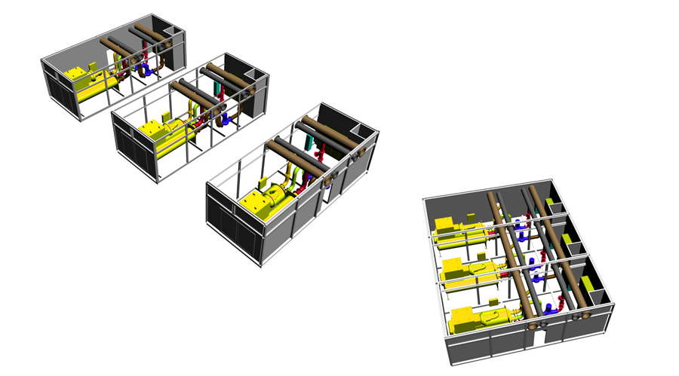
Multiple Chillers

Slide 13
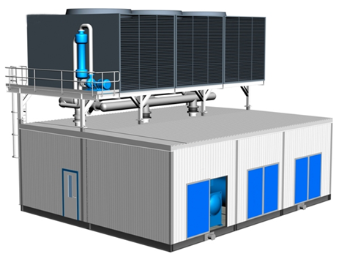
Multiple Chillers

Slide 14
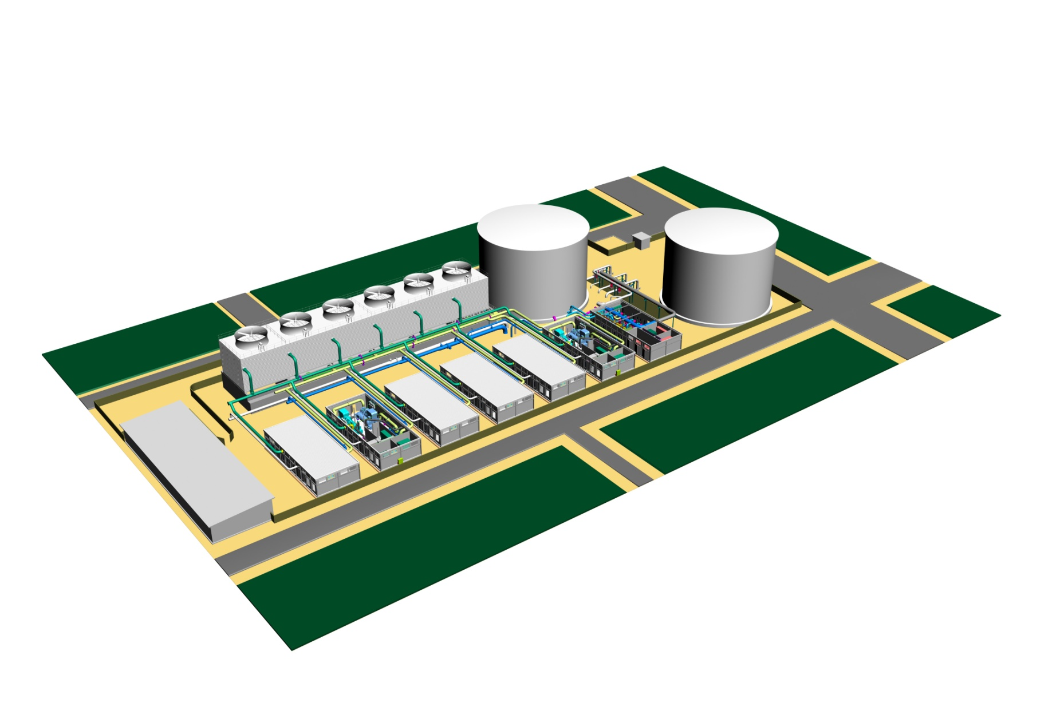
Voltage Options
Voltages:
11kV
6.6kV
3.3kV
400V

Slide 15
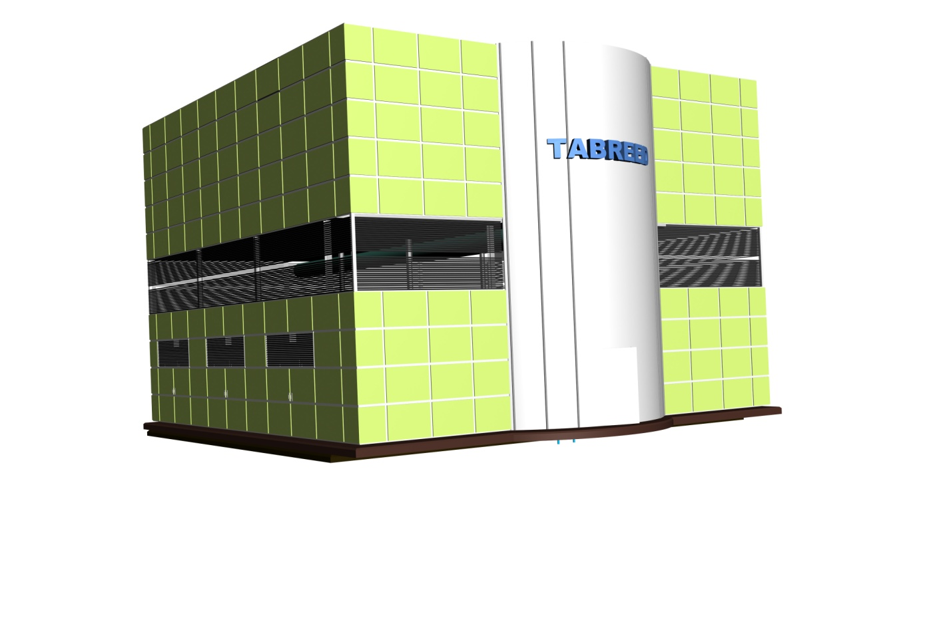
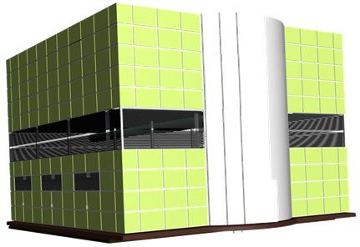
System Solutions
Chilled Water Production & Distribution:
Individual Chiller Plant 600TR to 10,000TR
Modular Systems above 10,000TR
Chiller Options
Screw
Centrifugal
Absorption
Refrigerants
R-134a
R-22
1,000TR – 30,000TR

Slide 16
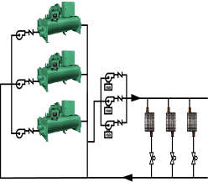
Primary–Secondary System
Tried & tested
Ensures safe chiller operation
Higher first cost
Good system efficiency
Larger plant room footprint
Pri Pumps
(const speed)
Secondary Pumps with VSD
Typical load with 2 way valve
De-coupler / Bypass
CHILLED WATER PRODUCTION (PRIMARY)
CHILLED WATER DISTRIBUTION (SECONDARY)

Slide 17
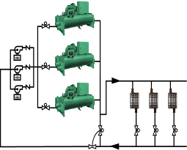
Variable Primary Chilled Water Flow
Modern Chillers are safe at varying flow thanks to latest controls
Lower capital
Best system efficiency
Lower overall footprint
Automatic Isolation Valve
Pri Pumps with VSD
Typical load with 2 way valve
Bypass Valve
Flow Meter

Slide 18
Types of Packaged Plants
Temporary Cooling Plant
Solidly Constructed rigid, riggable, reusable plant
Variable Primary or Constant Volume Comes complete with Cooling Tower Skid
Single Chiller in one module
Screw and Centrifugal Chillers
Primary design consideration is portability

Slide 19
Types of Packaged Plants - Temporary Cooling Plants
A big seller to District Cooling Companies
DC plants are hardly ever ready on time.
Allows them to meet their commitments
.. And bill for it
Moved from project to project
No secondary pumps needed
A beast of burden!
1,220 TR

Slide 20
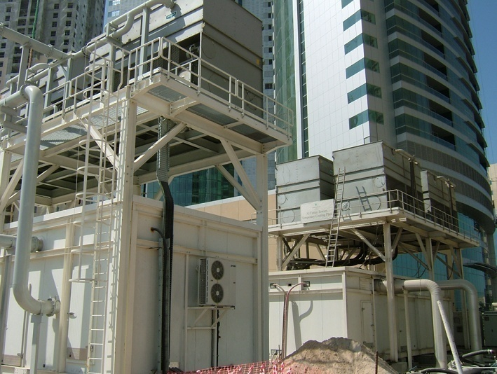
Types of Packaged Plants - Temporary Cooling Plants
Notes:
YORK MAKES TEMPORARY, LOW FOOT PRINT, HIGH CAPACITY CHILLER PLANT. RUGGEDLY MADE, THE PLANT SHOWN HERE PROVIDES 2,500TR ON A 5 x 15M BASE WITH MEDIUM VOLTAGE STARTERS

Slide 21
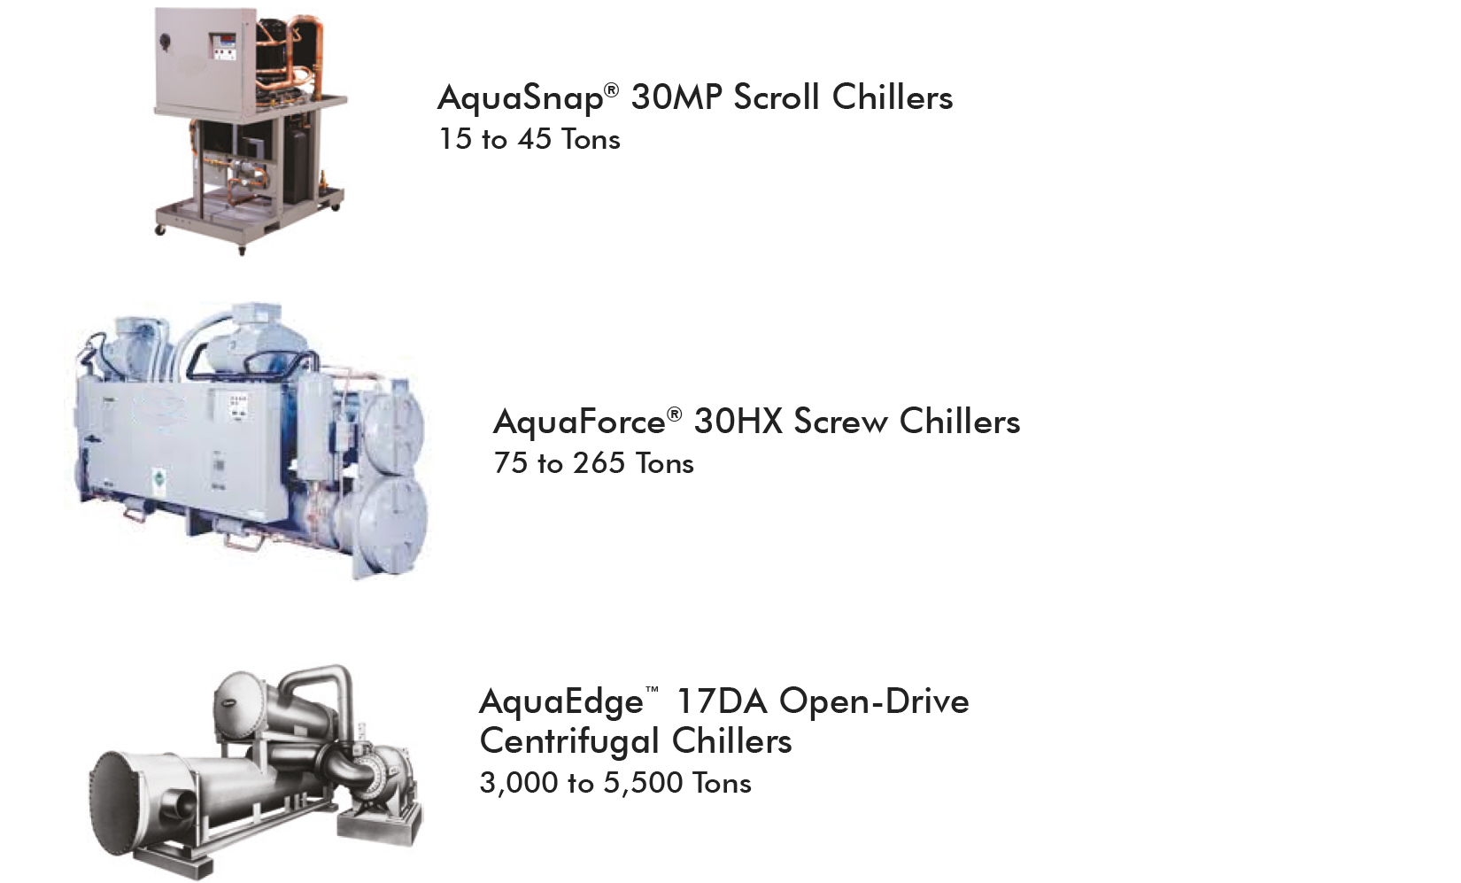
Chillers (Water-Cooled)

Slide 22
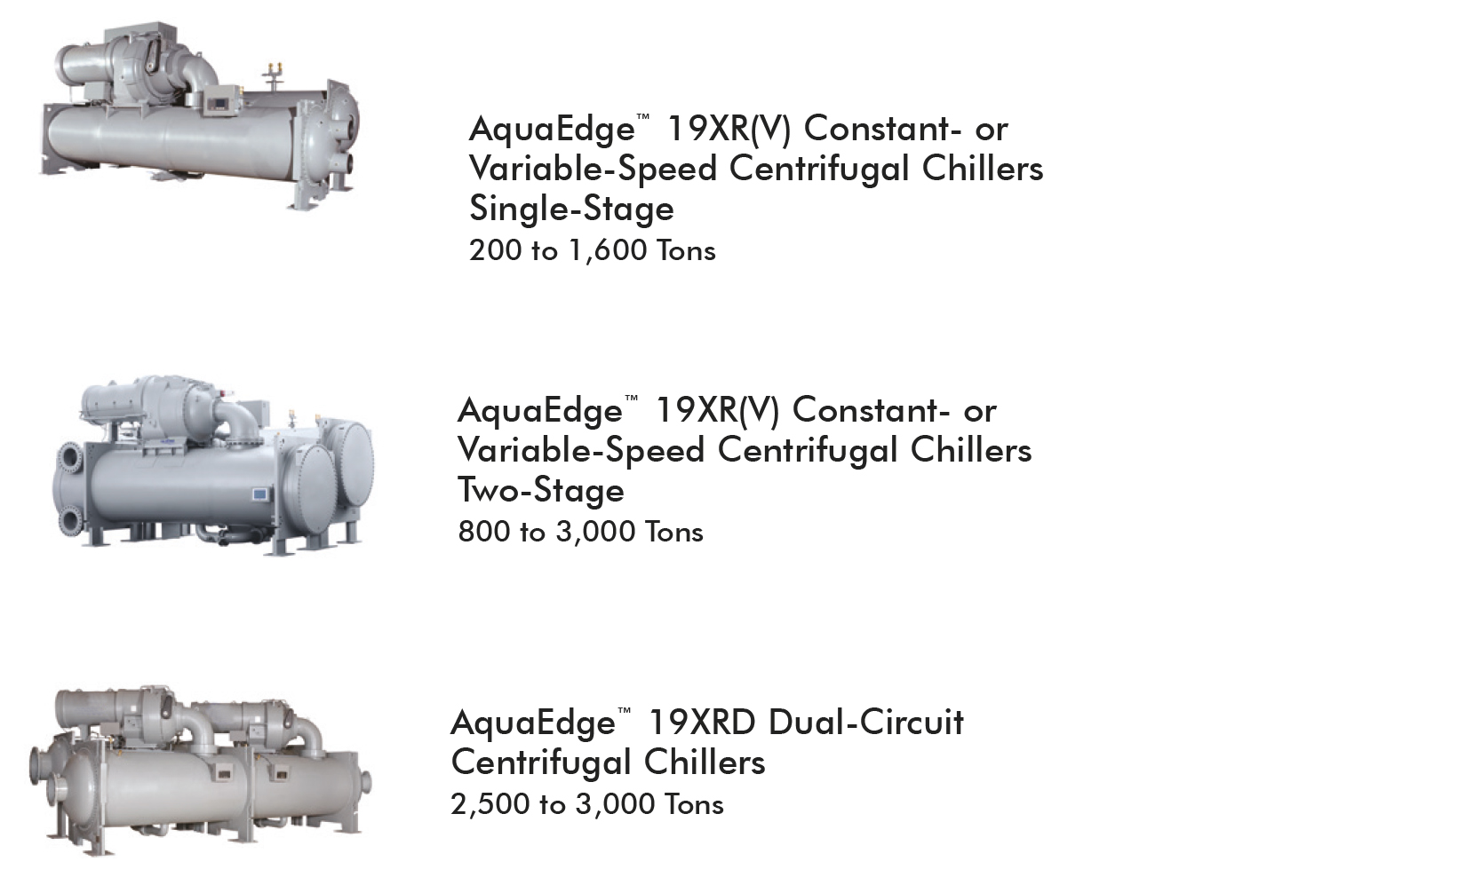
Chillers (Water-Cooled)

Slide 23
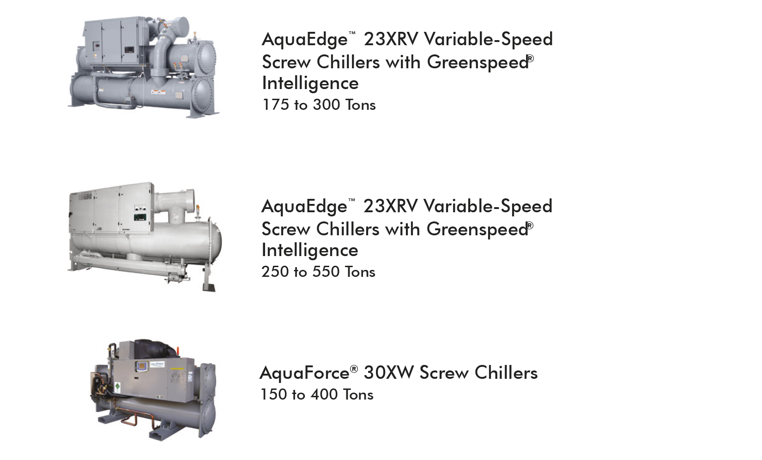
Chillers (Water-Cooled)

Slide 24
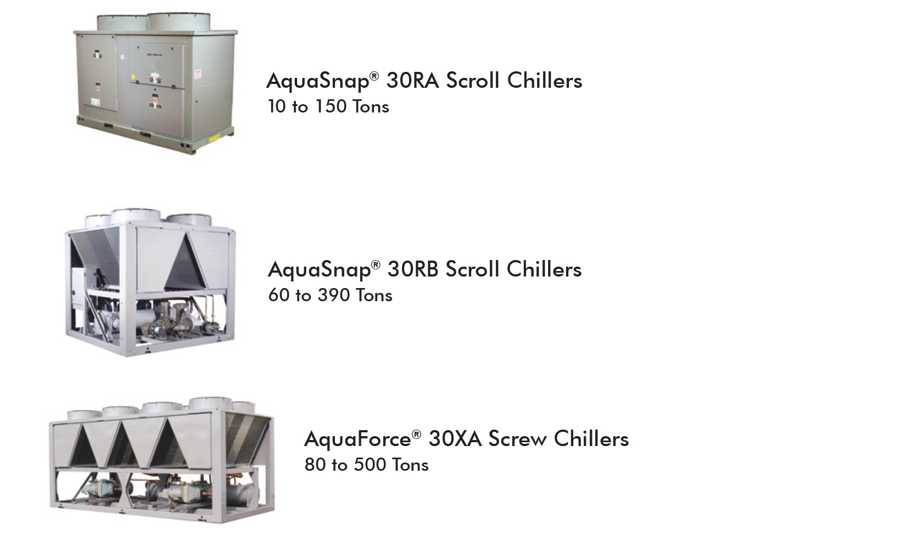
Chillers (Air-Cooled)

Slide 25
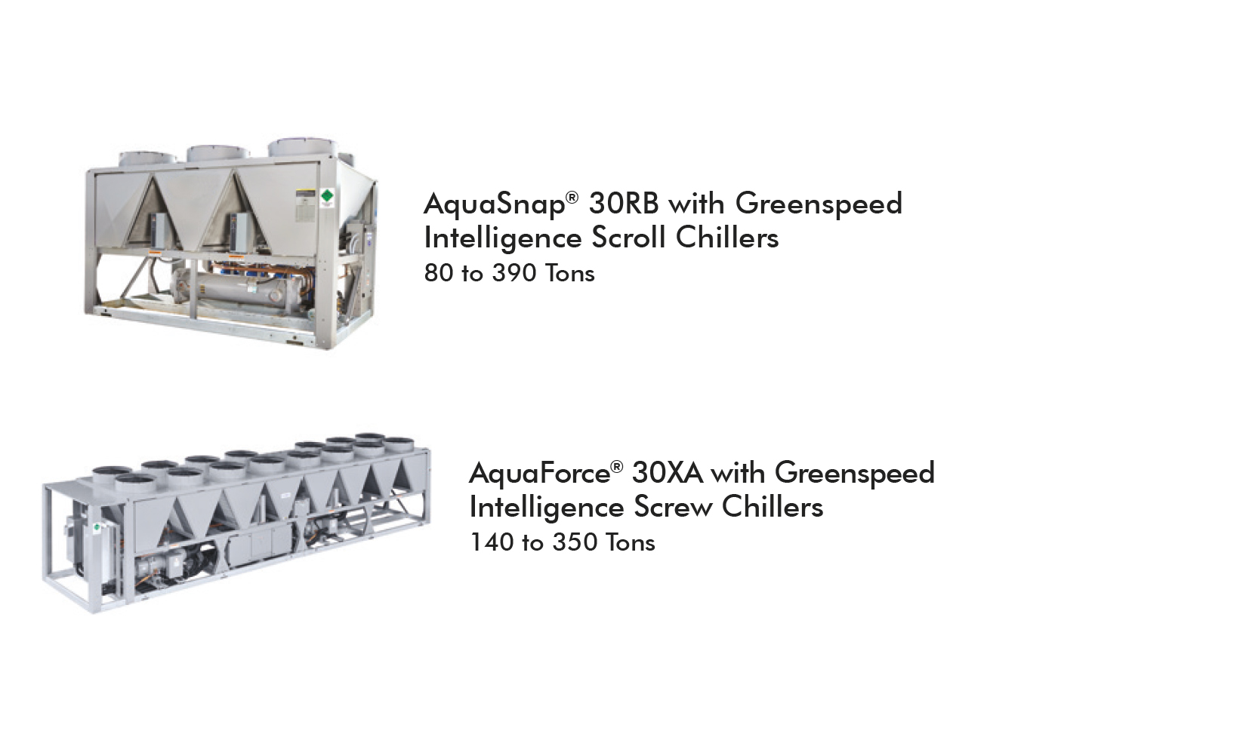
Chillers (Air-Cooled)

Slide 26
Types of Packaged Plant
Permanent Cooling Plant
Solidly Constructed Rigid, riggable, permanent plant
Variable Primary or Constant Volume Comes complete with Cooling Tower Skid
Single or Multiple Chillers
Screw and Centrifugal Chillers
Primary design consideration is efficiency & ease of maintenance

Slide 27
Types of Packaged Plants - Permanent Cooling Plants
11kV SWITCH GEAR
11kV / 400v TXFR AREA
400v CONDENSER WATER PUMP
400v CHILLED WATER PUMP
CHILLER & PUMP, ROOM, MCC AND MT ROOMS ARE AIR CONDITIONED
4,000TR Chiller Module
Notes:
ANOTHER VIEW WITH SEPARATE AREAS HIGHLIGHTED

Slide 28
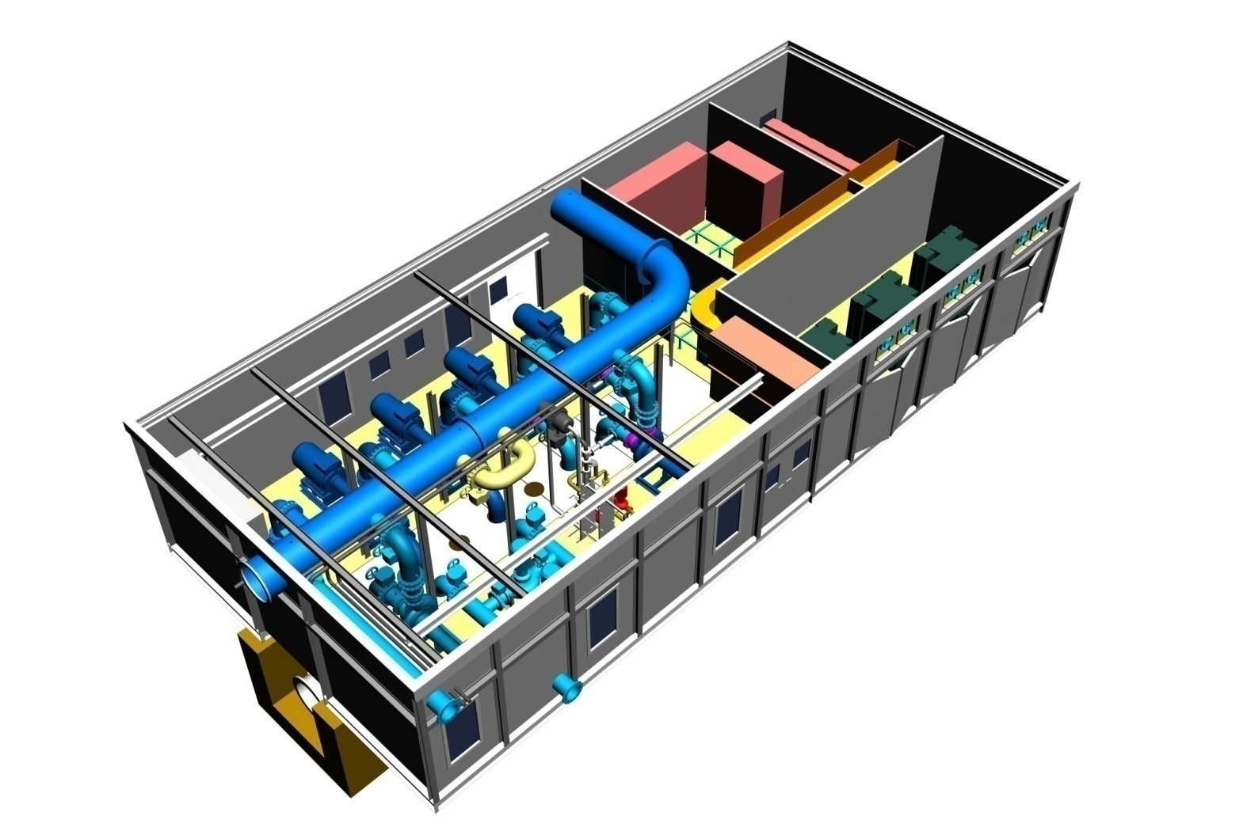
Secondary Distribution Module – Capable of Pumping 32,000TR at 9K
Types of Packaged Plants - Permanent Cooling Plants
11kV SW/GEAR
400v MCC & VSD AREA
11kV / 400v TXFR AREA
PUMP ROOM & MCC AIR CONDITIONED
400v CH/W PUMPS W/ VSD
Notes:
PREFABRICATED SECONDARY CHILLED WATER PUMP MODULE WITH MAIN COMPONENT AREAS INDICATED.

Slide 29
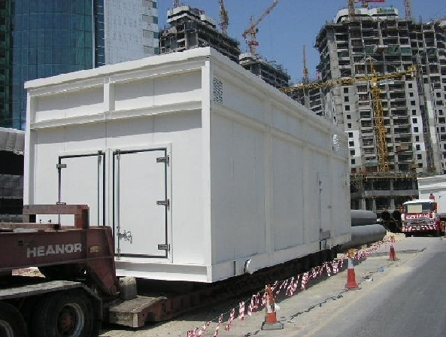
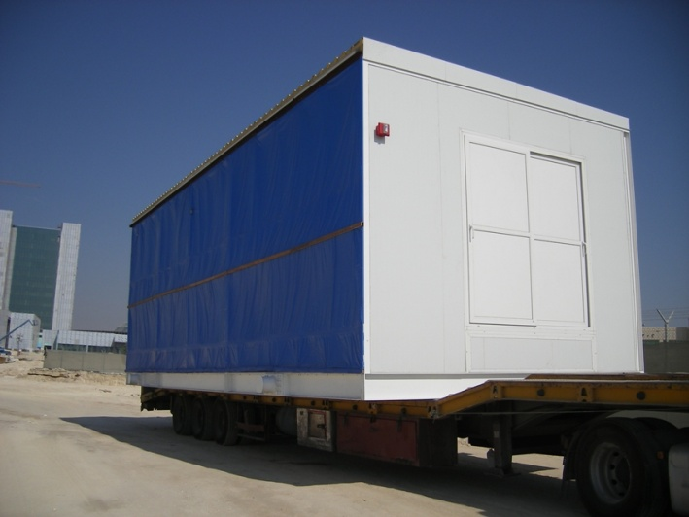
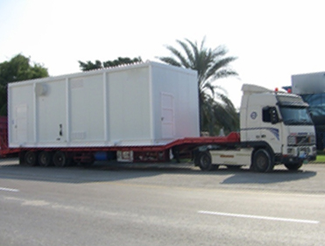
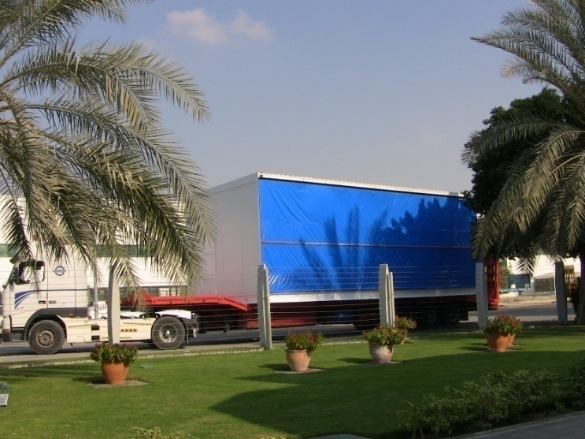
Transportation
To any place in the World from Flo Fab Canada

Slide 30
Delivery
Strip Foundations prepared
Two Section Assembly

Slide 31
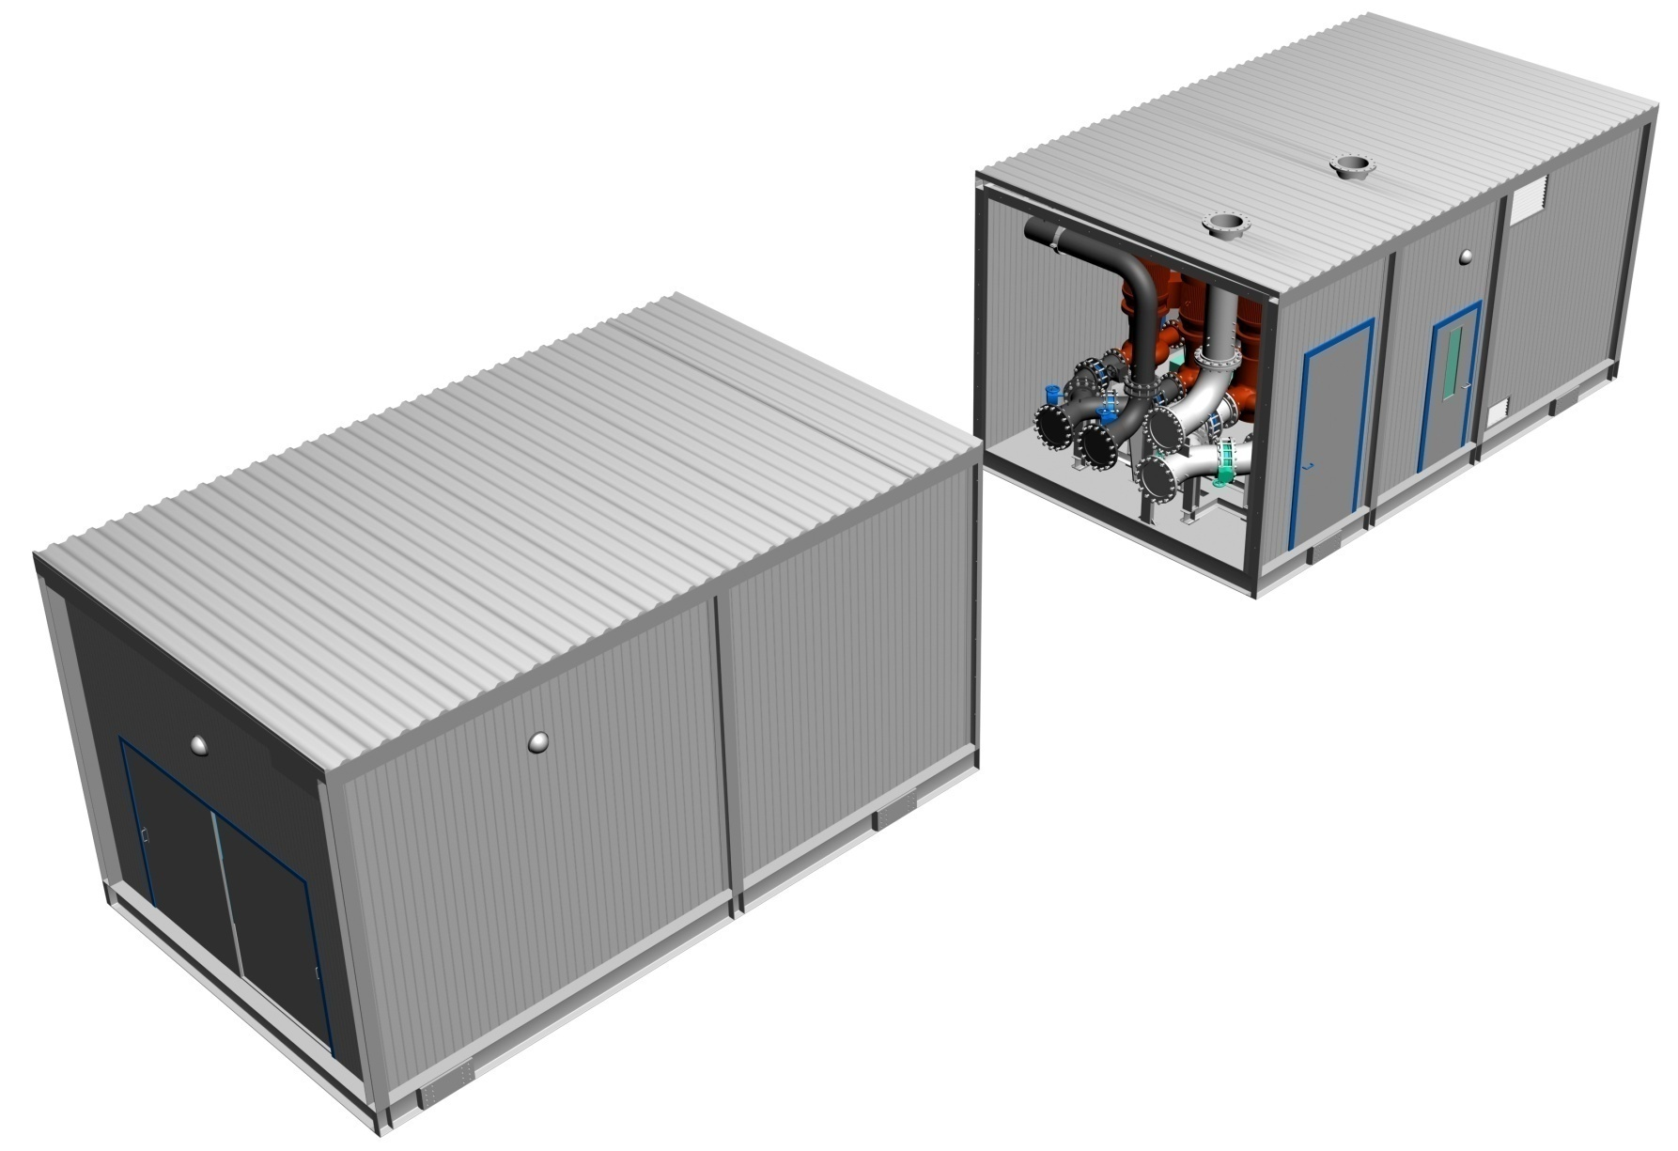
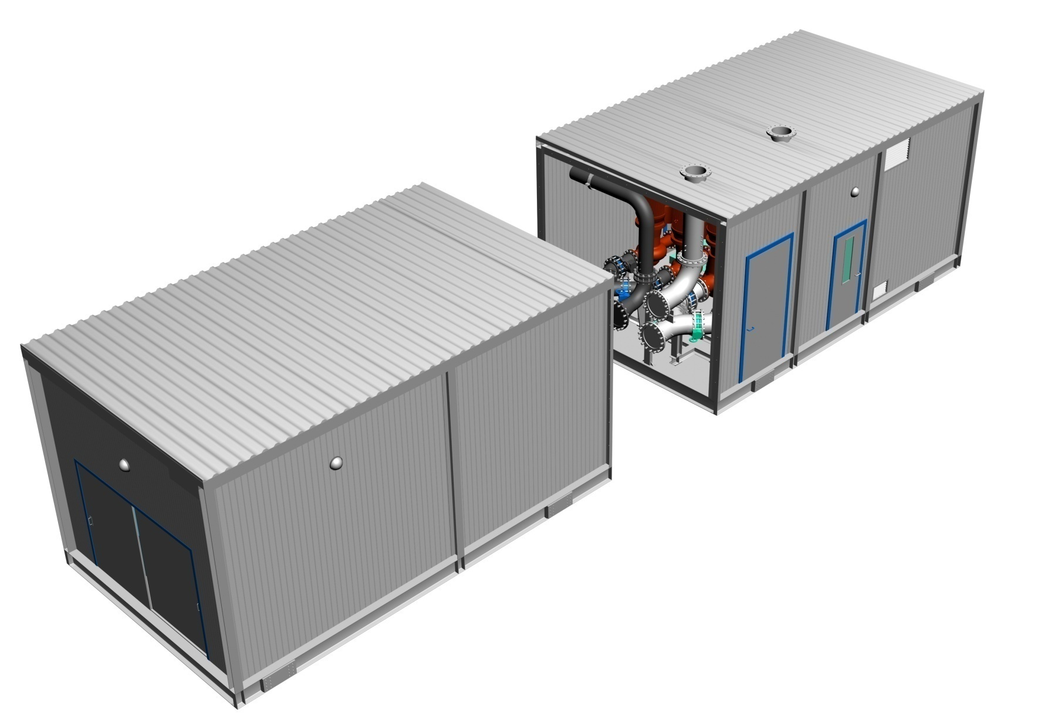
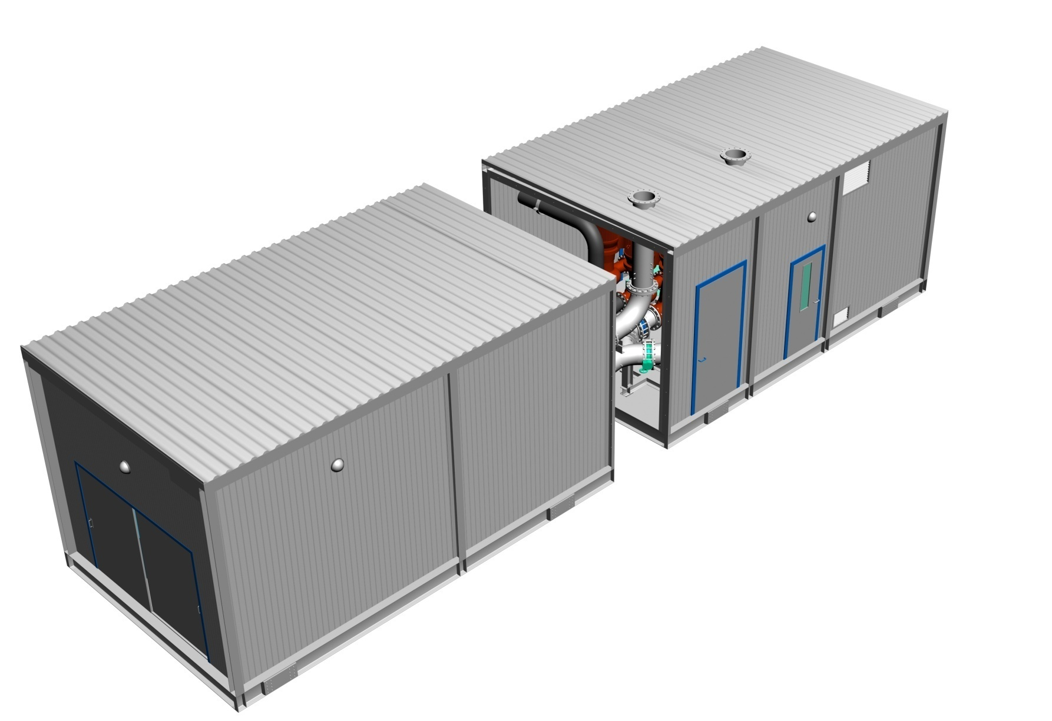
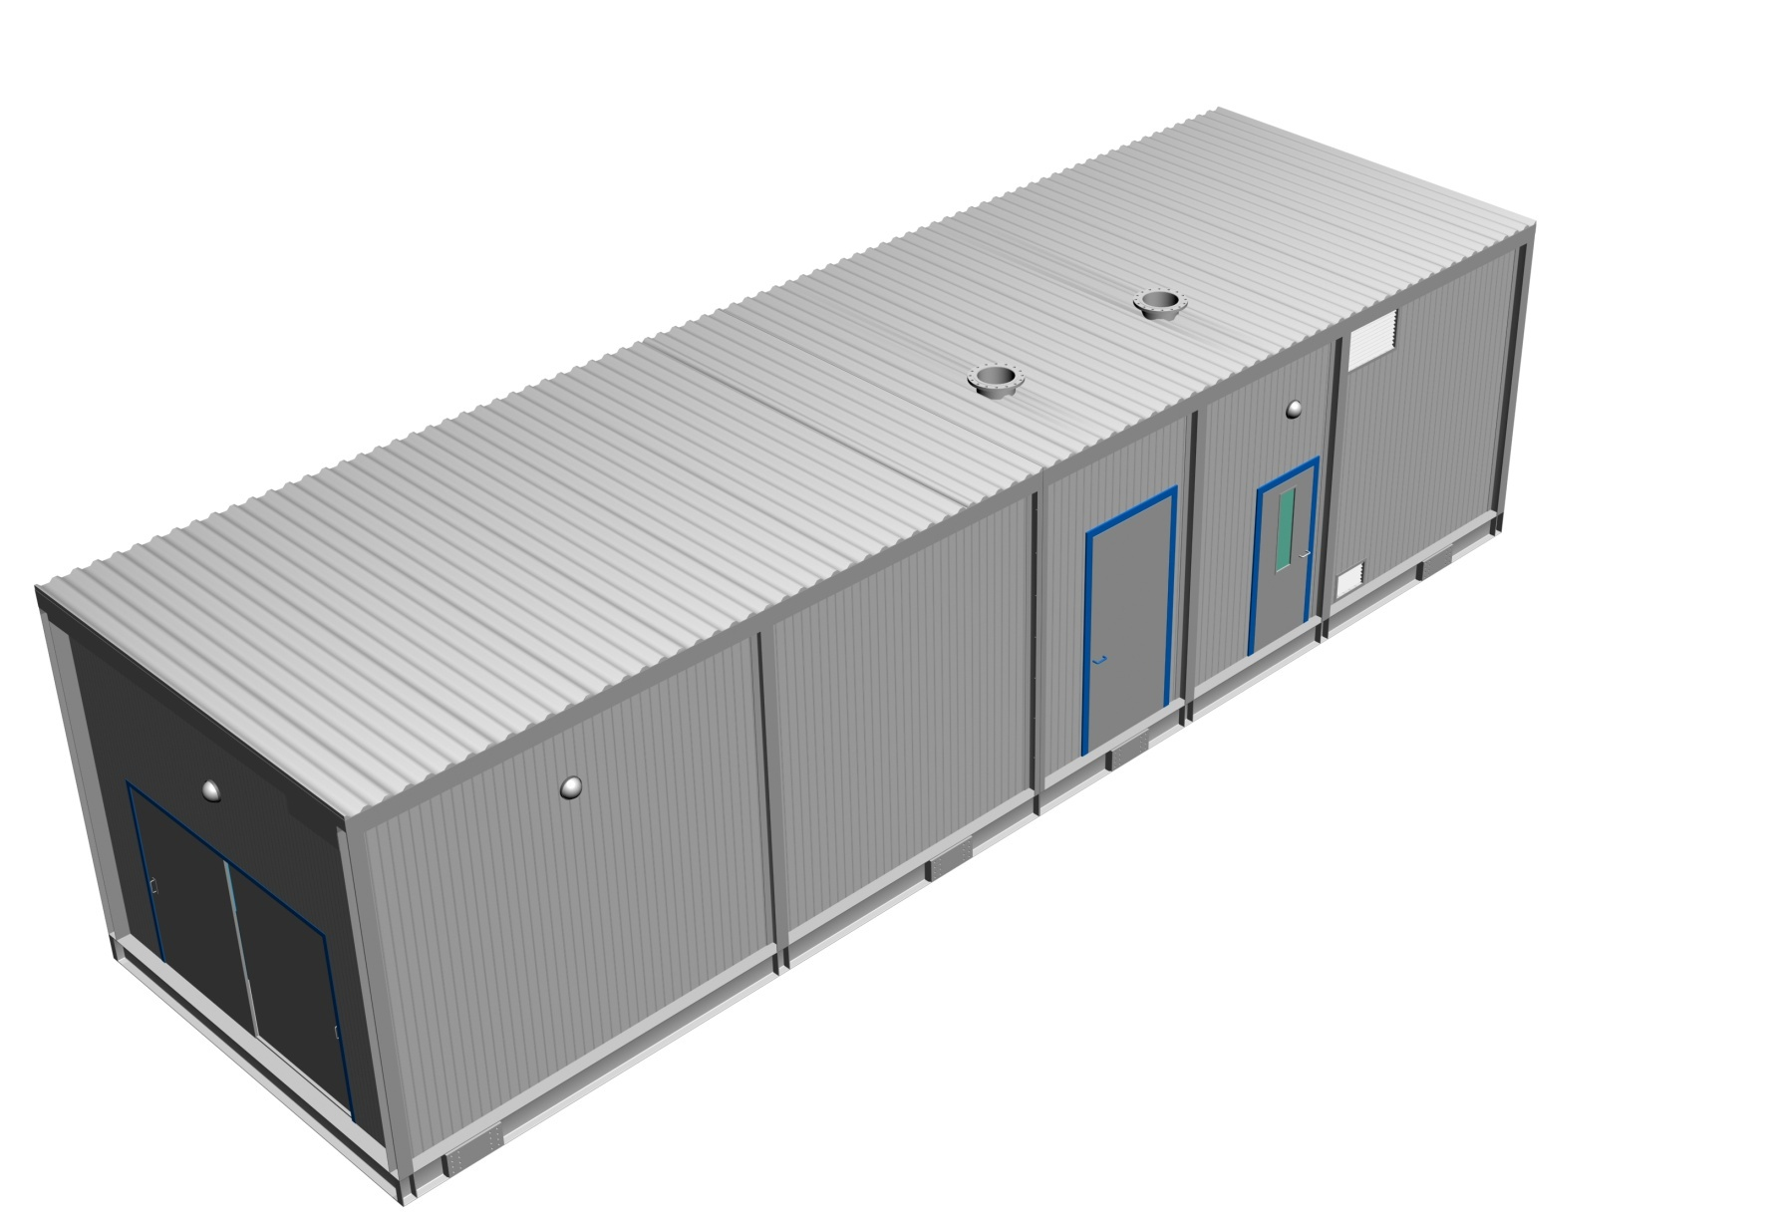
Shipping Split
For module lengths > 12m
Notes:
31

Slide 32
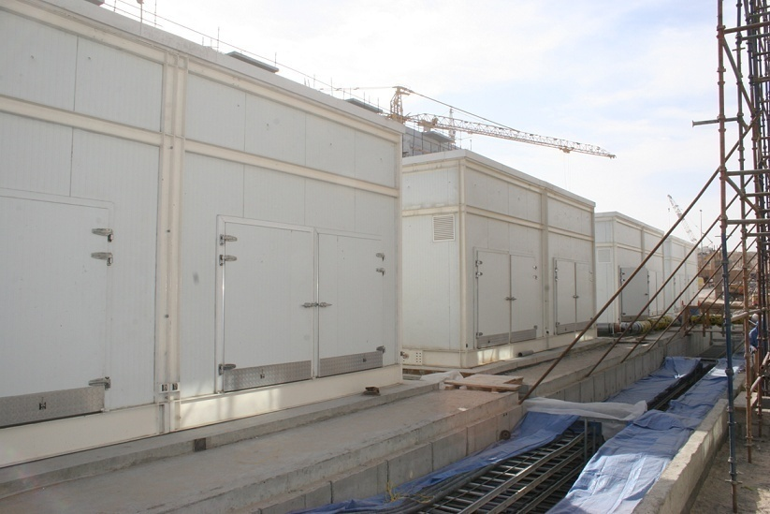
50,000TR Permanent Packaged Plant
Notes:
Each of the plants shown above are 5,000TR.
Total plant when finished will be 50,000TR
All that is required is a concrete base. All tie-ins, mechanical and electrical on this modular design are on one end.
The module comes in three sections

Slide 33
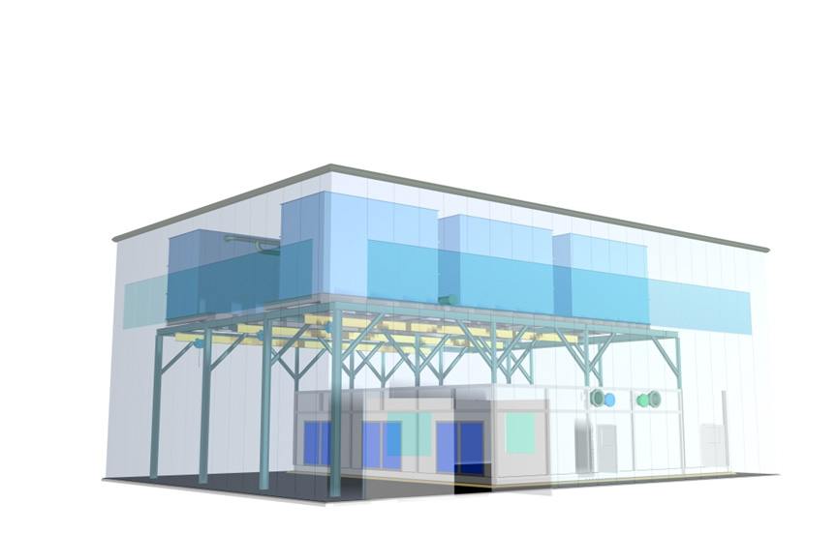
Assembly Graphic
Solutions for Multiple Chiller Systems…

Slide 34
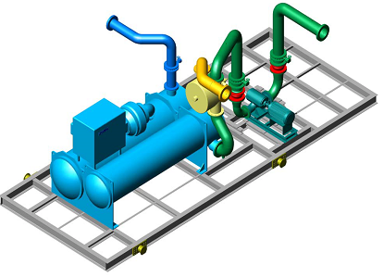
Maintenance Enhancements (available options)
Marine Water Boxes at pipe connection ends
Sliding Water Box Access Doors
Automatic Condenser Tube Cleaning System
Condenser Water Side-stream Filtration
Lifting Gantries

Slide 35
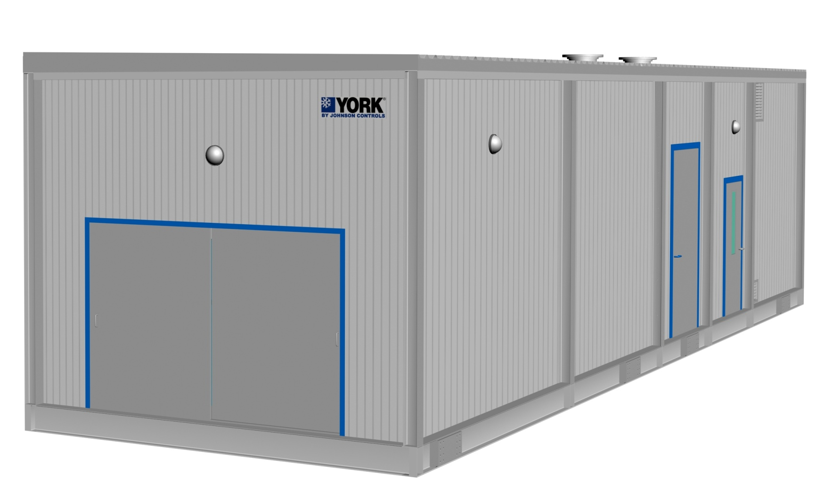
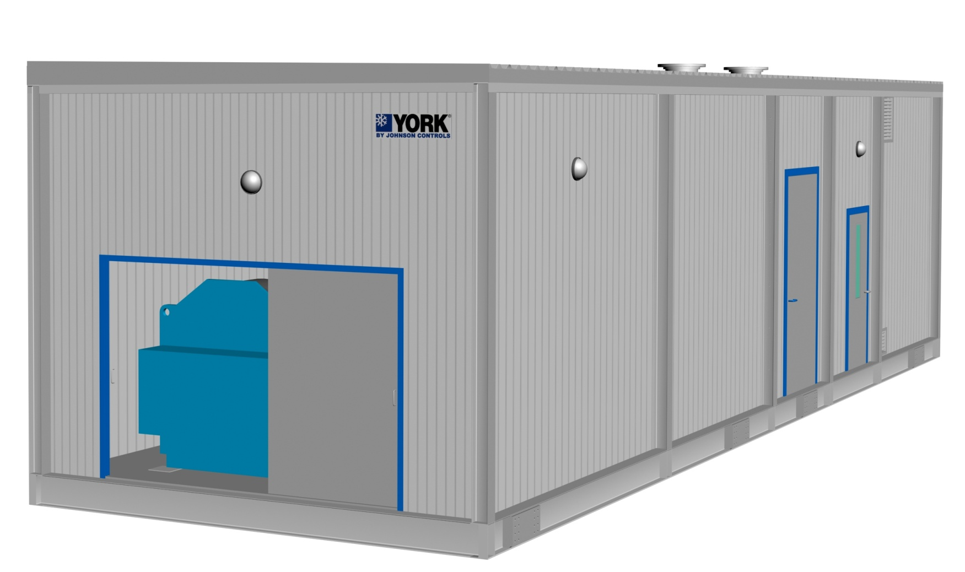
Maintenance Enhancements : Chiller Tube Service Access
Notes:
35

Slide 36
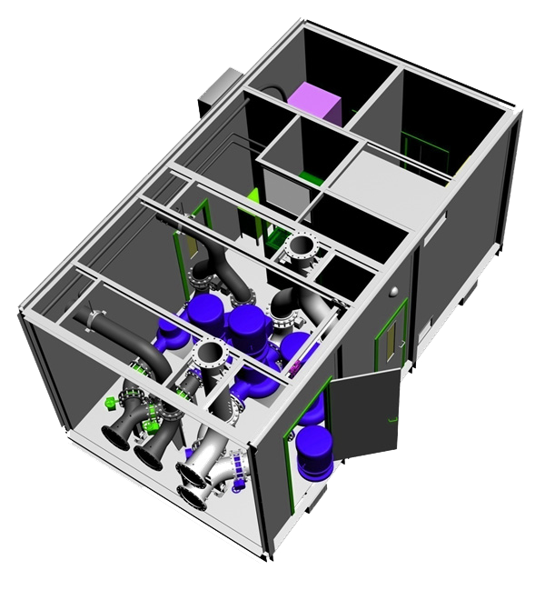
Overhead Gantry and Chain Pulley Block
Maintenance Enhancements : Pump removal Design
Notes:
36

Slide 37
What we normally do NOT offer !!
All civil works including foundation, cable trenches, water tanks etc.
Raised platform/structure for Cooling Tower Skid in case it is not placed above the Chiller Module.
Medium voltage power connection including termination to incomer section of chiller starter panel
Low voltage power connection including termination to incomer section of packaged plant LVMCC panel
All electrical power & control cabling external to the plant incl. main incoming power cables
Grounding arrangement including earth strip & earth pit.

Slide 38
What we normally do NOT offer !!
All pipe work external to the plant
Makeup, drain and overflow connections to cooling towers
Flushing & chemical cleaning of pipe work
Dosing chemicals for condenser & chilled water treatment
System water charging (condenser & chilled water)
Chilled water Air Separators, Expansion tank & Dosing Pot
Cooling Tower Make-up arrangement including tank, pumps etc
Local Authority coordination and approvals
Temporary power & water for site related work

Slide 39
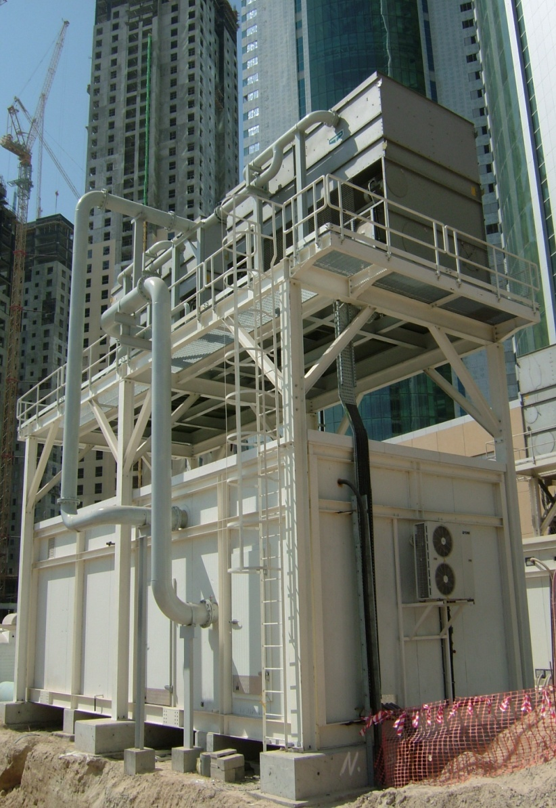
Case Study : Empower - Mobile Cooling for DC Provider
Type of Plant : Temporary Plant
Capacity : 81,000TR (across 6 orders)
Description : Single chiller modules
2500TR (YDJ2) x 11 #
1220TR (YKJ2) x 5 #
2000TR (YKJ4) x 1 #
2500TR (YKJ7) x 8 #
2500TR (YKK7) x 10 #
Key Selling Factors:
Shorter lead times
Reliable after sales support
Flexible design – customization
Local manufacture

Slide 40
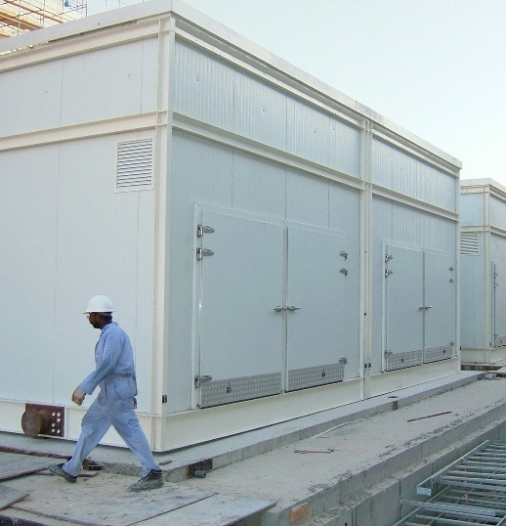
Case Study : Dubai Festival City - Large Mixed Use Development
Type of Plant : Permanent Plant
Capacity : 50,000TR (phased dely)
Description :
10 # x 5000TR chiller modules
2500TR (YDJ2) x 2# series-counterflow
Primary - Secondary system
Cooling tower, Secondary Pumps & MV by client
Migrating from potable make-up to TSE
Key Selling Factors:
Shorter lead time
Good relationship with consultant
Phased delivery to match construction schedule

Slide 41
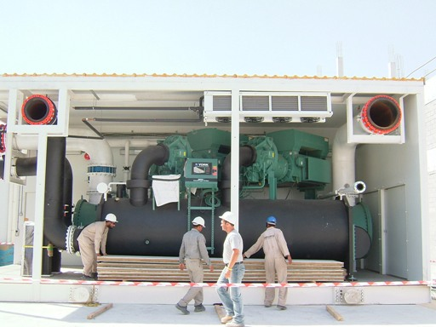
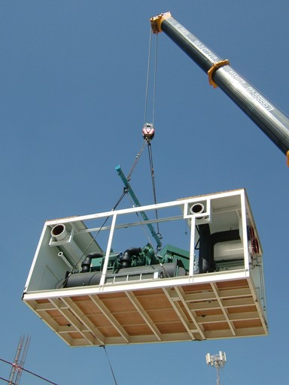
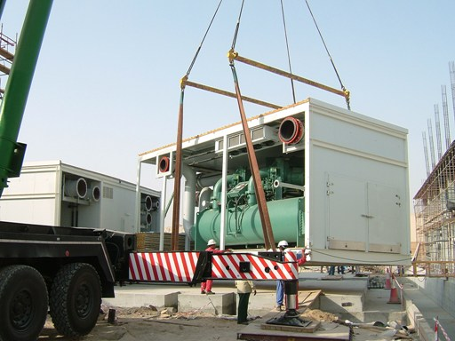
Case Study : Dubai Festival City - Large Mixed Use Development

Slide 42
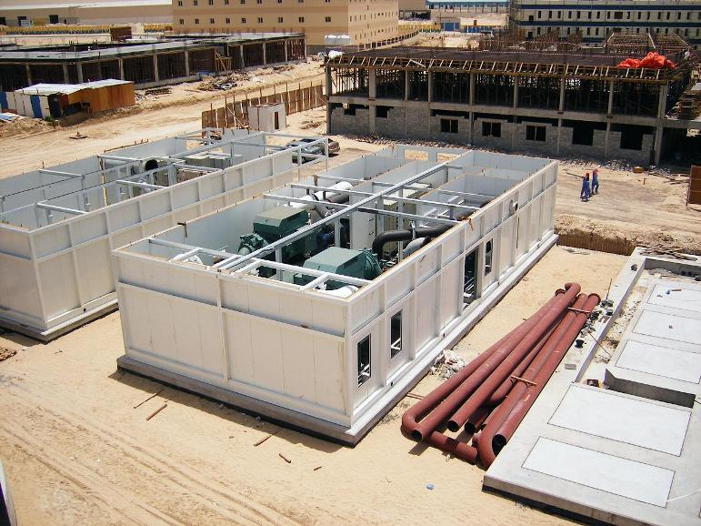
Case Study : Dubai Investment Park - Industrial Park & Labour Accommodation
Type of Plant : Permanent Plant
Capacity : 12,000TR
Description :
3# x 4000TR chiller modules
1# Secondary Pumping Module
2000TR (YKJ4) x 2# series-counterflow
Primary - Secondary system
Cooling towers, TES, MV, ETS & Plant Management System by JCI
Key Selling Factors:
Locally available engineering setup
Good relationship with consultant
Phased delivery to match construction schedule
O & M capability

Slide 43
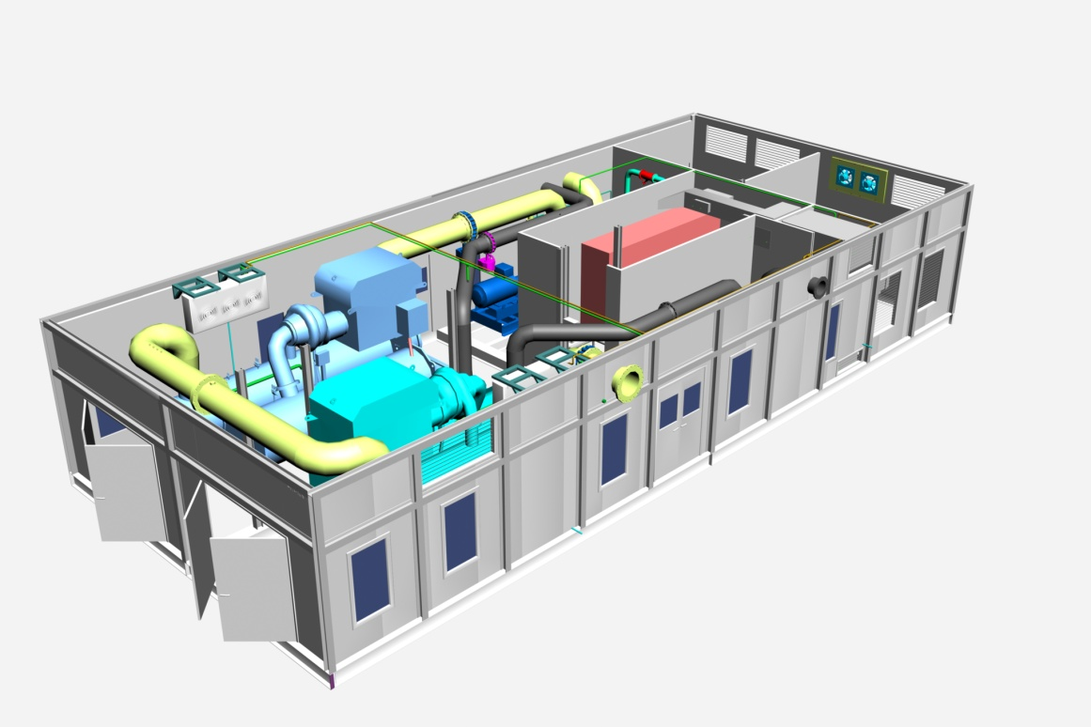
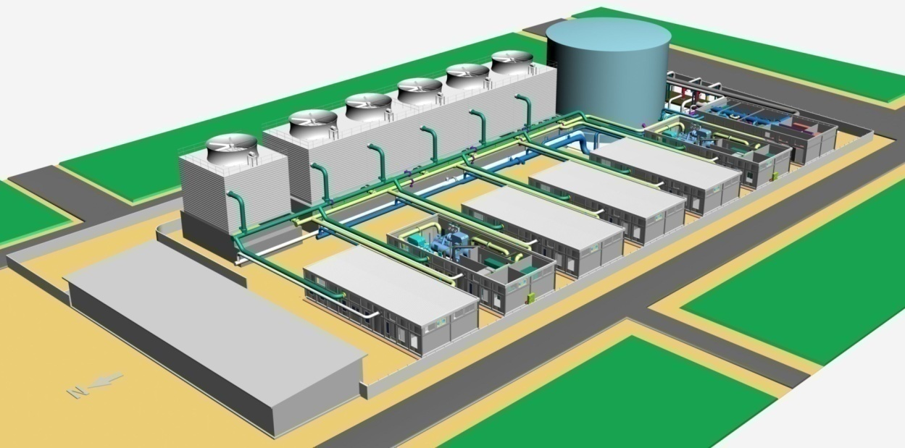
Case Study : Dubai Investment Park - Industrial Park & Labour Accommodation

Slide 44
Case Study : Dubai Investment Park - Industrial Park & Labour Accommodation
EXTERNAL VIEW
10 m
4.3 m
SITE LAYOUT
22 m

Slide 45
Case Study : Al Naboodah - Villas & Office Complex
Type of Plant : Permanent Plant
Capacity : 1200TR + 400TR (extn)
Description :
1# chiller module / 3# x 400TR (YSS4)
(Extn) 1# chiller module with 1 # chiller
Cooling tower skids
Variable Primary Flow (VPF) system
Key Selling Factors:
Worked closely with owner
Excellent sales & engineering support to client / consultant / contractor
Spin-offs
Air-side order
5 years O & M contract

Slide 46
Case Study : Dubai World Trade Centre - Sheikh Saeed Exhibition Hall
Type of Plant : “Long Term Temporary” Plant
Capacity : 4000TR
Description :
2500TR (YKJ7) & 1500TR (YKK3)
Cooling tower skids
Primary-Secondary System
Secondary Pumping by others
Project management, 11kV Power Module, Make-up water Tank / Pump & Expansion Tank by JCI
Key Selling Factors:
Very short lead time
Sales working closely with Owner
Local engineering & manufacturing set-up
Excellent after sales capability
In-house project management capability
Fantastic teamwork

Slide 47
Case Study : Dubai World Trade Centre - Sheikh Saeed Exhibition Hall (factory)

Slide 48
Case Study : Dubai World Trade Centre - Sheikh Saeed Exhibition Hall (delivery)

Slide 49
Case Study : ARAMCO, Saudi Arabia - North Park Office Complex
Type of Plant : “Long Term Temporary” Plant
Capacity : 4000TR
Description :
1# x 4000TR chiller module
2000TR (YKJ4) x 2# in parallel
Field erected Cooling towers
Primary-Secondary System
Secondary Pumping by others
Raw Water for cooling tower Make-up
Key Selling Factors:
Ability to engineer & customize in compliance with ARAMCO standards
Good existing references with ARAMCO
Middle East based engineering & manufacturing set-up
Local Saudi organization for sales, project execution & service

Slide 50
Case Study : ARAMCO, Saudi Arabia - North Park Office Complex (off-loading & site assembly)

Slide 51
Case Study : ARAMCO, Saudi Arabia - North Park Office Complex (off-loading & site assembly)

Slide 52
Case Study : Tabreed - UAE Armed Forces Camp at Malaiha, Sharjah
Type of Plant : Permanent Plant
Capacity : 2 # x 5000TR (different sites)
Description :
2# x 5000TR Chiller Modules
Cooling tower skids
Variable Primary Flow (VPF) System
Turn-key order with Project management, 11kV/3.3kV Power Module, Make-up water Tank / Pump & Expansion Tank by JCI
Key Selling Factors:
Very short completion time
Local engineering & manufacturing set-up
Excellent track record with past Tabreed orders
In-house project management capability
Fantastic teamwork

Slide 53
Modular packaged Chilling Systems - Solutions to Suit Every Application
Apartment units
Lodging
Schools
Colleges & Universities
Hospitals
High Technology
Homes
Retail
Shopping Malls
Government
Life Sciences
Airports
High-rise Apartments
Medical Clinics
Small Commercial
Large Commercial
Arenas/Convention Centers
Residential Mid Market Complex

Slide 54
OTHERS !!!!!! Middle East Project List (Sep 2012)
# | Year | Project / Client | Application | Type of Plant | Country | Qty | Total Tons | Voltage
1 | 2005 | Empower-1 | District Cooling | Mobile Temporary Plant | UAE | 7 | 12,300 | 3300 / 400
2 | 2005 | Tabreed | District Cooling | Mobile Temporary Plant | Bahrain | 2 | 2,400 | 400
3 | 2005 | Dubai Festival City | District Cooling | Permanent Plant | UAE | 10 | 50,000 | 11000 / 400
4 | 2006 | Dubai Investment Park | District Cooling | Permanent Plant + ETS | UAE | 3 | 12,000 | 11000 / 400
5 | 2006 | Deira City Centre | Shopping Mall | Replacement Permanent Plant | UAE | 2 | 2,600 | 11000 / 400
6 | 2007 | Dubai World Trade Centre | Residential Bldgs | Mobile Temporary Plant | UAE | 2 | 2,400 | 11000 / 400
7 | 2007 | Empower-2 | District Cooling | Mobile Temporary Plant | UAE | 8 | 20,000 | 11000 / 400
8 | 2007 | Emicool | District Cooling | Mobile Temporary Plant | UAE | 4 | 4,800 | 11000 / 400
9 | 2008 | Al Naboodah | Villa Complex | Permanent Plant (Screw Chlrs) | UAE | 1 | 1,200 | 400
10 | 2008 | Empower-3 | District Cooling | Mobile Temporary Plant | UAE | 9 | 22,000 | 3300 / 400
11 | 2008 | Empower-4 | District Cooling | Mobile Temporary Plant | UAE | 1 | 2,000 | 3300 / 400
12 | 2008 | Al Naboodah Extension | Office Bldg | Permanent Plant (Screw Chlr) | UAE | 1 | 400 | 400
13 | 2009 | Dubai World Trade Centre | Exhibition Hall | Long Term Temporary Plant | UAE | 2 | 4,000 | 11000 / 400
14 | 2009 | Saudi ARAMCO | Office Bldg | Permanent Plant | Saudi | 1 | 4,000 | 4160 / 460
15 | 2010 | Al Rayyana / Sorouh | Residential Bldgs | Permanent Plant | UAE | 1 | 7,200 | 11000 / 400
16 | 2011 | Malaiha Camp / Tabreed | Military Camp | Permanent Plant | UAE | 2 | 10,000 | 11/3.3kV/400
17 | 2011 | Capitala Rihan Heights | Residential Bldgs | Permanent Plant | UAE | 1 | 4,000 | 11000 / 400
18 | 2011 | Sh. Zayed University | University Campus | Permanent Plant | UAE | 2 | 9,450 | 11000 / 400
19 | 2011 | GASCO (OilCo) | Indl. Refrigeration | Replacement Permanent Plant | UAE | 1 | 1,300 | 3300 / 400
20 | 2012 | Empower-5 | District Cooling | Mobile Temporary Plant | UAE | 8 | 20,000 | 11000 / 400
21 | 2012 | Emirates Hangars | Hangar Cooling | Permanent Plant | UAE | 1 | 3,080 | 400
 |  |  |  |  | Total | 69 | 195,130
Regional Medical Center
Muskogee, OK, USA
The Gazette
Montréal, QC, CA
Research and Medical Clinic
Tulsa, OK, USA

Slide 56
Questions & Discussions

