Slide 2
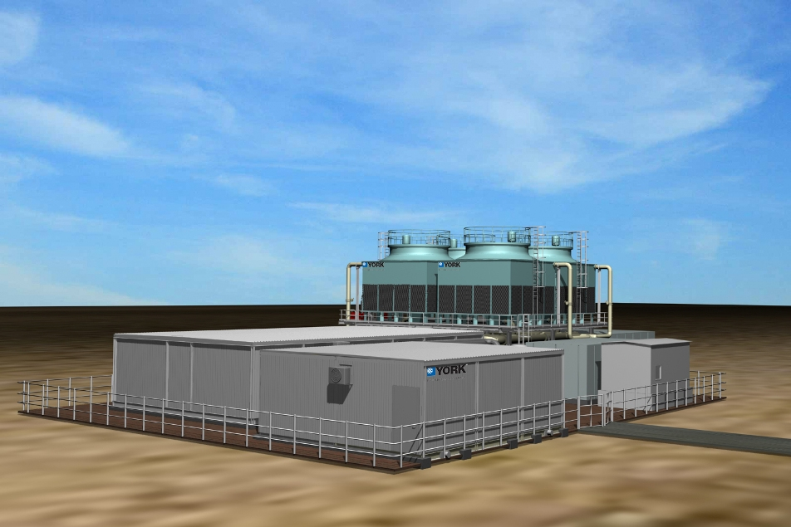
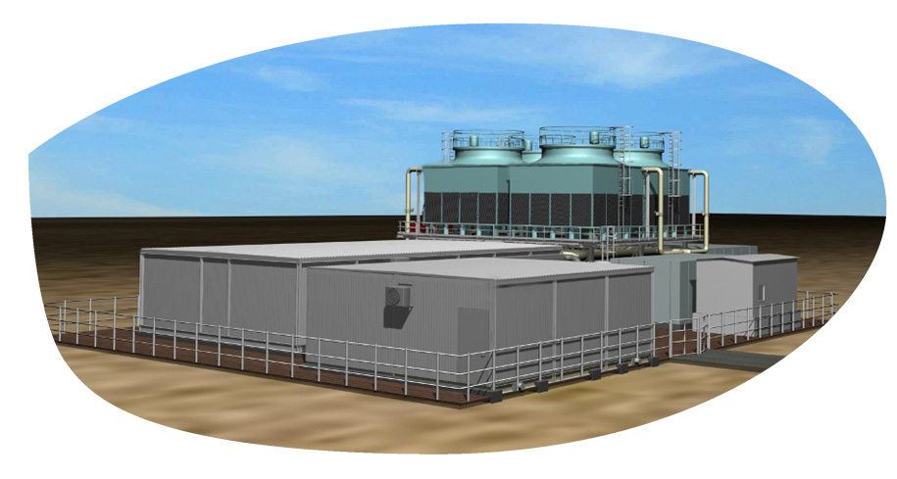
Flo Fab Modular chilling package

Slide 3
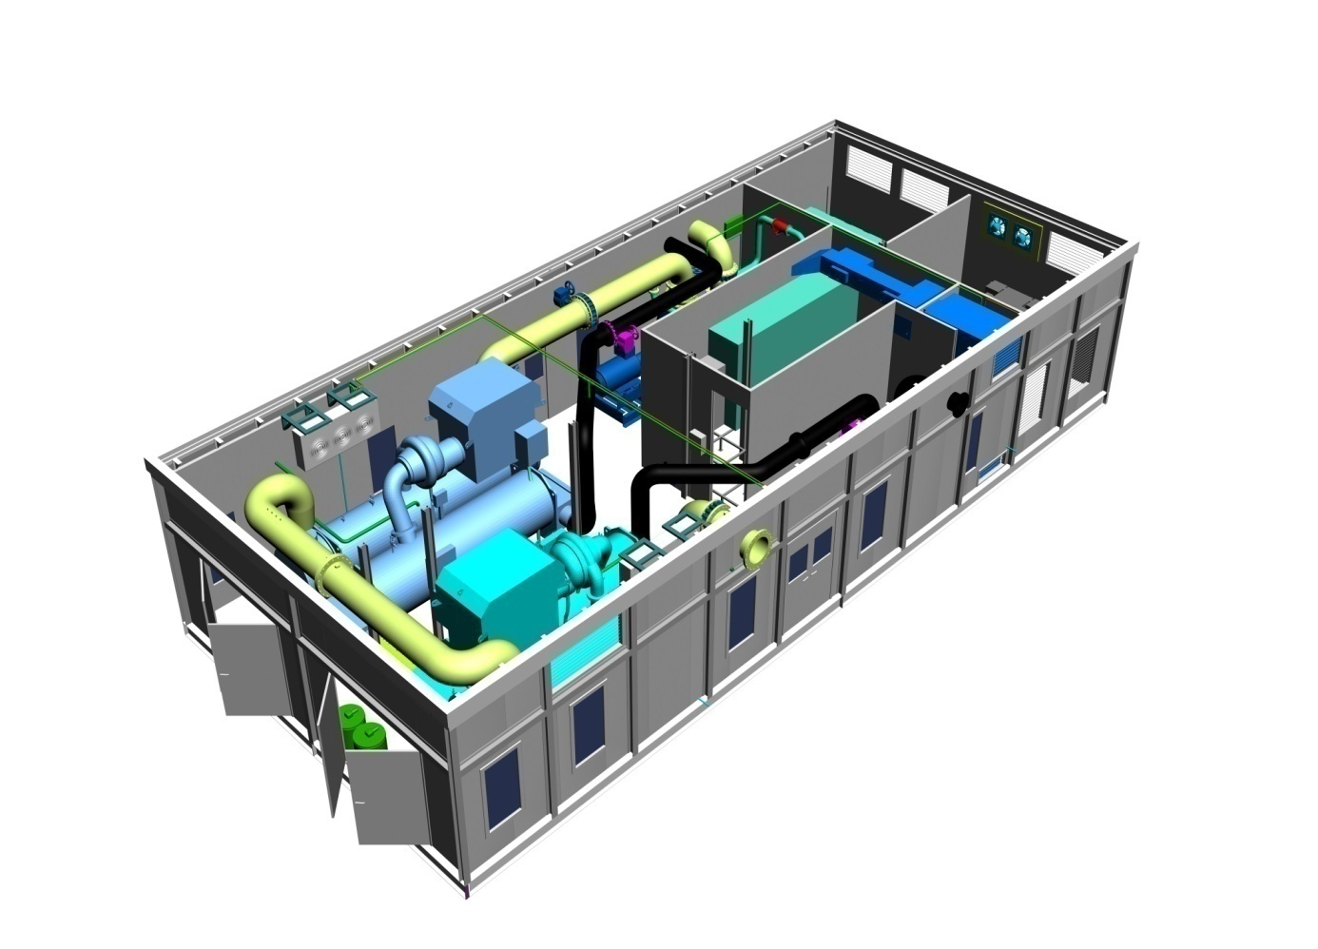
Agenda
What is a Packaged Plant ?
Benefits to Customer
The Flo Fab Advantage
The Manufacturing Facility in Canada
What we DON’T Offer

Slide 4
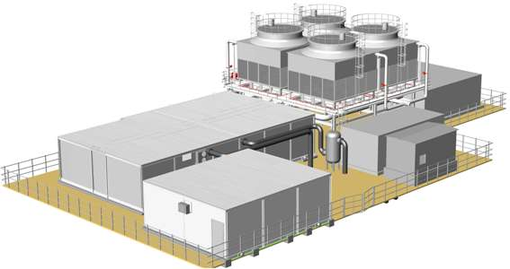
What is a Packaged Plant ?
A ‘packaged’ plant is a pre-designed factory assembled self-contained system shipped in modules for assembly at site.
It contains chillers, cooling towers, instrumentation, controls, pumps, pipework, electrics and all that is necessary for
producing chilled water.
Packaged plants can be
pre-engineered for the
majority of chiller plant applications to
customer specification.

Slide 5
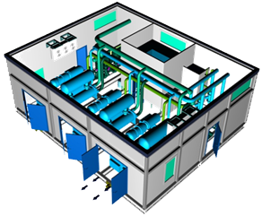
Benefits to Customer
Complete self-contained factory built Chiller Plant inclusive of all components necessary for reliable and efficient operation
Single point of responsibility - design, assembly & commissioning of packaged plant by Flo Fab. Helps avoid coordination issues - improves project management
High system energy efficiency – smaller carbon footprint / "green" performance.
Standard high quality as plant is manufactured in controlled factory environment by a well trained team working to standard work procedures

Slide 6
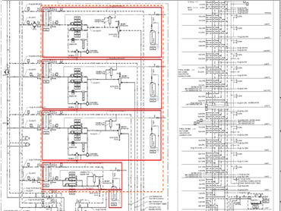
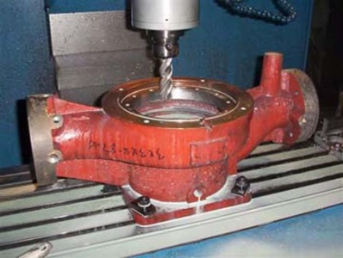
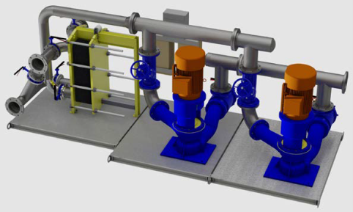
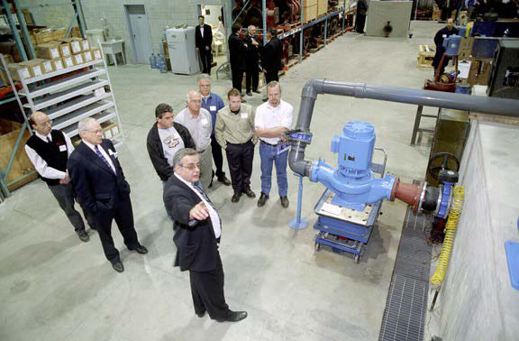
Quotation Requirements for Skid Package
What we need ?
1.1 System PID
1.2 Pumps, Tanks and Heat Exchangers Schedule
1.3 Cut sheets for non Flo Fab parts like
ex. Boilers, Chillers, etc...
1.4 Skids footprint
1.5 Mechanical room footprint
1.6 Details sequence of control
Quality Control
All pumps are factory tested and certified performance
test is available when requested by the consultant.
Test facilities up to 400 HP with 27,000 gallon test
bench with calibrated instruments...
2.1 Heating and Cooling Systems
2.2 Module HC will be composed of two pumps, control panel VFD, expansion tank, air separator, chemical pot Feeder, and glycol fill system (optional), balancing valves, isolation valves, air vents and drain connections, multifunction valves, suction diffusers or Y strainers, interconnecting black steel schedule 40 piping. All package components are mounted on a structural steel base with lifting lugs....

Slide 7
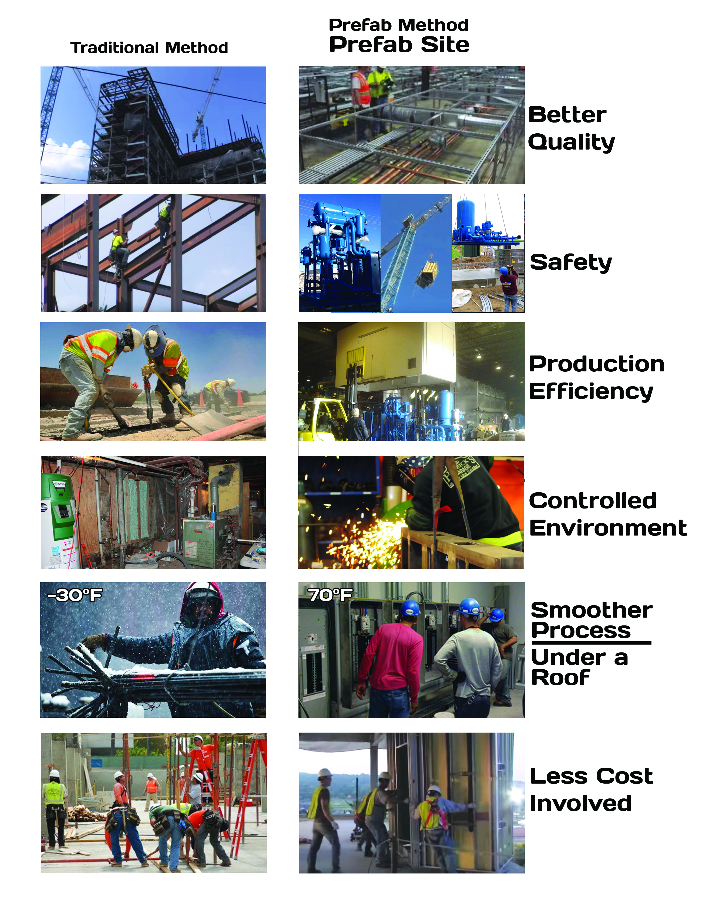

Slide 8
Skid Advantages
- Solution for both : New construction and Retrofit.
- Easily add more modules for future expansion.
- One single point of Responsibility / Contact .
- One single submittal for approval Vs. Individual ^{submittals for each component.}
- Financial : Cost reduction, Effectively reduce total cost of ownership for all project stake holders (Contractor / Consultant Engineer / End User)
- Financial : Space saving due to optimized space utilization.
- Financial : Time (Cost) saving : Skid built in parallel during building construction, also .
^{- Financial : : Cash flow} management: One single invoice / payment for all ^{works}
- Financial :: Overhead saving including project management, logistical
coordination, insurance expense, ...etc.
- Financial : No surplus or extra components left after
^{fabrication by contractor.}
- Time (Cost) saving : No construction delay due to
missing one single component order, wrong delivery
^{or defective component.}
- Quality: Assembly within controlled environment by
certified technicians / welders using approved work
^{methods / procedures.}
- Quality / Financial : Factory wired and tested = site
^{plug & play}
- Safety: Avoid unpleasant site safety incidents and
lost days as we tremendously minimize job site
^{man-hours.}

Slide 9
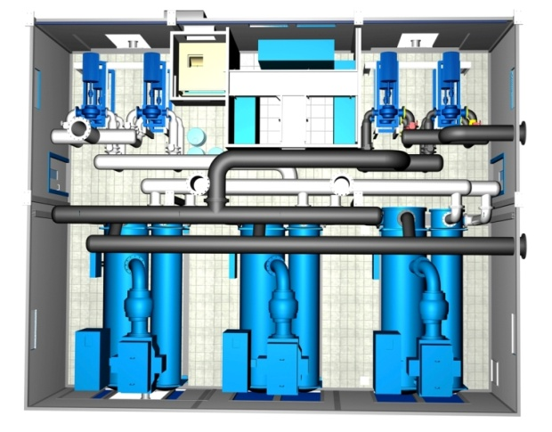
Benefits to Customer
Guaranteed performance - engineered, manufactured & commissioned by same agency
Greater flexibility – affords scalability in case of phased construction
Reduced job site risk & EHS problems due to greatly reduced site work
Significantly smaller space requirement
Reduced construction schedules – improved project management. Manufacture of plant can continue in the factory while site approvals are still underway

Slide 10
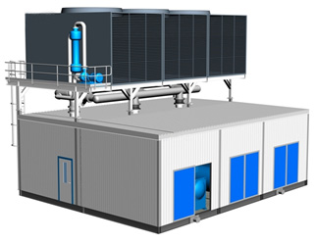
Benefits to Customer
Reduced contingency costs due to lesser site exposure & better project management
Minimum & simple site tie -ins such as chilled water piping connections, cooling tower make-up & drain connections, incoming electric power, earthing etc
Possible to relocate in case of future site development
In short – it is a WINNING PROPOSITION !!!

Slide 11
The Flo Fab Advantage
Company’s Brand Equity
Engineering & Manufacturing Setup in North America
Optimized Equipment and Controls Selection & Design
Different options Centrifugal/Screw /Absorption Chillers
Different options Air handling Units, Cooling Towers, Blower Coils & Split Units (in-house products)
Global Sourcing Agreement with reputed suppliers for other major components
Excellent After Market Service & Spares Setup

Slide 12
– Certification Certified
Notes:
12

Slide 13
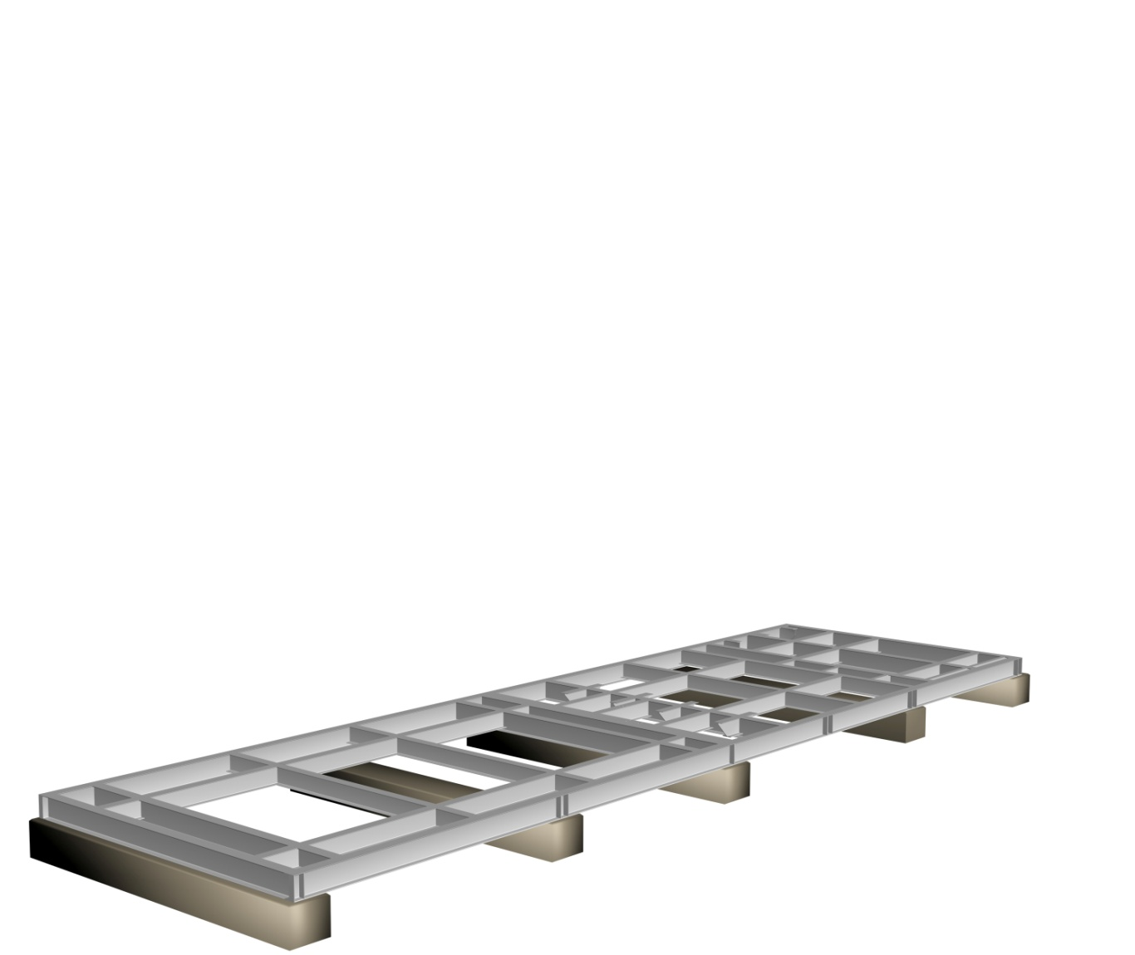
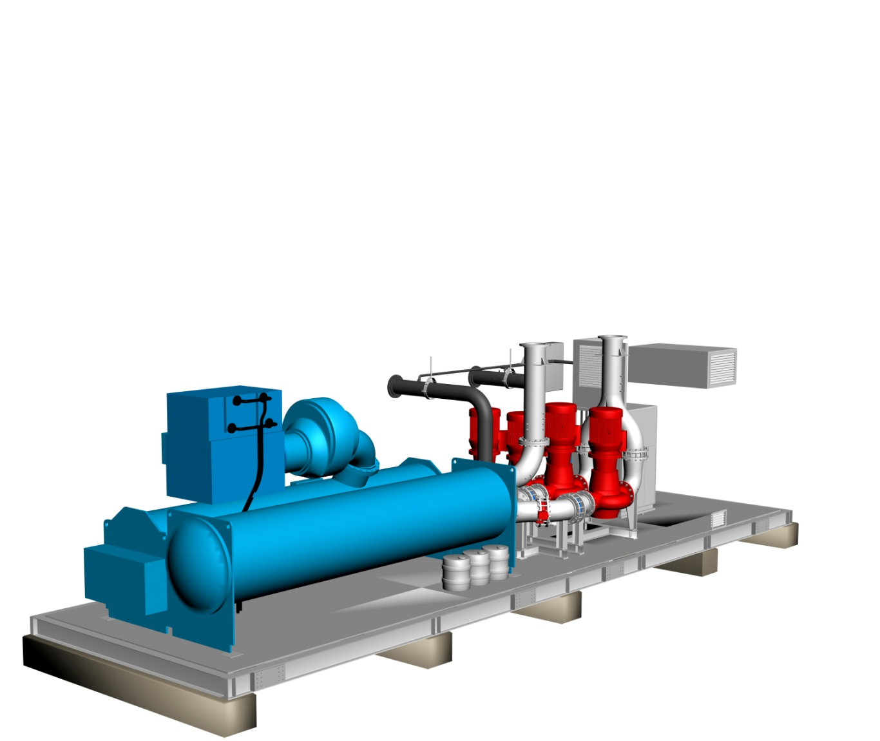
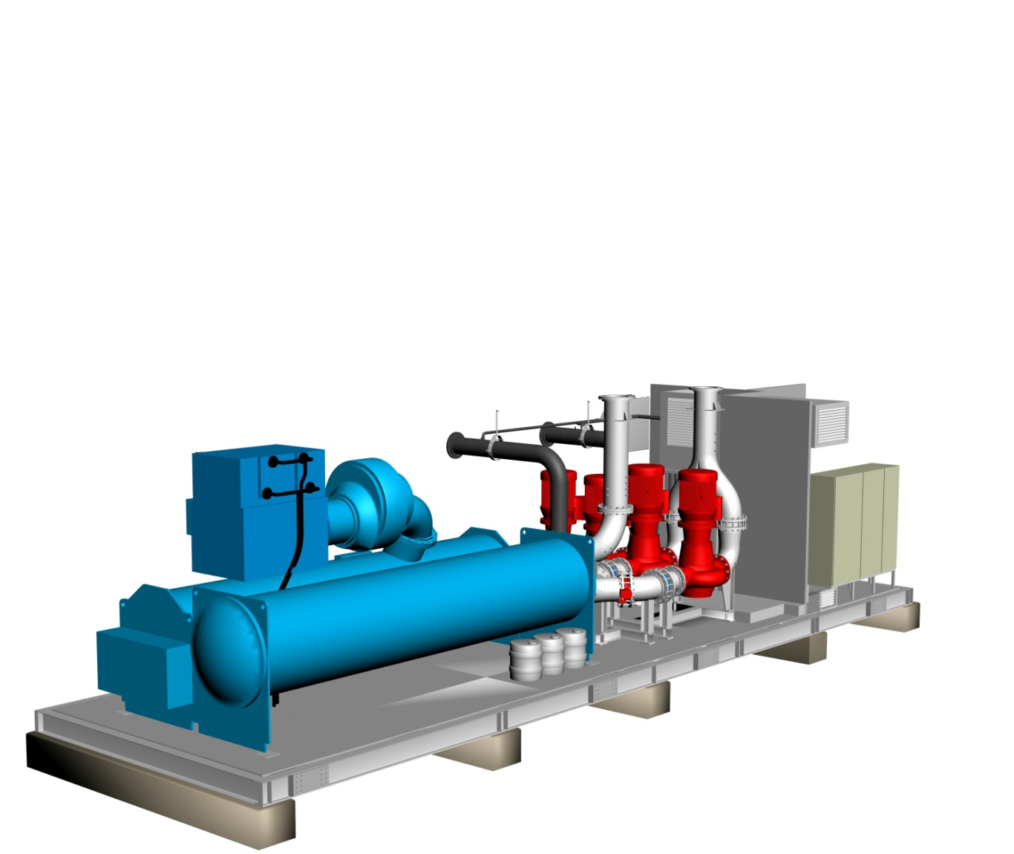
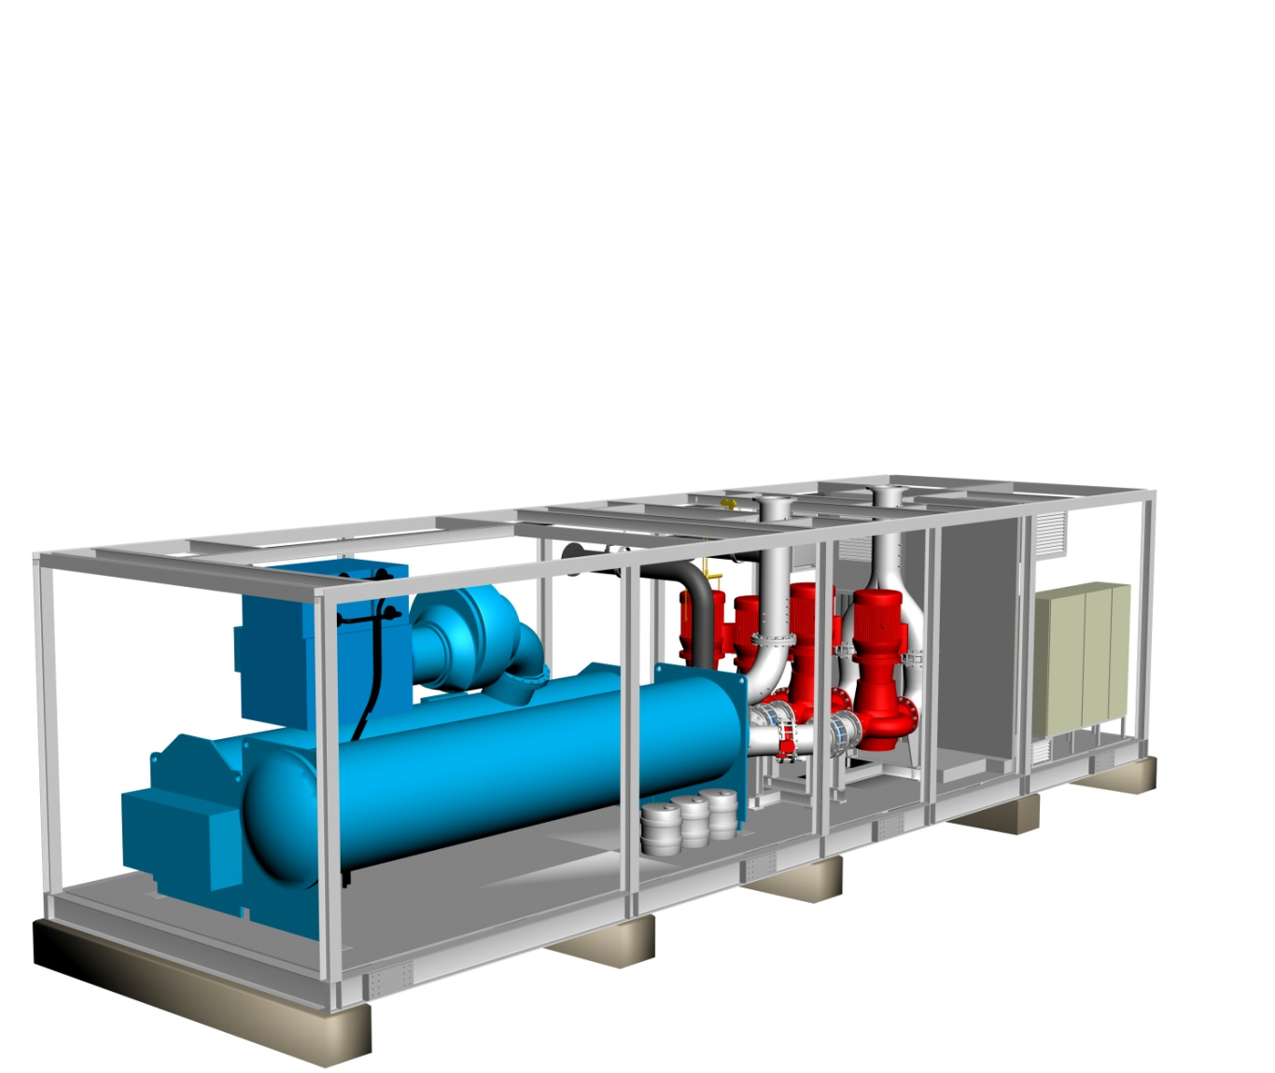
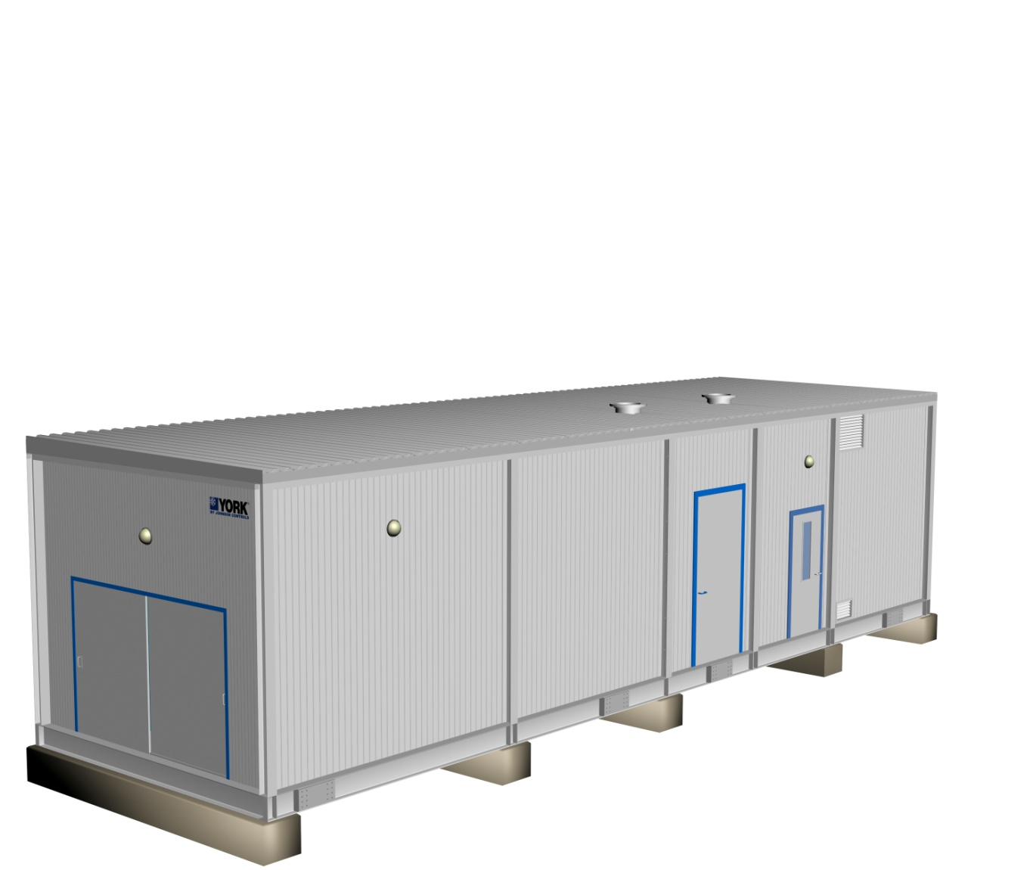
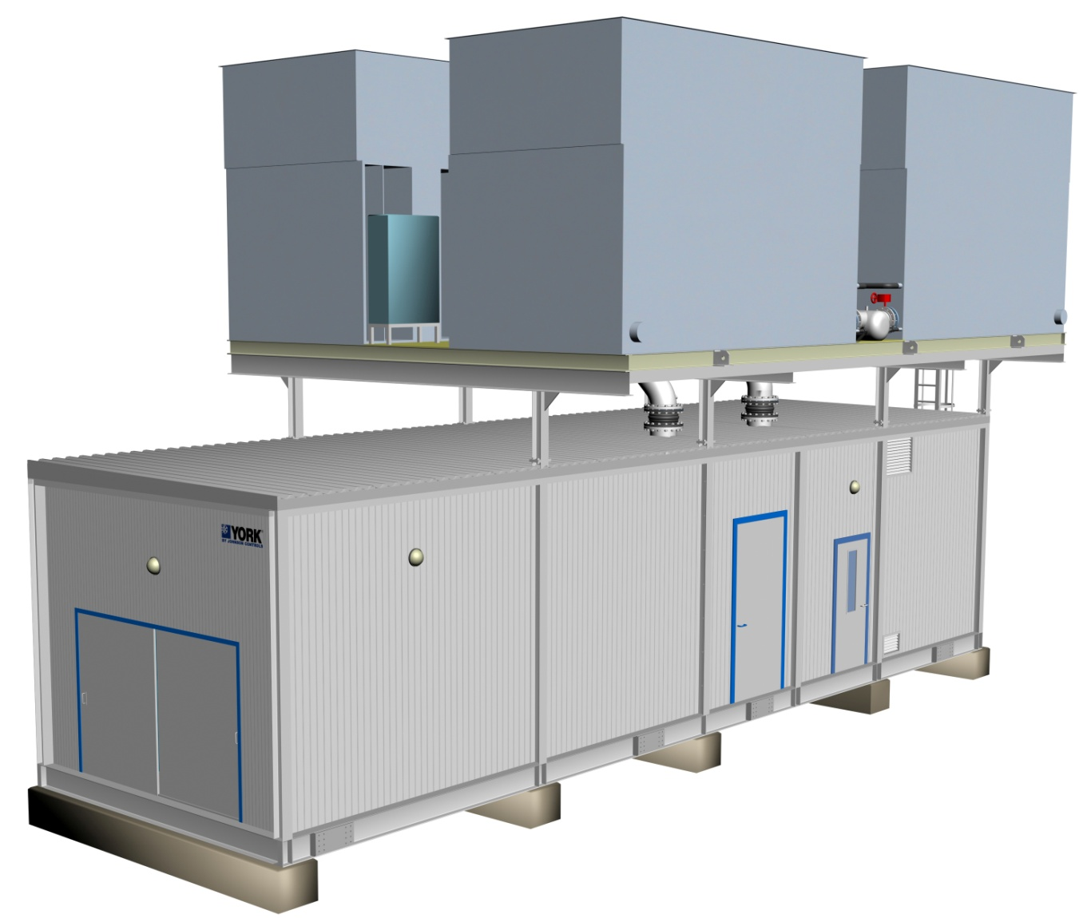
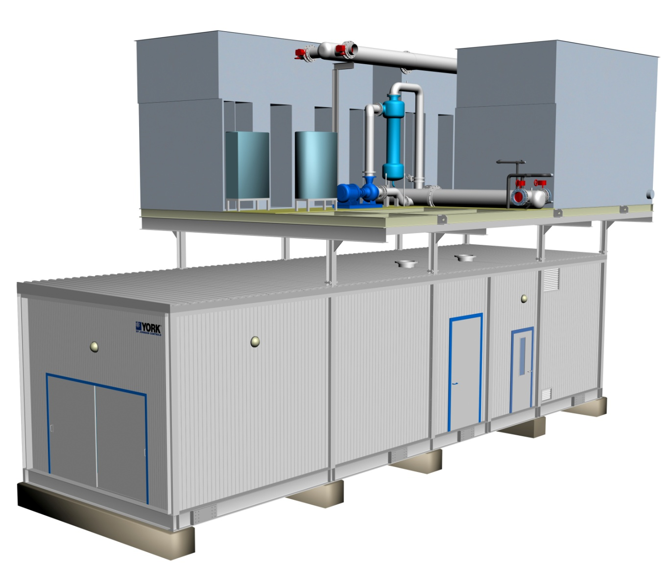
Modularized Packaged Chilling System
Produced within Controlled Environment :
Manufactured, Not Constructed
Proven Engineered Design and Fabrication Standards
Strict Quality Control
Controlled Environment with High Safety Standards
Established Knowledgeable Skilled Workforce
Job Site Progress / Conditions Irrelevant to Production
Notes:
13

Slide 14
Applications
Constant Volume Chilled Water Circuits
Primary-Secondary
Variable Primary
High delta T (9K)
Permanent Plant
Temporary (Portable) Cooling
Long Term Temporary Plant
Turbine Inlet Air-cooling

Slide 15
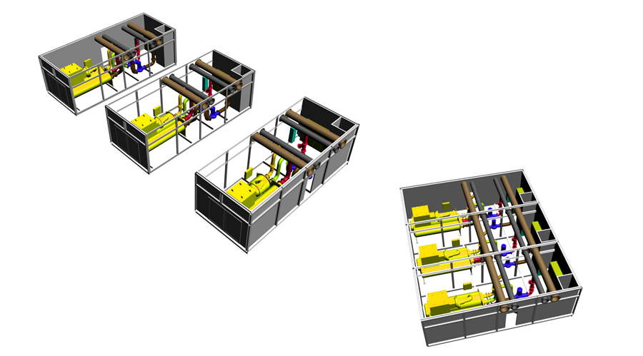
Multiple Chillers

Slide 16
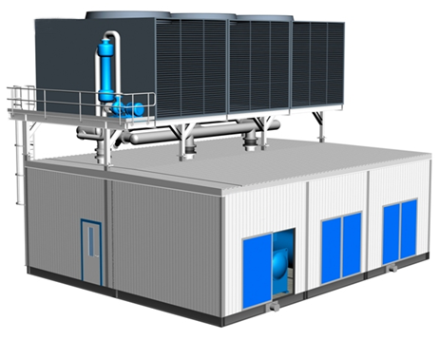
Multiple Chillers

Slide 17
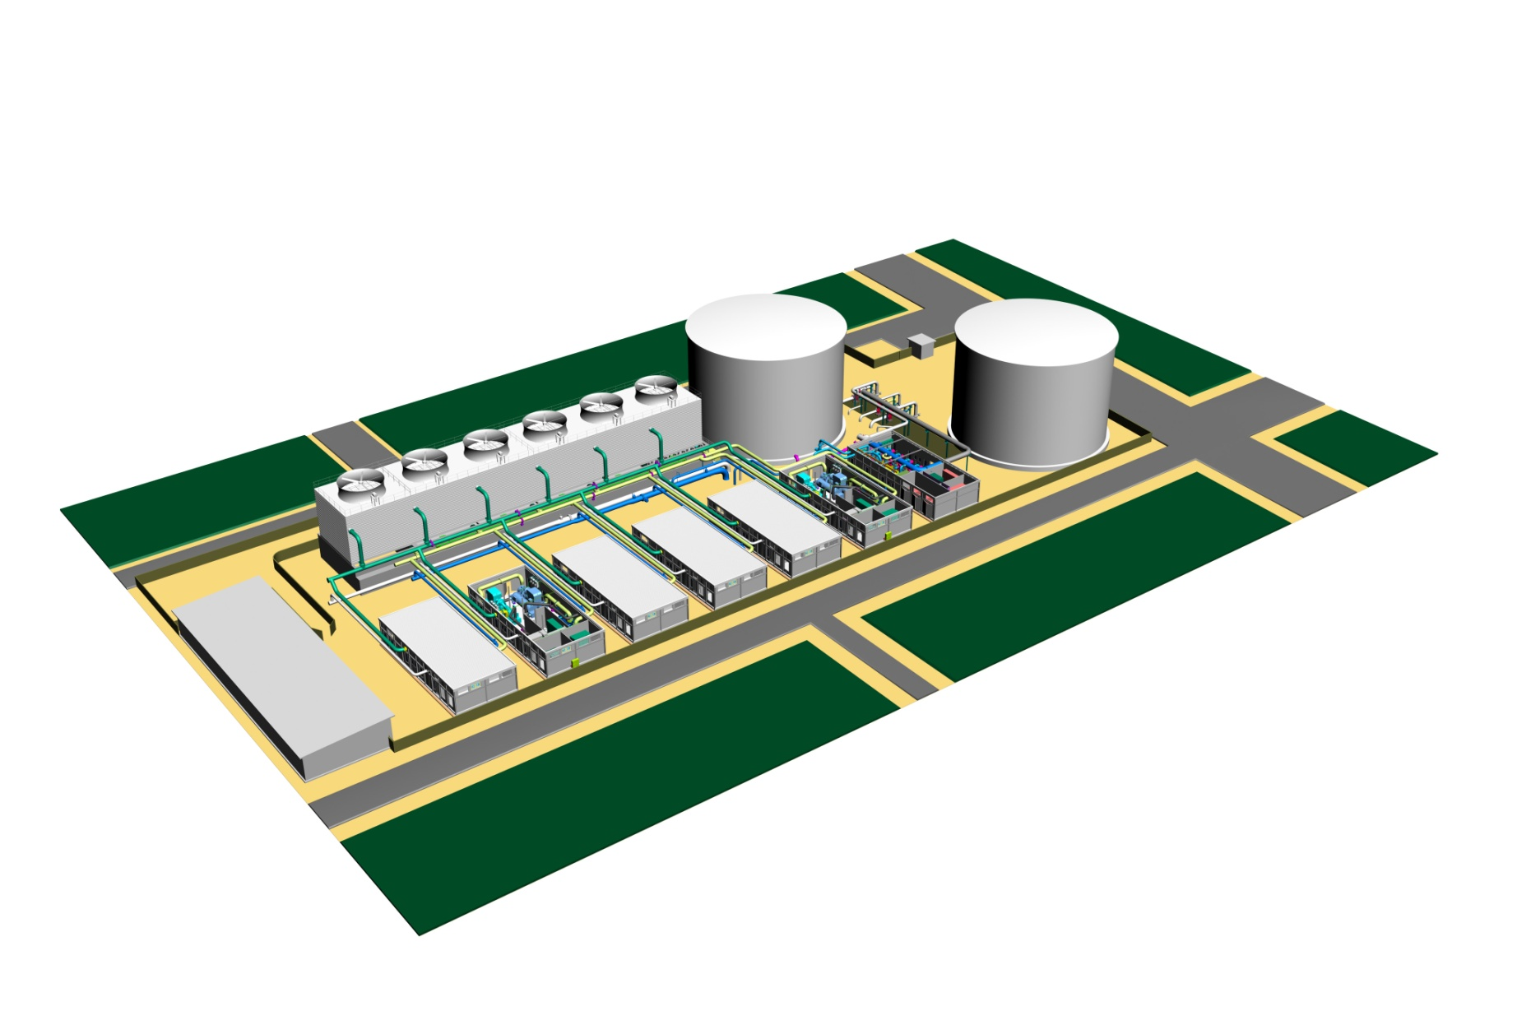
Voltage Options
Voltages:
11kV
6.6kV
3.3kV
400V

Slide 18
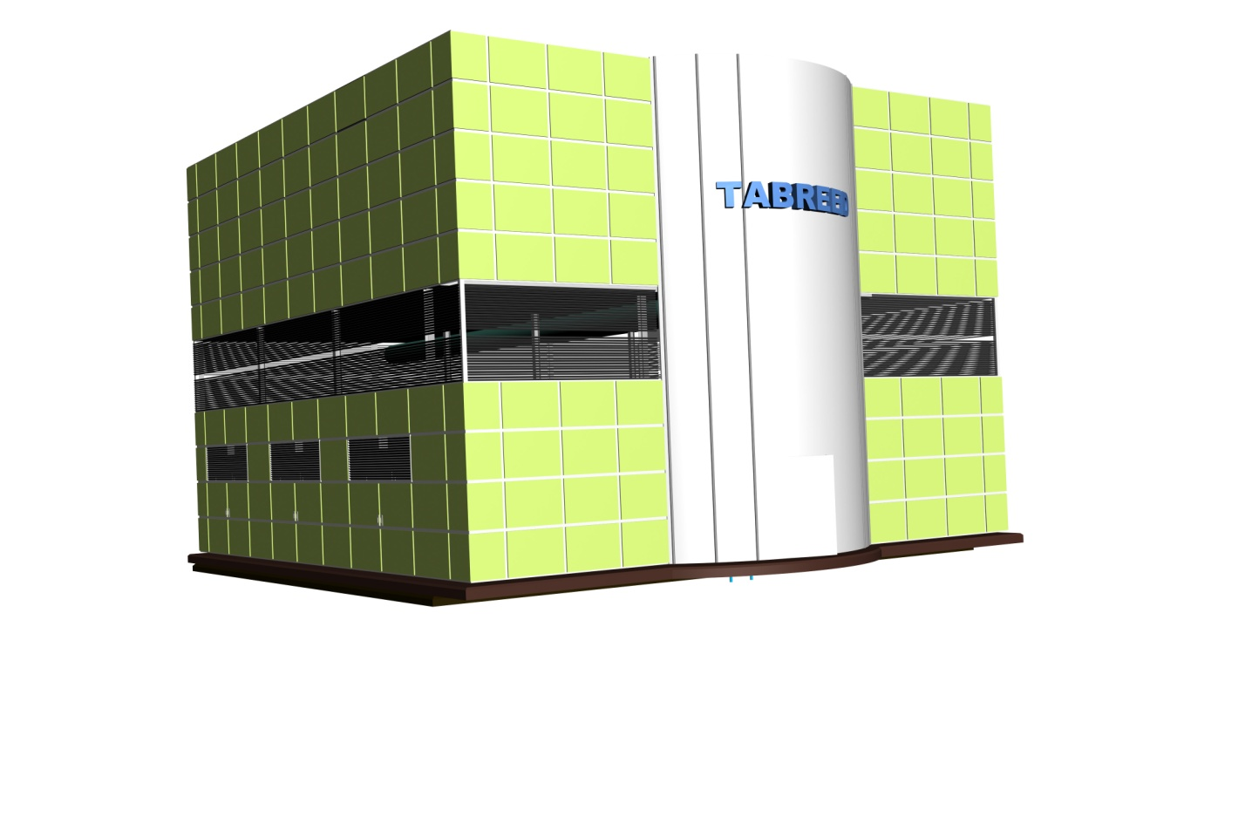
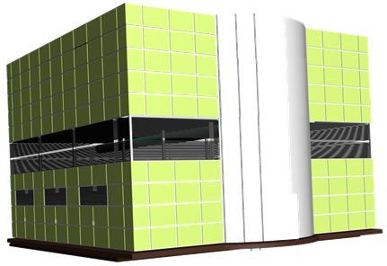
System Solutions
Chilled Water Production & Distribution:
Individual Chiller Plant 600TR to 10,000TR
Modular Systems above 10,000TR
Chiller Options
Screw
Centrifugal
Absorption
Refrigerants
R-134a
R-22
1,000TR – 30,000TR

Slide 19
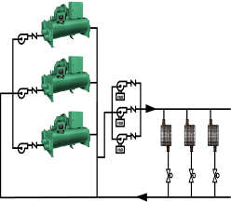
Primary–Secondary System
Tried & tested
Ensures safe chiller operation
Higher first cost
Good system efficiency
Larger plant room footprint
Pri Pumps
(const speed)
Secondary Pumps with VSD
Typical load with 2 way valve
De-coupler / Bypass
CHILLED WATER PRODUCTION (PRIMARY)
CHILLED WATER DISTRIBUTION (SECONDARY)

Slide 20
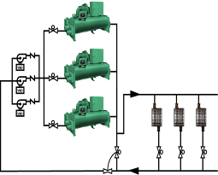
Variable Primary Chilled Water Flow
Modern Chillers are safe at varying flow thanks to latest controls
Lower capital
Best system efficiency
Lower overall footprint
Automatic Isolation Valve
Pri Pumps with VSD
Typical load with 2 way valve
Bypass Valve
Flow Meter

Slide 21
Types of Packaged Plants
Temporary Cooling Plant
Solidly Constructed rigid, riggable, reusable plant
Variable Primary or Constant Volume Comes complete with Cooling Tower Skid
Single Chiller in one module
Screw and Centrifugal Chillers
Primary design consideration is portability

Slide 22
Types of Packaged Plants - Temporary Cooling Plants
A big seller to District Cooling Companies
DC plants are hardly ever ready on time.
Allows them to meet their commitments
.. And bill for it
Moved from project to project
No secondary pumps needed
A beast of burden!
1,220 TR

Slide 23
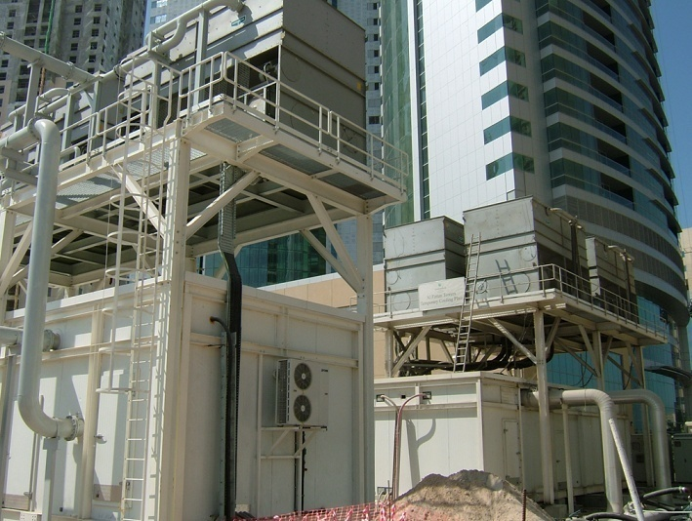
Types of Packaged Plants - Temporary Cooling Plants
Notes:
YORK MAKES TEMPORARY, LOW FOOT PRINT, HIGH CAPACITY CHILLER PLANT. RUGGEDLY MADE, THE PLANT SHOWN HERE PROVIDES 2,500TR ON A 5 x 15M BASE WITH MEDIUM VOLTAGE STARTERS

Slide 24
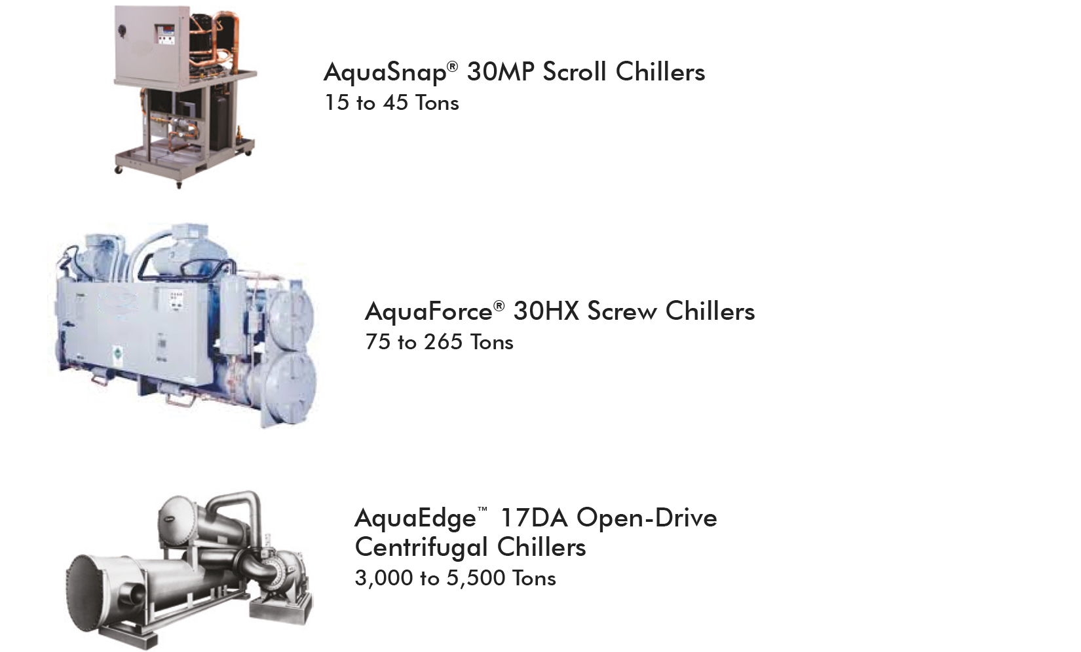
Chillers (Water-Cooled)

Slide 25
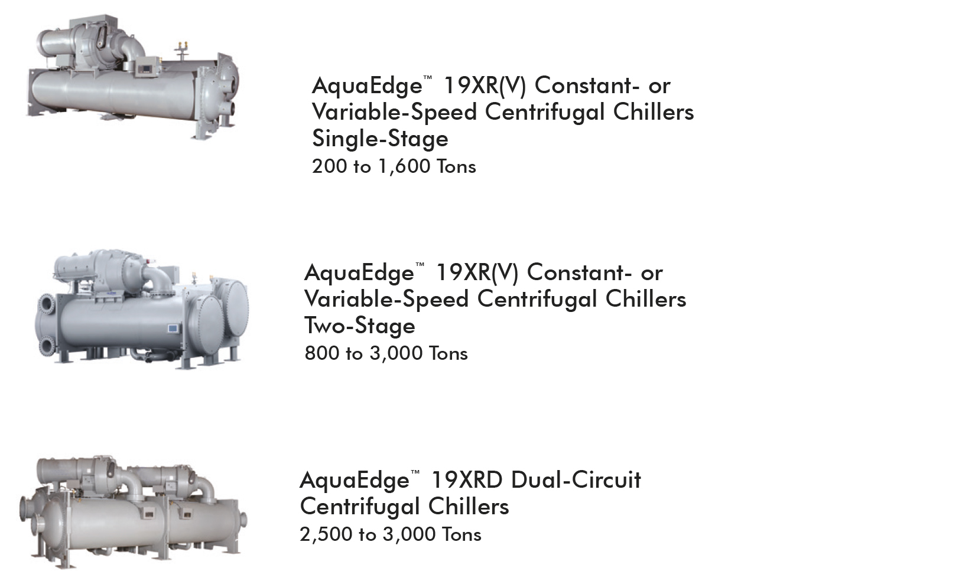
Chillers (Water-Cooled)

Slide 26
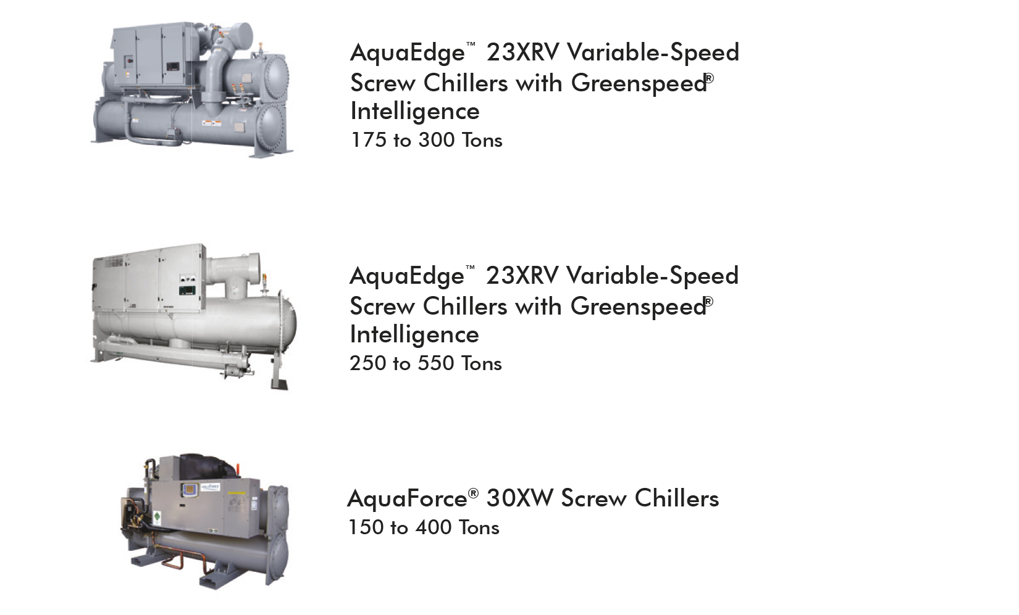
Chillers (Water-Cooled)

Slide 27
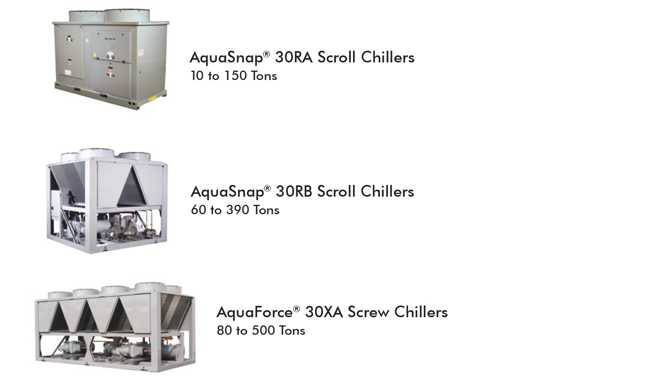
Chillers (Air-Cooled)

Slide 28
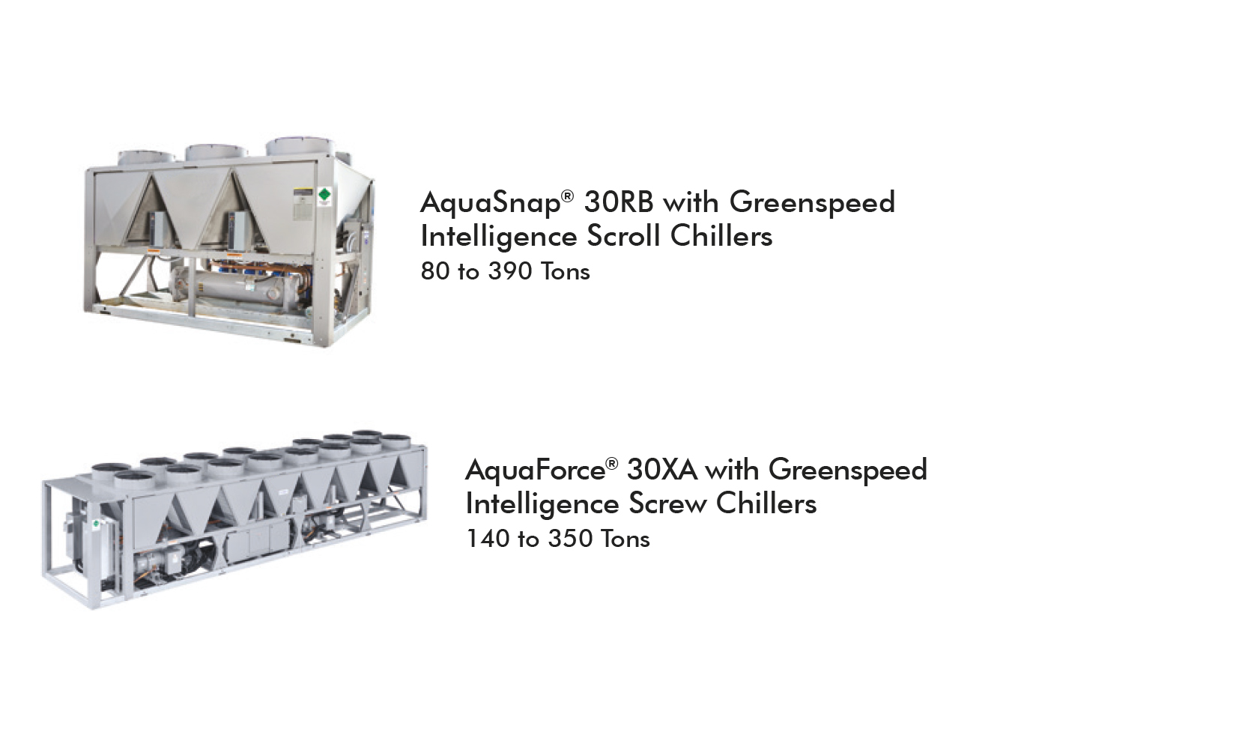
Chillers (Air-Cooled)

Slide 29
Types of Packaged Plant
Permanent Cooling Plant
Solidly Constructed Rigid, riggable, permanent plant
Variable Primary or Constant Volume Comes complete with Cooling Tower Skid
Single or Multiple Chillers
Screw and Centrifugal Chillers
Primary design consideration is efficiency & ease of maintenance

Slide 30
Types of Packaged Plants - Permanent Cooling Plants
11kV SWITCH GEAR
11kV / 400v TXFR AREA
400v CONDENSER WATER PUMP
400v CHILLED WATER PUMP
CHILLER & PUMP, ROOM, MCC AND MT ROOMS ARE AIR CONDITIONED
4,000TR Chiller Module
Notes:
ANOTHER VIEW WITH SEPARATE AREAS HIGHLIGHTED

Slide 31
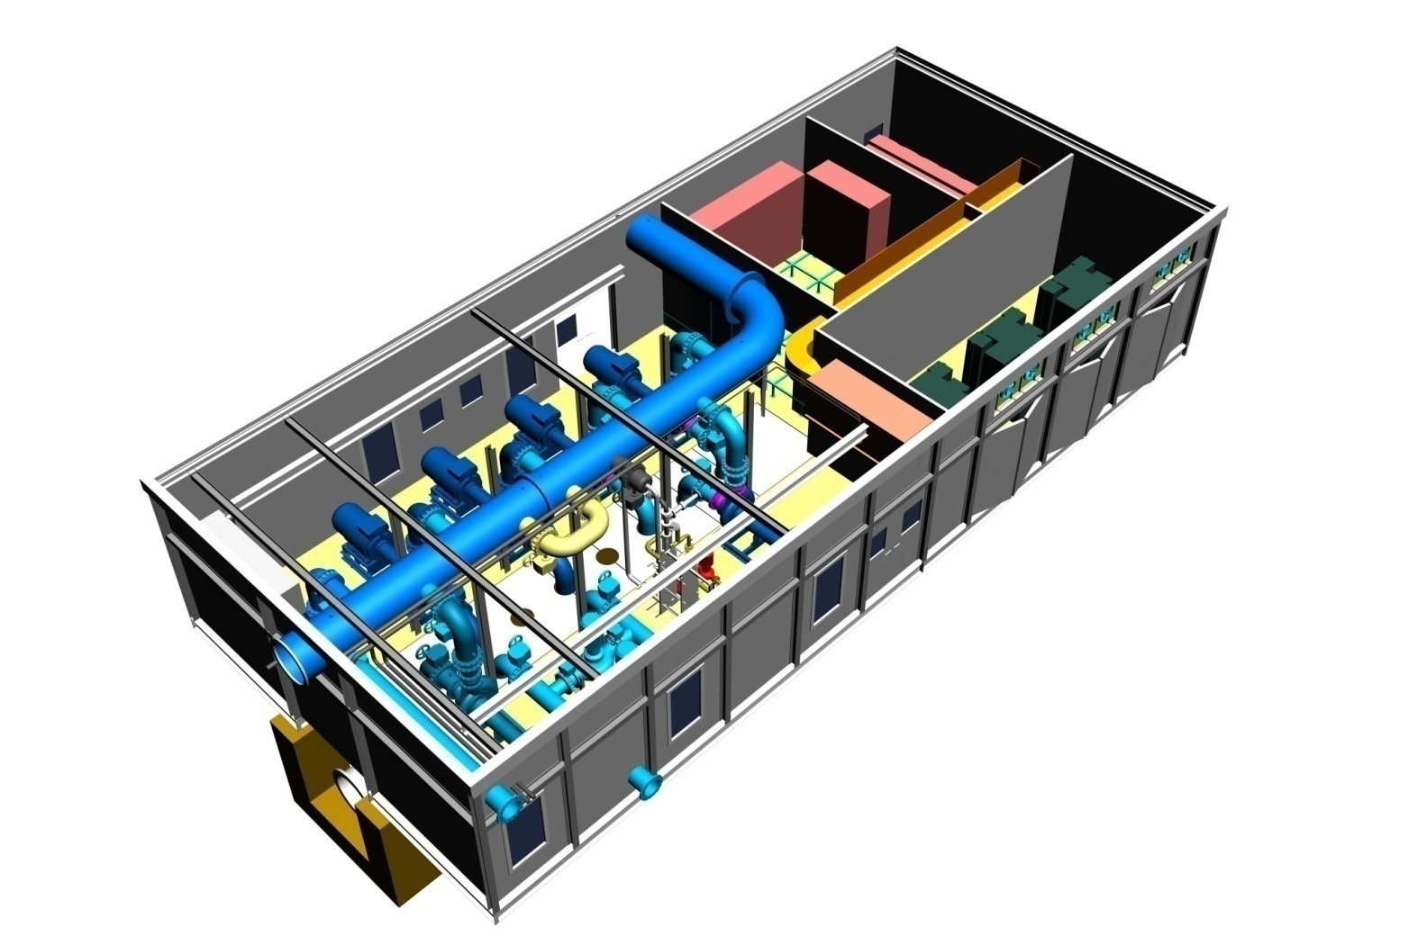
Secondary Distribution Module – Capable of Pumping 32,000TR at 9K
Types of Packaged Plants - Permanent Cooling Plants
11kV SW/GEAR
400v MCC & VSD AREA
11kV / 400v TXFR AREA
PUMP ROOM & MCC AIR CONDITIONED
400v CH/W PUMPS W/ VSD
Notes:
PREFABRICATED SECONDARY CHILLED WATER PUMP MODULE WITH MAIN COMPONENT AREAS INDICATED.

Slide 32
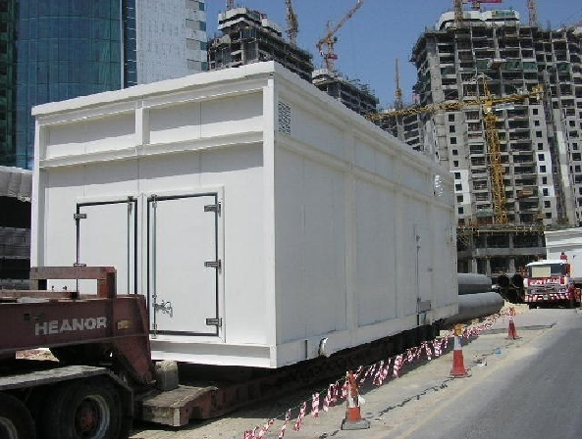
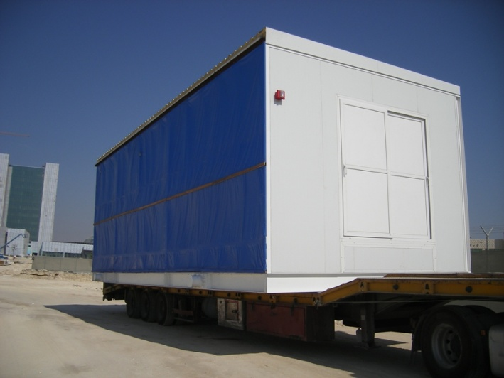
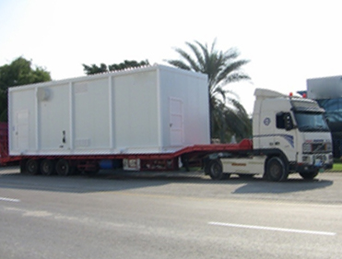
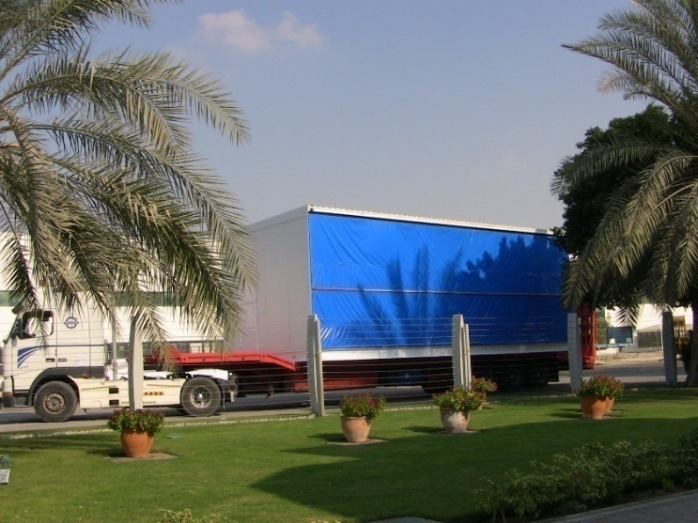
Transportation
To any place in the World from Flo Fab Canada

Slide 33
Delivery
Strip Foundations prepared
Two Section Assembly

Slide 34
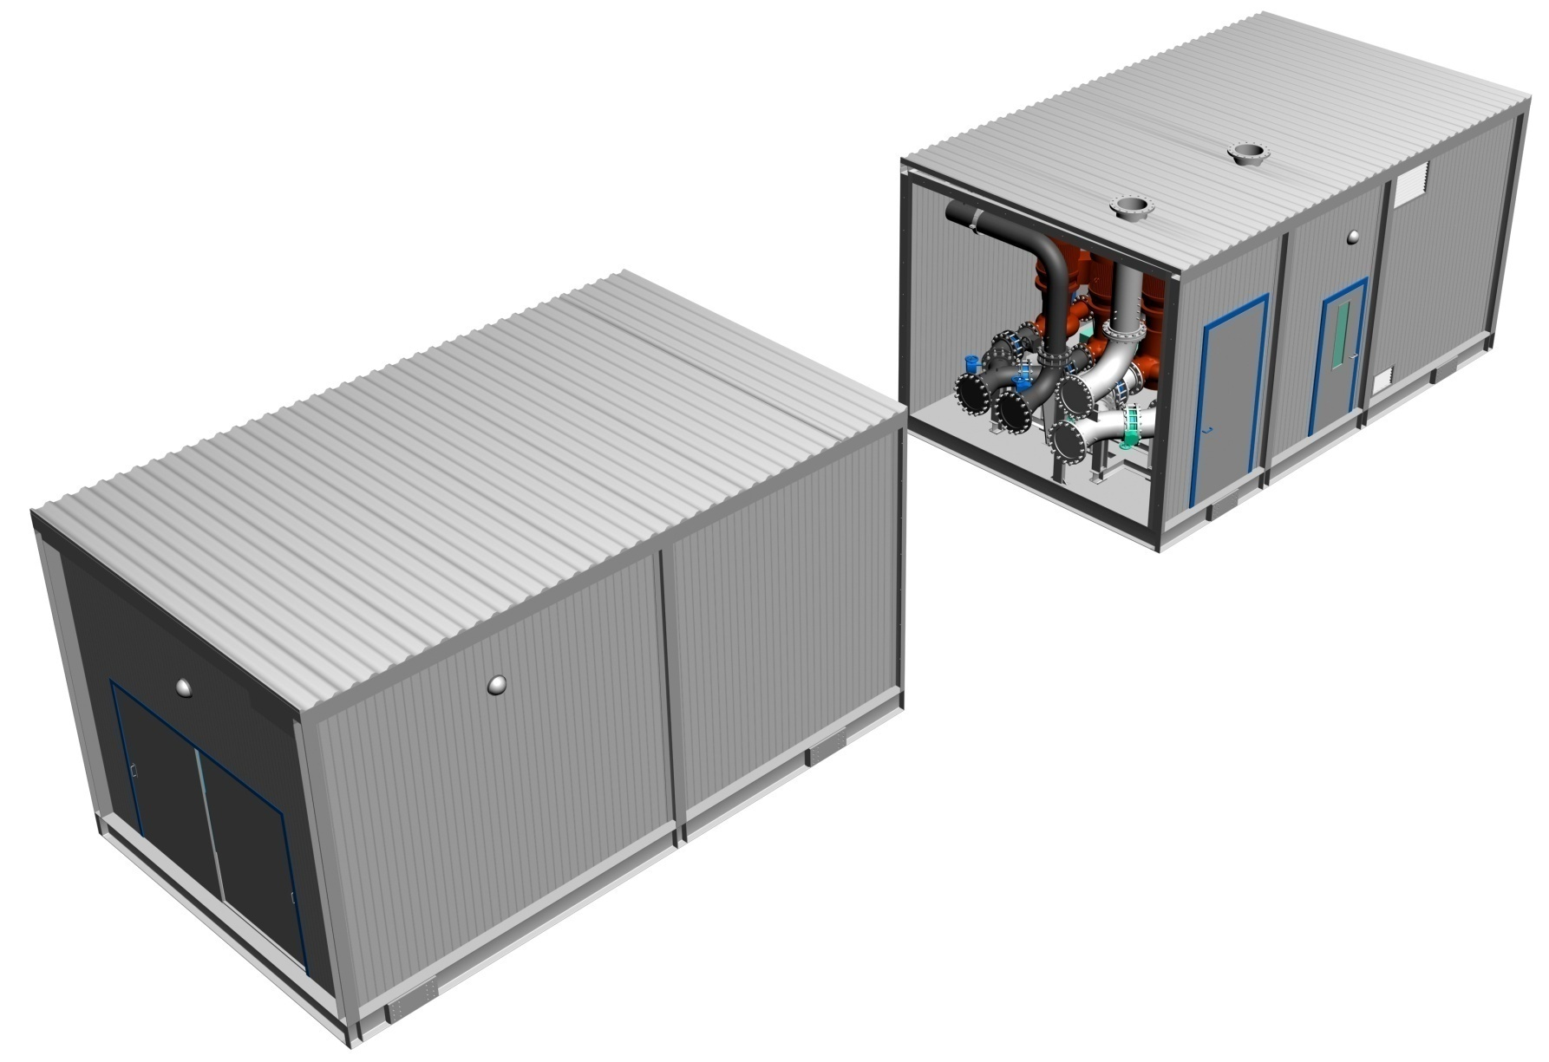
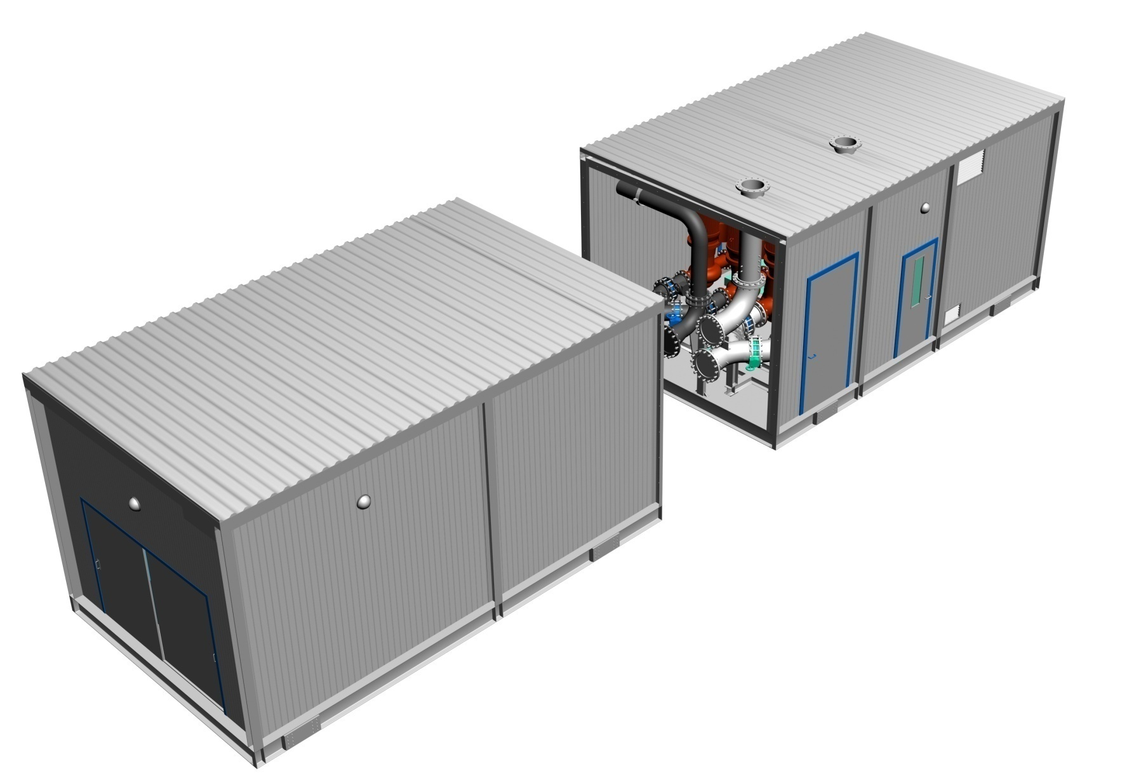
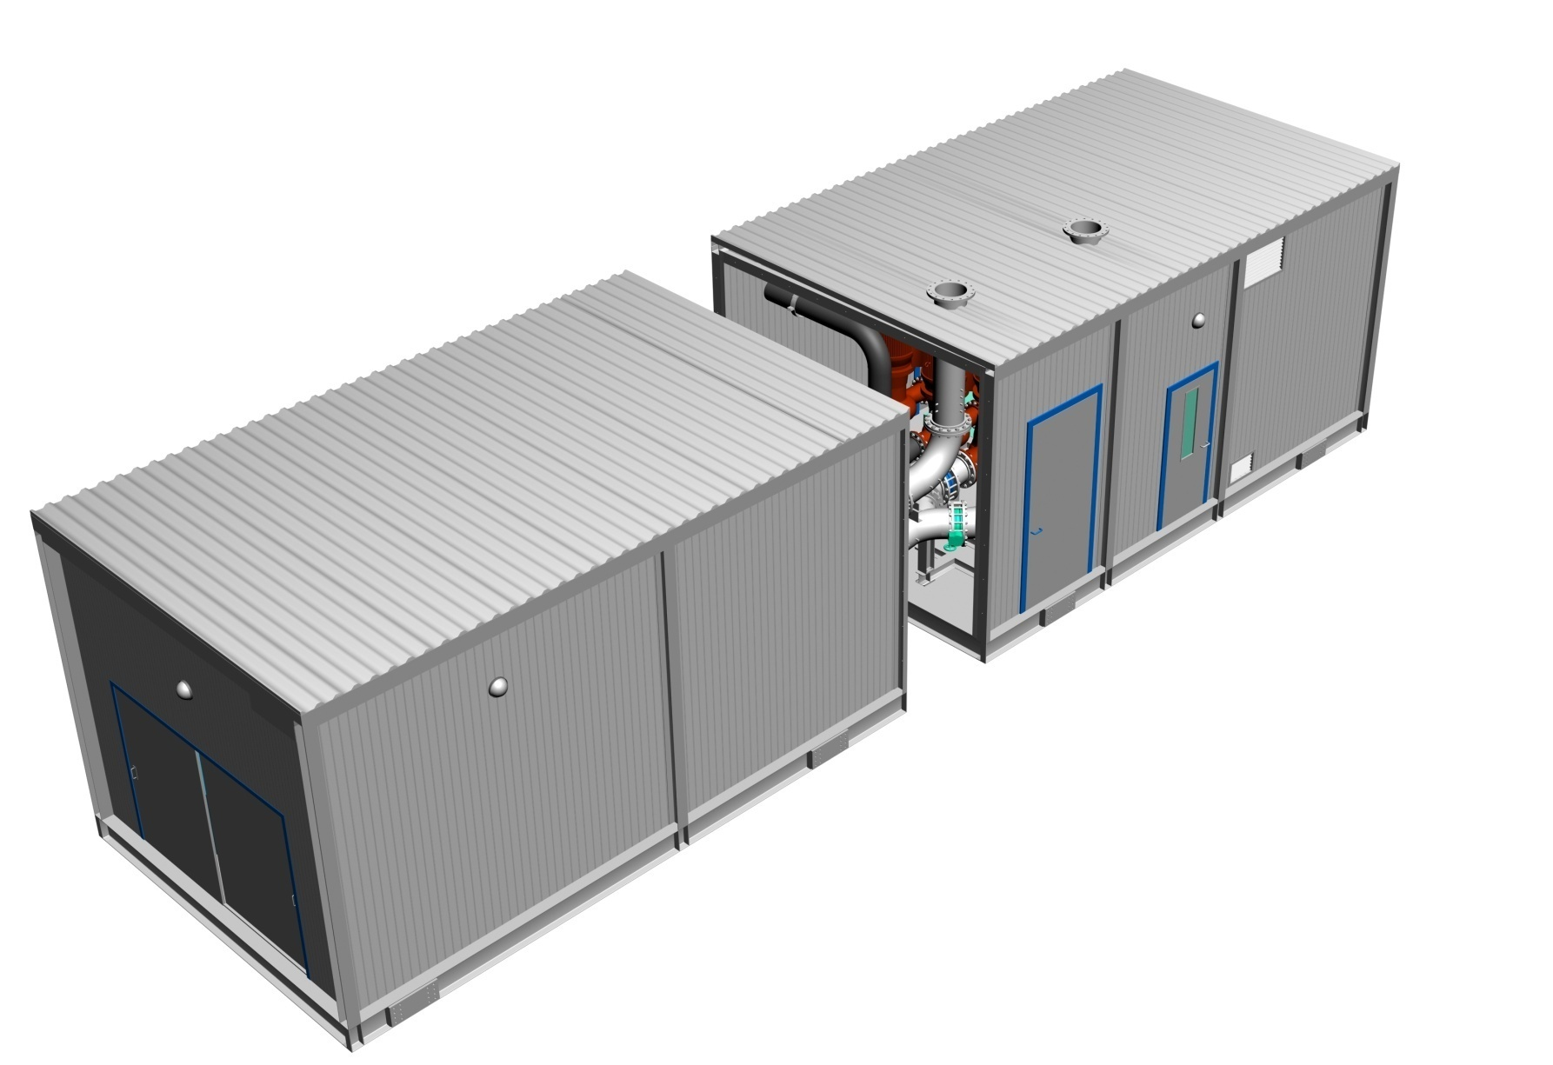
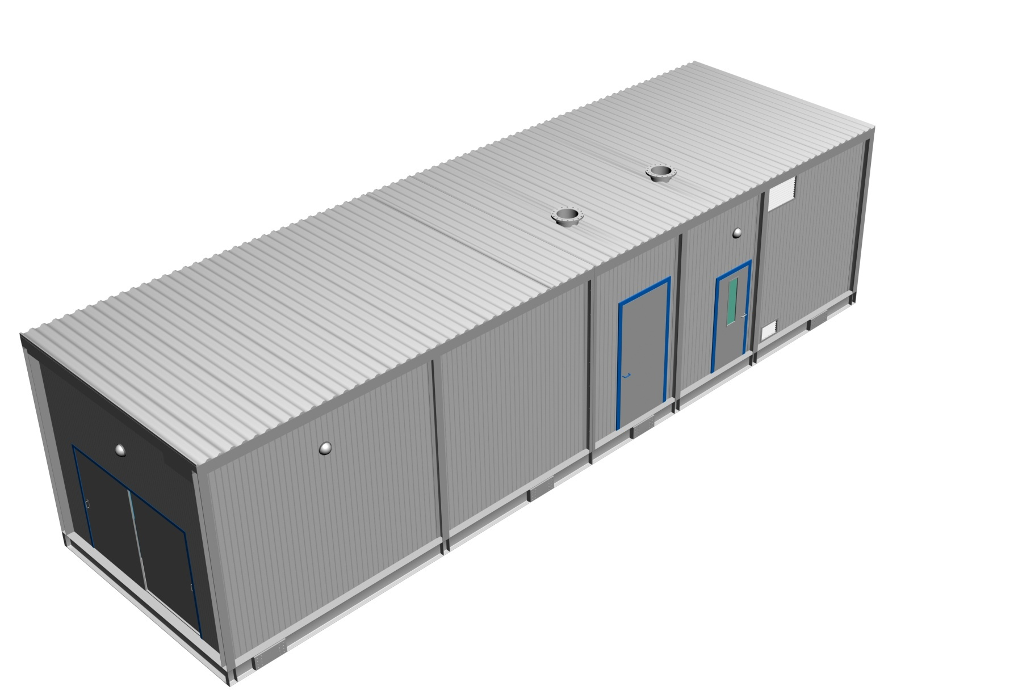
Shipping Split
For module lengths > 12m
Notes:
34

Slide 35
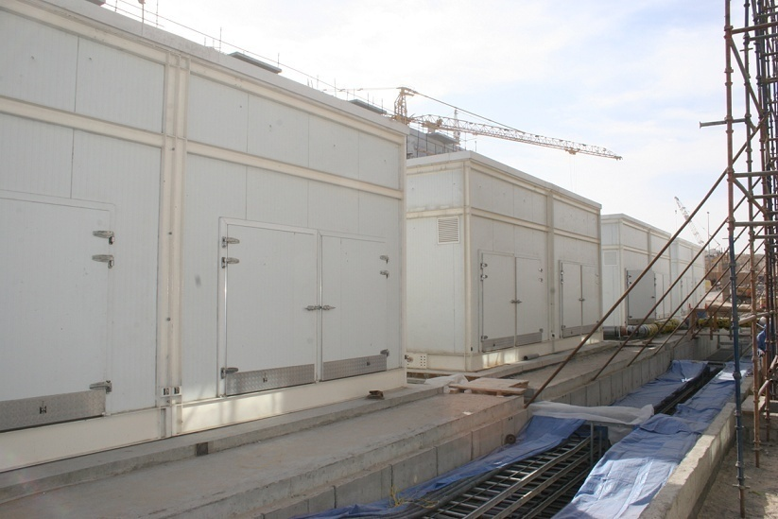
50,000TR Permanent Packaged Plant
Notes:
Each of the plants shown above are 5,000TR.
Total plant when finished will be 50,000TR
All that is required is a concrete base. All tie-ins, mechanical and electrical on this modular design are on one end.
The module comes in three sections

Slide 36
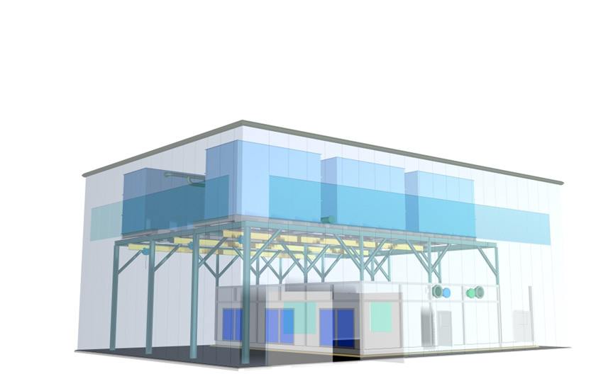
Assembly Graphic
Solutions for Multiple Chiller Systems…

Slide 37
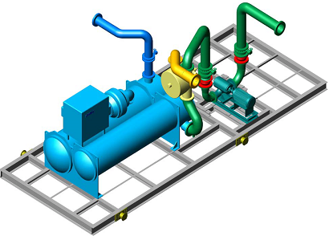
Maintenance Enhancements (available options)
Marine Water Boxes at pipe connection ends
Sliding Water Box Access Doors
Automatic Condenser Tube Cleaning System
Condenser Water Side-stream Filtration
Lifting Gantries

Slide 38
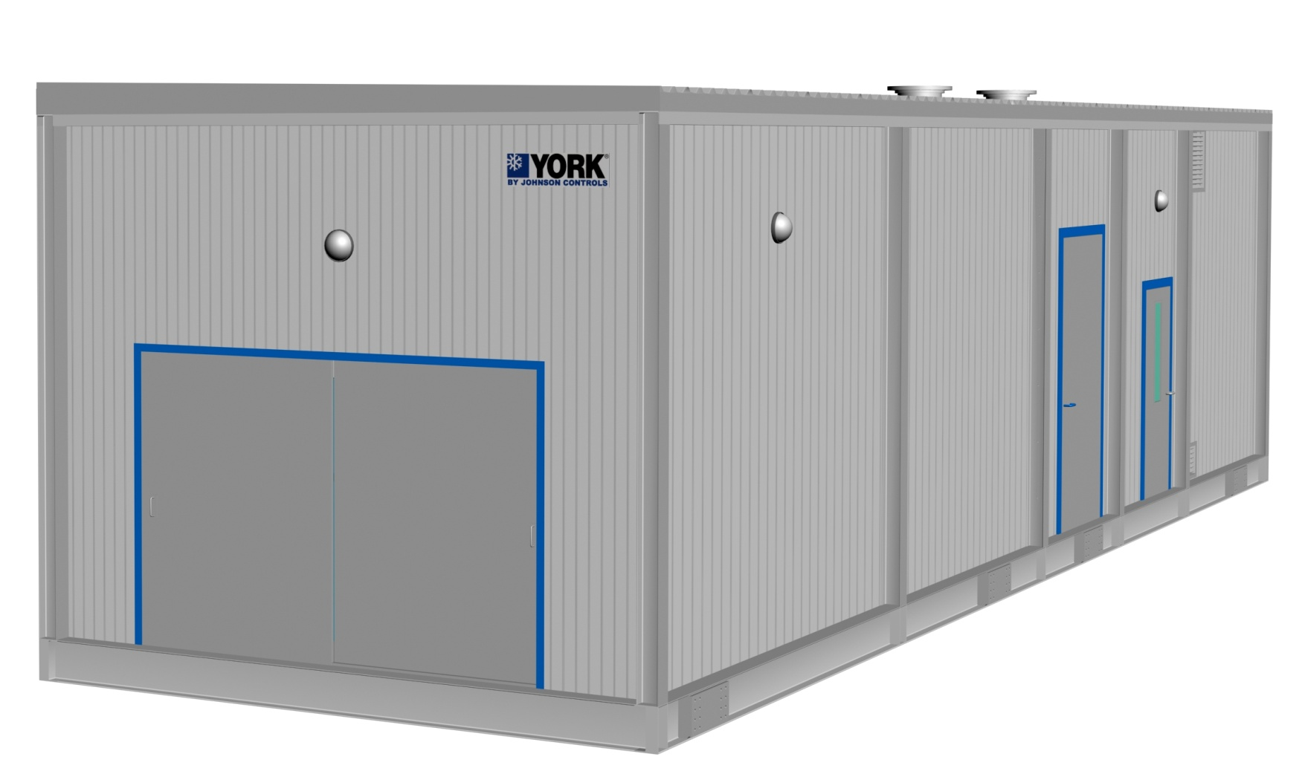
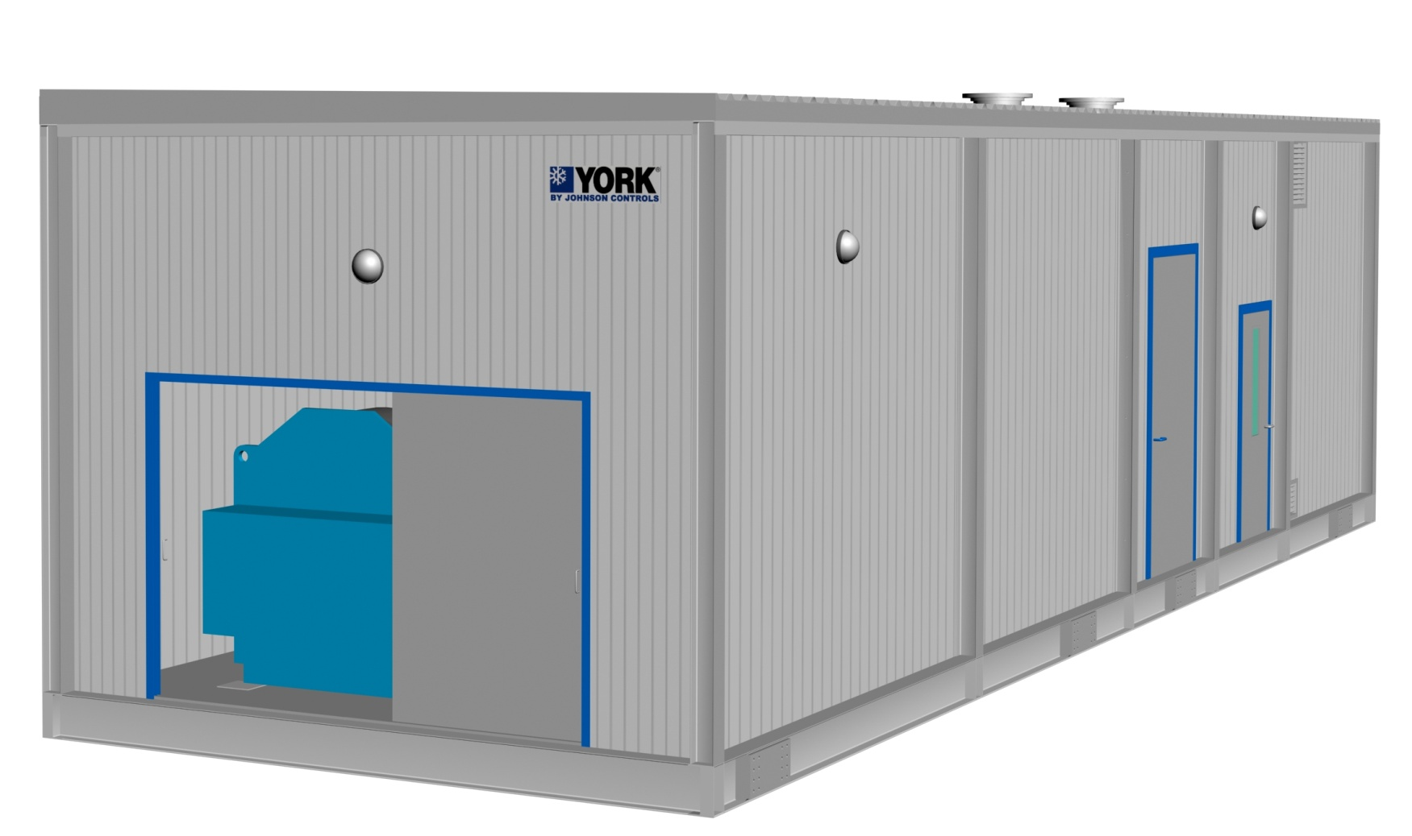
Maintenance Enhancements : Chiller Tube Service Access
Notes:
38

Slide 39
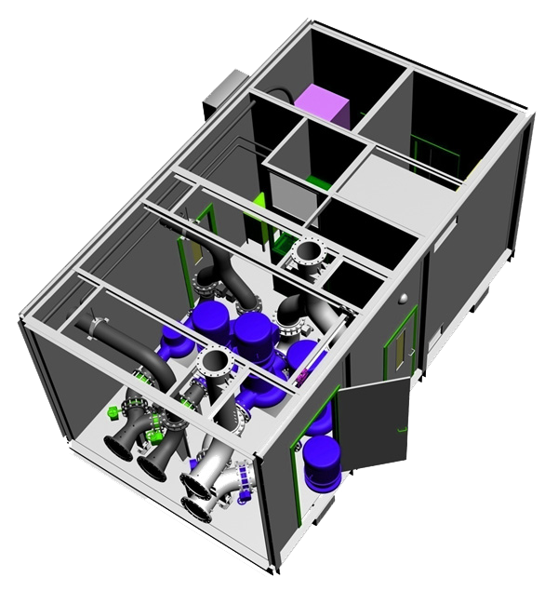
Overhead Gantry and Chain Pulley Block
Maintenance Enhancements : Pump removal Design
Notes:
39

Slide 40
What we normally do NOT offer !!
All civil works including foundation, cable trenches, water tanks etc.
Raised platform/structure for Cooling Tower Skid in case it is not placed above the Chiller Module.
Medium voltage power connection including termination to incomer section of chiller starter panel
Low voltage power connection including termination to incomer section of packaged plant LVMCC panel
All electrical power & control cabling external to the plant incl. main incoming power cables
Grounding arrangement including earth strip & earth pit.

Slide 41
What we normally do NOT offer !!
All pipe work external to the plant
Makeup, drain and overflow connections to cooling towers
Flushing & chemical cleaning of pipe work
Dosing chemicals for condenser & chilled water treatment
System water charging (condenser & chilled water)
Chilled water Air Separators, Expansion tank & Dosing Pot
Cooling Tower Make-up arrangement including tank, pumps etc
Local Authority coordination and approvals
Temporary power & water for site related work

Slide 42
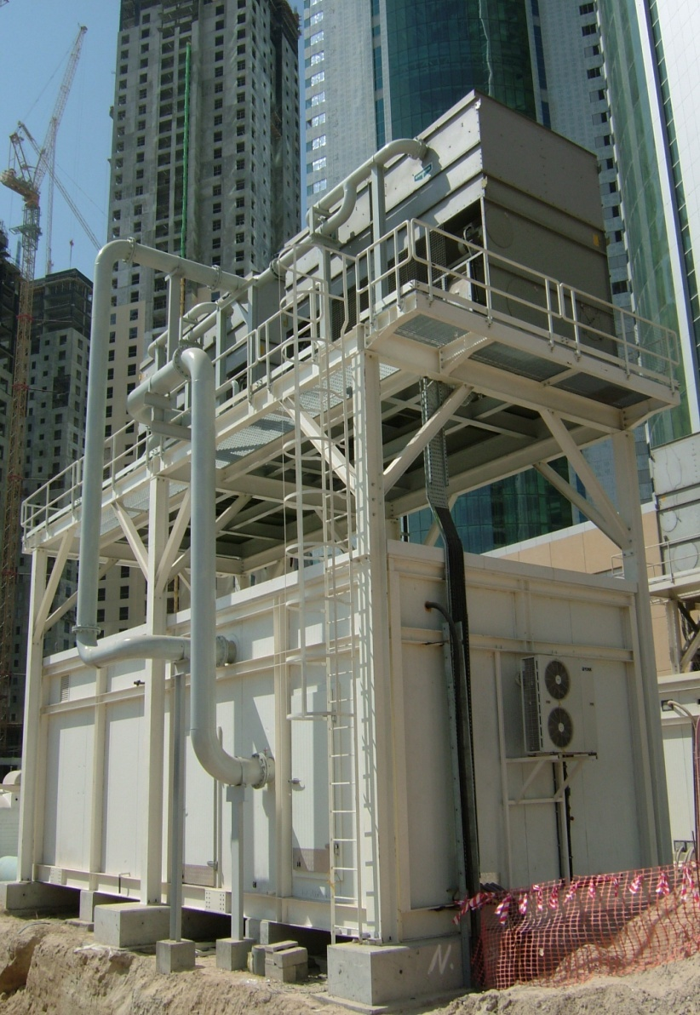
Case Study : Empower - Mobile Cooling for DC Provider
Type of Plant : Temporary Plant
Capacity : 81,000TR (across 6 orders)
Description : Single chiller modules
2500TR (YDJ2) x 11 #
1220TR (YKJ2) x 5 #
2000TR (YKJ4) x 1 #
2500TR (YKJ7) x 8 #
2500TR (YKK7) x 10 #
Key Selling Factors:
Shorter lead times
Reliable after sales support
Flexible design – customization
Local manufacture

Slide 43
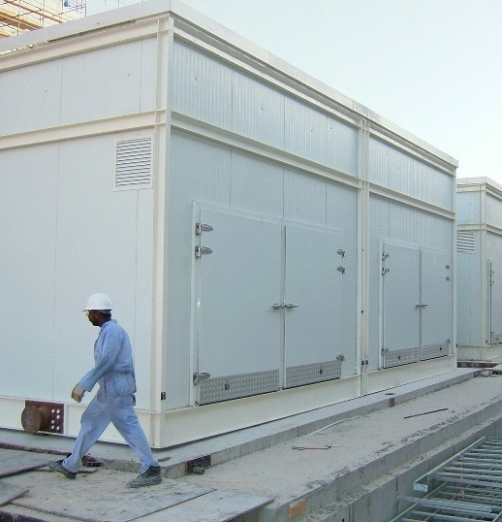
Case Study : Dubai Festival City - Large Mixed Use Development
Type of Plant : Permanent Plant
Capacity : 50,000TR (phased dely)
Description :
10 # x 5000TR chiller modules
2500TR (YDJ2) x 2# series-counterflow
Primary - Secondary system
Cooling tower, Secondary Pumps & MV by client
Migrating from potable make-up to TSE
Key Selling Factors:
Shorter lead time
Good relationship with consultant
Phased delivery to match construction schedule

Slide 44
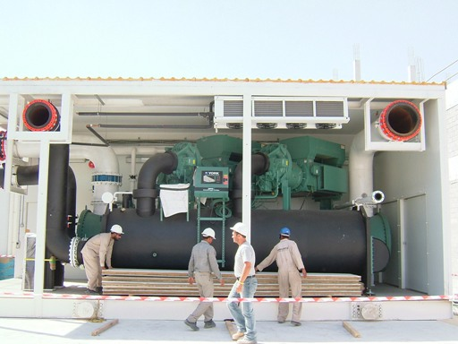
Case Study : Dubai Festival City - Large Mixed Use Development

Slide 45
Case Study : Dubai Investment Park - Industrial Park & Labour Accommodation
Type of Plant : Permanent Plant
Capacity : 12,000TR
Description :
3# x 4000TR chiller modules
1# Secondary Pumping Module
2000TR (YKJ4) x 2# series-counterflow
Primary - Secondary system
Cooling towers, TES, MV, ETS & Plant Management System by JCI
Key Selling Factors:
Locally available engineering setup
Good relationship with consultant
Phased delivery to match construction schedule
O & M capability

Slide 46
Case Study : Dubai Investment Park - Industrial Park & Labour Accommodation

Slide 47
Case Study : Dubai Investment Park - Industrial Park & Labour Accommodation
EXTERNAL VIEW
10 m
4.3 m
SITE LAYOUT
22 m

Slide 48
Case Study : Al Naboodah - Villas & Office Complex
Type of Plant : Permanent Plant
Capacity : 1200TR + 400TR (extn)
Description :
1# chiller module / 3# x 400TR (YSS4)
(Extn) 1# chiller module with 1 # chiller
Cooling tower skids
Variable Primary Flow (VPF) system
Key Selling Factors:
Worked closely with owner
Excellent sales & engineering support to client / consultant / contractor
Spin-offs
Air-side order
5 years O & M contract

Slide 49
Case Study : Dubai World Trade Centre - Sheikh Saeed Exhibition Hall
Type of Plant : “Long Term Temporary” Plant
Capacity : 4000TR
Description :
2500TR (YKJ7) & 1500TR (YKK3)
Cooling tower skids
Primary-Secondary System
Secondary Pumping by others
Project management, 11kV Power Module, Make-up water Tank / Pump & Expansion Tank by JCI
Key Selling Factors:
Very short lead time
Sales working closely with Owner
Local engineering & manufacturing set-up
Excellent after sales capability
In-house project management capability
Fantastic teamwork

Slide 50
Case Study : Dubai World Trade Centre - Sheikh Saeed Exhibition Hall (factory)

Slide 51
Case Study : Dubai World Trade Centre - Sheikh Saeed Exhibition Hall (delivery)

Slide 52
Case Study : ARAMCO, Saudi Arabia - North Park Office Complex
Type of Plant : “Long Term Temporary” Plant
Capacity : 4000TR
Description :
1# x 4000TR chiller module
2000TR (YKJ4) x 2# in parallel
Field erected Cooling towers
Primary-Secondary System
Secondary Pumping by others
Raw Water for cooling tower Make-up
Key Selling Factors:
Ability to engineer & customize in compliance with ARAMCO standards
Good existing references with ARAMCO
Middle East based engineering & manufacturing set-up
Local Saudi organization for sales, project execution & service

Slide 53
Case Study : ARAMCO, Saudi Arabia - North Park Office Complex (off-loading & site assembly)

Slide 54
Case Study : ARAMCO, Saudi Arabia - North Park Office Complex (off-loading & site assembly)

Slide 55
Case Study : Tabreed - UAE Armed Forces Camp at Malaiha, Sharjah
Type of Plant : Permanent Plant
Capacity : 2 # x 5000TR (different sites)
Description :
2# x 5000TR Chiller Modules
Cooling tower skids
Variable Primary Flow (VPF) System
Turn-key order with Project management, 11kV/3.3kV Power Module, Make-up water Tank / Pump & Expansion Tank by JCI
Key Selling Factors:
Very short completion time
Local engineering & manufacturing set-up
Excellent track record with past Tabreed orders
In-house project management capability
Fantastic teamwork

Slide 56
How it look like in the field inside the building ?

Slide 57
High Profile Jobs

Slide 59
How it look like inside a shelter ?

Slide 60
How it look like in the field outside the building ?
* How it look in the field outside the building.

Slide 61
Packaged
Systems
D-GLY Duplex
Glycol System
D-FOM Duplex
Fuel Oil System
D-HC-XRI
Duplex - Package

Slide 62
Packaged
Systems
BOI
Boiler
Package
D-CPS-HT Duplex
Constant Pressure
System
CHI
Chiller
Package

Slide 63
Packaged
Systems
LCOO Large Cooling Package
HCE Heating
Cooling with Enclosure

Slide 64
Enclosures

Slide 65
Industry leading – 25-year Warranty
Exclusive FiberBeam™ and
FiberWrap ™ Technology
Built to highest standards
Superior responsiveness and attention
to detail in all phases of a project.

Slide 66
Enclosure installation on skid package

Slide 67
Complete assembly with Shelter Works enclosure

Slide 68
How to rig equipment

Slide 69
Special package delivery

Slide 71
Explanation Videos…
https://youtu.be/6RszUZjqarY
https://youtu.be/rEgjRUsB8jM

Slide 74
Modular packaged Chilling Systems - Solutions to Suit Every Application
Apartment units
Lodging
Schools
Colleges & Universities
Hospitals
High Technology
Homes
Retail
Shopping Malls
Government
Life Sciences
Airports
High-rise Apartments
Medical Clinics
Small Commercial
Large Commercial
Arenas/Convention Centers
Residential Mid Market Complex

Slide 75
OTHERS !!!!!! Middle East Project List (Sep 2012)
# | Year | Project / Client | Application | Type of Plant | Country | Qty | Total Tons | Voltage
1 | 2005 | Empower-1 | District Cooling | Mobile Temporary Plant | UAE | 7 | 12,300 | 3300 / 400
2 | 2005 | Tabreed | District Cooling | Mobile Temporary Plant | Bahrain | 2 | 2,400 | 400
3 | 2005 | Dubai Festival City | District Cooling | Permanent Plant | UAE | 10 | 50,000 | 11000 / 400
4 | 2006 | Dubai Investment Park | District Cooling | Permanent Plant + ETS | UAE | 3 | 12,000 | 11000 / 400
5 | 2006 | Deira City Centre | Shopping Mall | Replacement Permanent Plant | UAE | 2 | 2,600 | 11000 / 400
6 | 2007 | Dubai World Trade Centre | Residential Bldgs | Mobile Temporary Plant | UAE | 2 | 2,400 | 11000 / 400
7 | 2007 | Empower-2 | District Cooling | Mobile Temporary Plant | UAE | 8 | 20,000 | 11000 / 400
8 | 2007 | Emicool | District Cooling | Mobile Temporary Plant | UAE | 4 | 4,800 | 11000 / 400
9 | 2008 | Al Naboodah | Villa Complex | Permanent Plant (Screw Chlrs) | UAE | 1 | 1,200 | 400
10 | 2008 | Empower-3 | District Cooling | Mobile Temporary Plant | UAE | 9 | 22,000 | 3300 / 400
11 | 2008 | Empower-4 | District Cooling | Mobile Temporary Plant | UAE | 1 | 2,000 | 3300 / 400
12 | 2008 | Al Naboodah Extension | Office Bldg | Permanent Plant (Screw Chlr) | UAE | 1 | 400 | 400
13 | 2009 | Dubai World Trade Centre | Exhibition Hall | Long Term Temporary Plant | UAE | 2 | 4,000 | 11000 / 400
14 | 2009 | Saudi ARAMCO | Office Bldg | Permanent Plant | Saudi | 1 | 4,000 | 4160 / 460
15 | 2010 | Al Rayyana / Sorouh | Residential Bldgs | Permanent Plant | UAE | 1 | 7,200 | 11000 / 400
16 | 2011 | Malaiha Camp / Tabreed | Military Camp | Permanent Plant | UAE | 2 | 10,000 | 11/3.3kV/400
17 | 2011 | Capitala Rihan Heights | Residential Bldgs | Permanent Plant | UAE | 1 | 4,000 | 11000 / 400
18 | 2011 | Sh. Zayed University | University Campus | Permanent Plant | UAE | 2 | 9,450 | 11000 / 400
19 | 2011 | GASCO (OilCo) | Indl. Refrigeration | Replacement Permanent Plant | UAE | 1 | 1,300 | 3300 / 400
20 | 2012 | Empower-5 | District Cooling | Mobile Temporary Plant | UAE | 8 | 20,000 | 11000 / 400
21 | 2012 | Emirates Hangars | Hangar Cooling | Permanent Plant | UAE | 1 | 3,080 | 400
 |  |  |  |  | Total | 69 | 195,130
Regional Medical Center
Muskogee, OK, USA
The Gazette
Montréal, QC, CA
Research and Medical Clinic
Tulsa, OK, USA

Slide 77
Thank You for
Your participation!
Visit our Website
www.flofab.com

