Slide 1



Slide 2


History
Flo Fab was established in 1981 by Denis Gauvreau who created and developed
the products line and constantly being perfected by Marc Gauvreau, as well as by
a team of professional engineers and designers. It’s a combination of existing designs from several renowned products and the innovative ideas of a new generation professionals.
Through the years, Flo Fab has acquired several companies and service entities including : AQUA-PROFAB (ASME Tanks manufacturer), MÉNARD, LÉONARD ÉLECTRIQUE, PMA. , Furthermore Flo Fab purchased equipment, fabrication designs and patterns from IDEALCO, a manufacturer of shell and tube type heat exchangers.
The after sales services, sales, engineering, R&D, production, quality control, accounting and administration departments of all the above companies share the same location.
In December 2014, Marc Gauvreau, son of the founder, acquired all shares of The company. Flo Fab and is constantly investing in new state of the art innovations new product like the XRI series and Prefab Skid for Hydronic Hearing 8 cooling system, pumping systems. This has allowed Flo Fab to retain competent and experienced staff of professionals with varied and specialized abilities that constantly work on improving our existing products and add new engineered solutions that exceeding customer’s expectations .
Flo Fab has grown quite rapidly and now proudly offers of a wide range of products available directly from one manufacturer. This includes pumps & pump packages, tanks, heat exchangers & hydronic accessories. This allows each project stakeholders to enjoy economical savings, peace of mind, best value for their investment and optimized total cost of ownership.

Slide 3
Flo Fab Pumps
Flo Fab Pumps
Overview: Design philosophy, common features, etc…
Vertical Inline
  Circulators, closed-coupled, spacer-coupled
Base-mounted
  End suction, closed-coupled, spacer-coupled,
  split case, double-suction, unique configurations
Submersibles
  Sewage, effluent, column, stainless steel, duplex,
  panels, accessories

Slide 4


Reliability & Durability
All pumps are with both casing & impeller wearing rings as standard.
Seals are Viton® with silicon carbide hard faces (NOT Carbon ceramic) for additional heat and chemical resistance.
All seals are rated up to 300ºF as standard.
Standard Motors, Seals, Bearings and couplings.
Heavy industrial class pump casing as it is poured to withstand 300 psi (Flange std.=150psi)
Higher efficiency due to smooth surfaces enhancing fluid mechanics as pump casting molds made from resin pattern NOT wood.
Notes:
John Crane Type 21 Mechanical seal !!! Features
The drive band's "dent and groove" design eliminates overstressing of the elastomer bellows to prevent bellows slip and protect the shaft and sleeve from wear.
Non-clogging, single-coil spring provides greater dependability than multiple spring designs and will not foul due to fluid contact.
Flexible elastomer bellows automatically compensates for abnormal shaft-end play, run-out, primary ring wear and equipment tolerances.
Parameters
Temperature Limits-40°F to 400°F/-40°C to 205°C (depending on materials used)
Pressure Limits150 psi(g)/10 bar(g)
Speed LimitsUp to 2500fpm/13m/s, depending on configuration and shaft size

Slide 5
Quality Control
All Pumps are factory tested with a live 10 sec video and stored on the web quote
Test facilities up to 400 HP with 27,000 gallons test bench with calibrated instruments
Factory designs using Inventor, Revit Files and CAD drawings
Upgraded factory limited warranty 5/8 Years

Slide 6
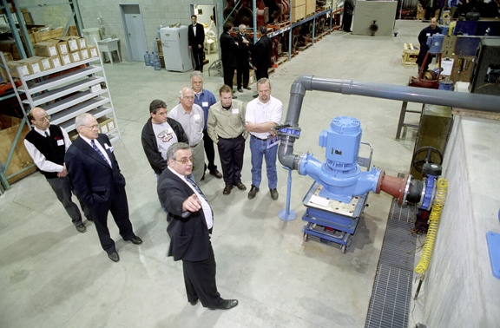
Facility Test Bench up to 400Hp

Slide 7
More than 60% of US projects at the bid phase originate with MASTERSPEC
Proud approved supplier for MASTERSPEC

Slide 8



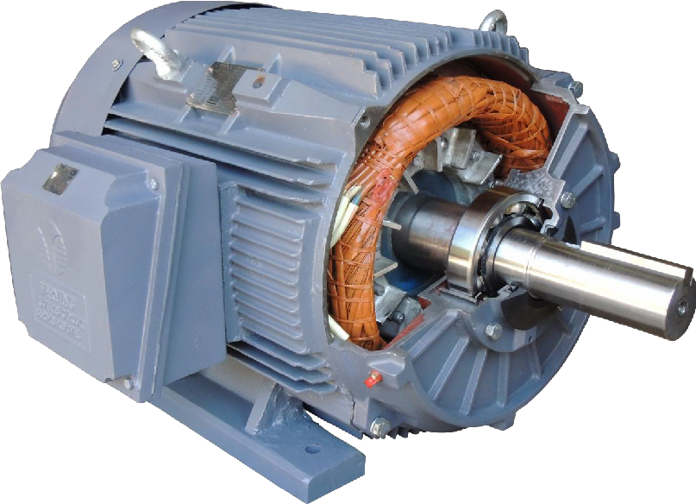


Built To Last
Rugged Construction…
Fully phase insulated all
copper windings
Corrosion resistant hardware
Lap winding eliminates first to last turn contact
Dual oversized bearings increase life
Stainless steel 50/60HZ nameplate and wiring diagram
Techtop “Gauntlet”
bearing sealing system
Cast iron oversized NPT
threaded
conduit box
Cast iron inner and outer bearing retainers
Anti-bacterial “Tropicalized” windings
Color coded oversized lead AWG
Removable feet for easy F1, F2, F3 conversion. Up to 326T frame
Leads are fully protected from abrasion

Slide 9
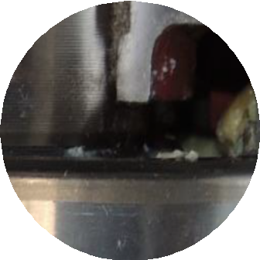

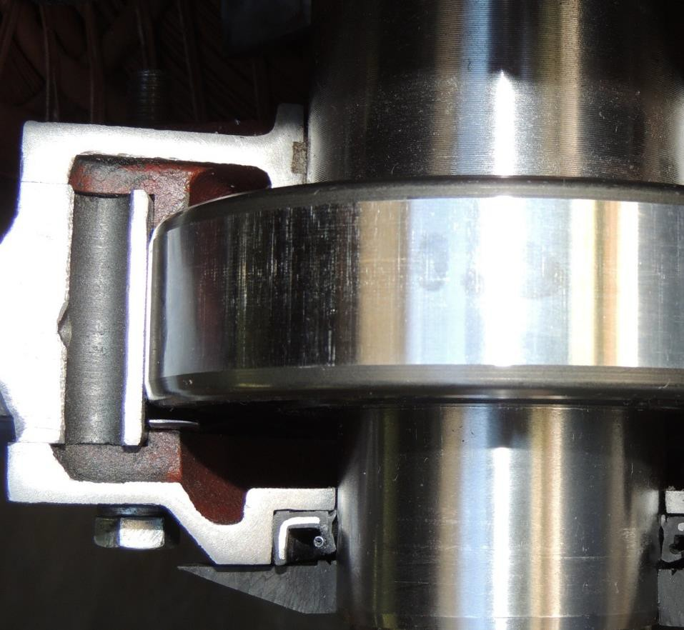
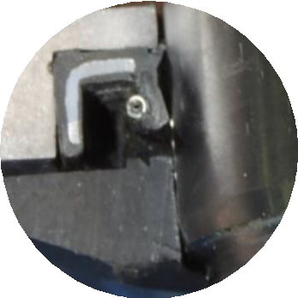
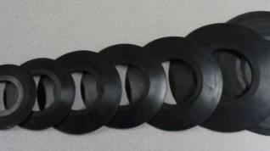
Ingress Protection
The “Gauntlet” – Techtop’s sealing system
Felt seals protect bearing and contain lubricant
Double lip oil seals keep contaminants out and lubrication in.
Slingers keep excess liquid away from seals

Slide 10
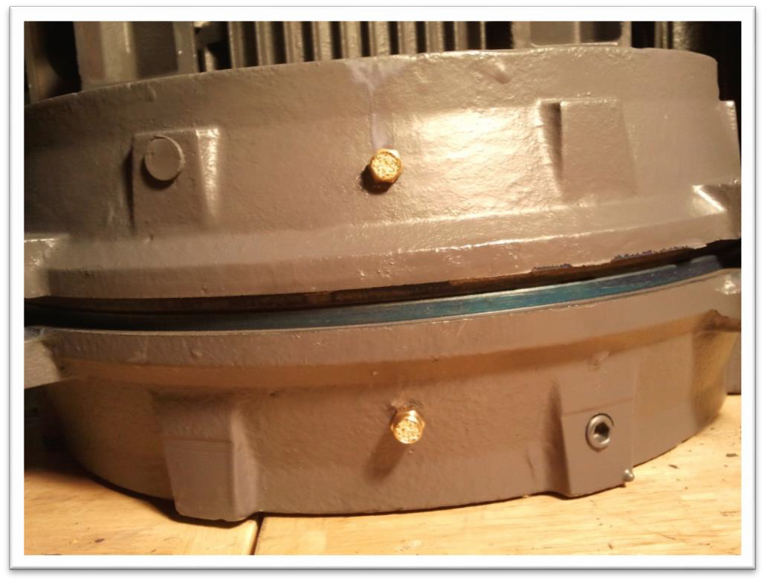
Ingress Protection
How We Handle Condensation
NEW FEATURE: All new motors will be fitted with significantly larger sintered brass drain plugs. The size of the plugs will increase in proportion to the size of the motor.
This allows for more rapid drainage and greatly increases the drain plugs necessary maintenance intervals.
Above: TECHTOP Motor showing one
way drains on both Drive-End-Bell and Opposite- Drive-End Bell.

Slide 11

Sensorless
Up to 10 distinct curves in the H-Q and P-Q plane programmable into the ISA.
Notes:
Instant on-line calculation of power and frequency based on user-defines H-Q reference.

Slide 12
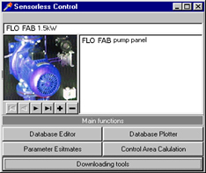
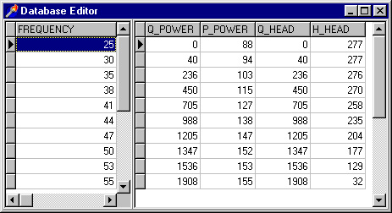
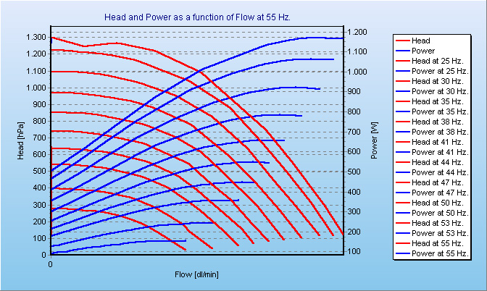
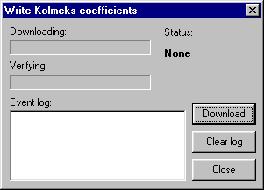
How to do...
Easy programming of H-Q and P-Q curves by means of user-friendly download program.

Slide 13
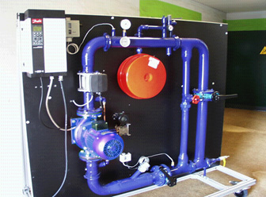
Results...
Pressure on the tested pump can be controlled within +/- 5% of the reference. (Based on lab. tests. Actual accuracy depends on pump and system design).

Slide 14
Sensorless Pump Control
Advantages
No loose components (sensor, hanging wires,....etc.) One single piece for immediate site installation.
No sensor needed.
Constant pressure or increasing pressure with flow.
Tuning on site not needed.

Slide 15
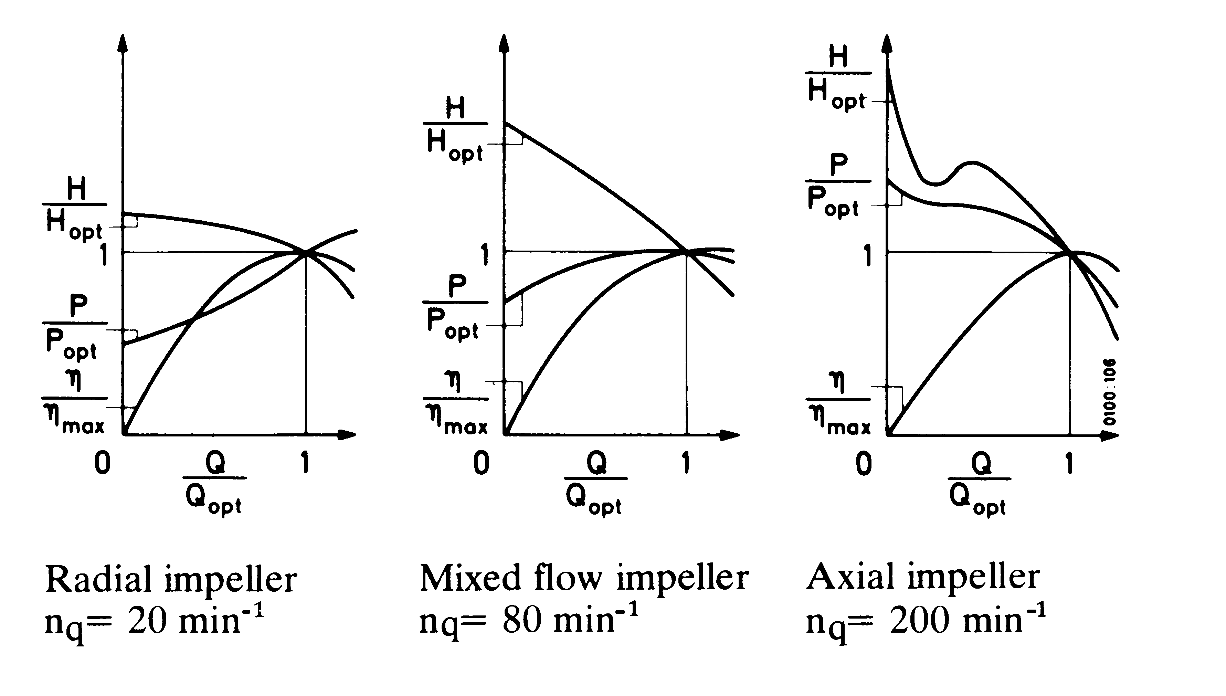
The Flo Fab Solution:
Possible STD Limitations Industrial app Not possible

Slide 16
The Flo Fab Solution:
High precision of pressure ( +/- 5 % ) by means of patent pending motor temperature compensation (Depends on pump and system design).
Stable control by means of 3-point controller with I feed back.
Easy download of pump data via PC programme and serial link.
Flow estimate ( +/- 3 % ).
Setting of pressure on site by means of: Pot meter, 0/4 - 20 mA, 10 V or serial link.
Head at min. and max. flow can be set individually.
PC tools which compress up to 10 sets of pump H-Q-P-n data by means of “Least square fit”.
High efficiency.

Slide 17
Web capability’s of www.flofab.com
Pump Selections
Expansion Tank Selections
Plate and Frame Heat Exchanger Selections
Hot Water Storage Selections
Make your own quotes
Build a Schedule
www.flofab.com

Slide 18
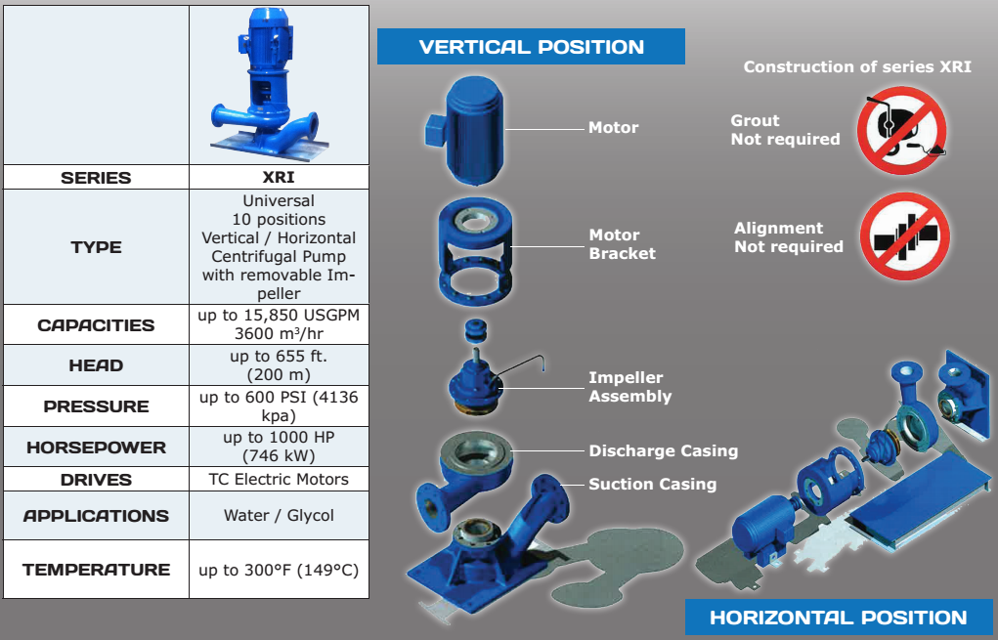
Unique XRI Pump Design & Benefits

Slide 19
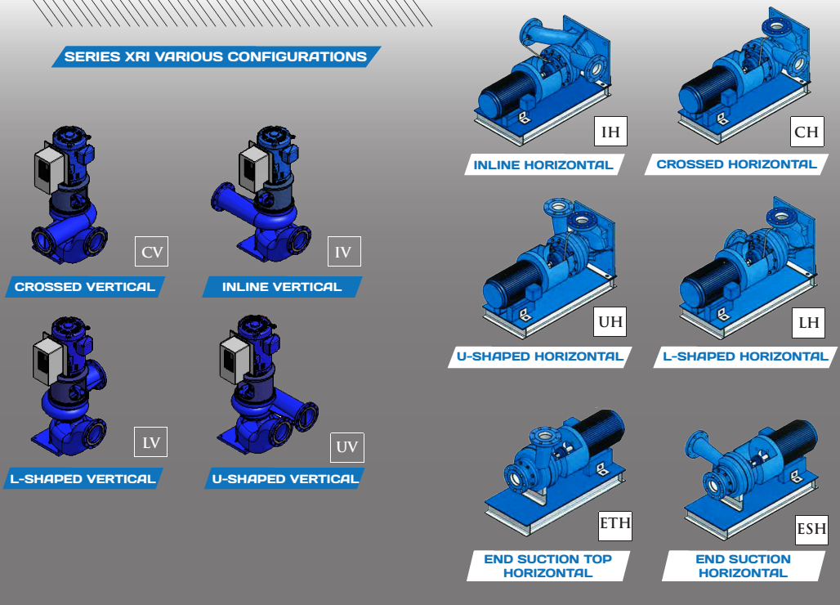
XRI Multiple Positions

Slide 20
XRI Pump Video…
https://www.youtube.com/watch?v=WVYCGdltj-o

Slide 21
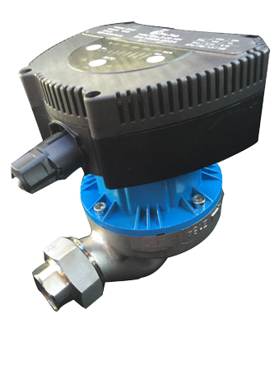
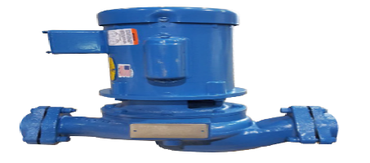
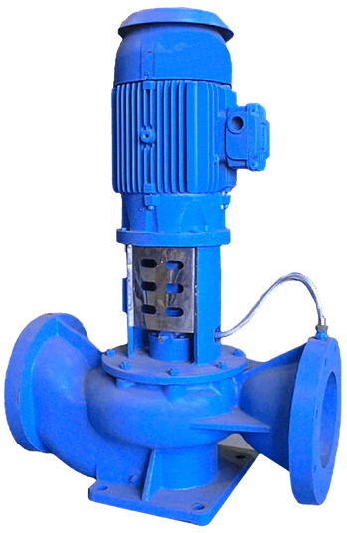
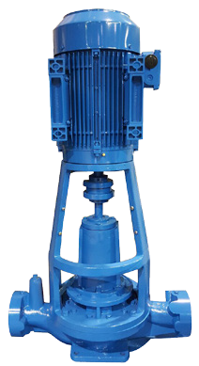
VERTICAL IN-LINE PUMPS
SERIES | 500 | 600 | 840SC | 880RI
SIMILAR TO | Magna / Astro / UP /PL / 00 | 2400 / 1900 / 1600 S / H / 90 / 60 |  | 4300 / 80SC / VLI / KS
TYPE | Circulating Pump | In-Line Circulator | Vertical In-Line Centrifugal Split Coupling | Vertical In-Line Centrifugal Split Coupling
CAPACITIES | up to 234 USGPM (54 m³/hr) | up to 290 USGPM (61 m³/hr) | 454 to 8000 USGPM (1816 m³/hr) | Up to 3000 USGPM (680 m³/hr)
HEAD | up to 43 ft. (14 m) | up to 120 ft. (37 m) | up to 410 ft. (125 m) | up to 650 ft. (198 m)
PRESSURE | up to 145 PSI (999 kPa) | up to 250 PSI (1724 kPa) | up to 600 PSI (4136 kPa) | up to 250 PSI (1724 kPa)
HORSEPOWER | up to 2/5 HP (280 kW) | up to 10 HP (7.5 kW) | up to 400 HP (298 kW) | up to 200 HP (149kW)
DRIVES | ECM Motor ERP Ready | 56C Electric Motors | TC Electric Motors | TC Electric Motors
APPLICATIONS | Water / Glycol | Water / Glycol | Water / Glycol | Water / Glycol
TEMPERATURE | up to 220°F (104°C) | up to 250°F (121°C) | up to 300°F (149°C) | up to 300°F (149 °C)
CONSTRUCTION MATERIAL | Cast Iron, Stainless, Bronze |  | Cast Iron, Bronze Fitted as Standard, Other Materials Also Available | Cast Iron, Bronze Fitted as Standard, Other Materials Also Available
-
Construction of series XRI

Slide 22
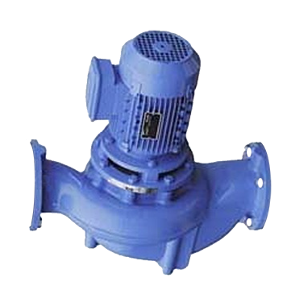
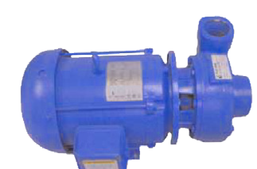
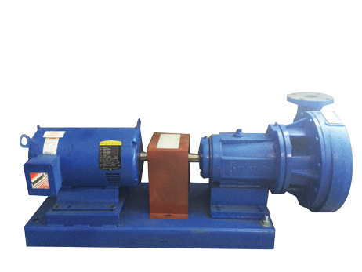
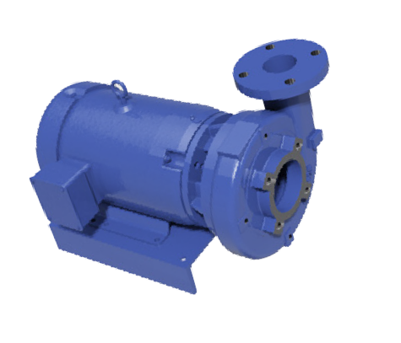
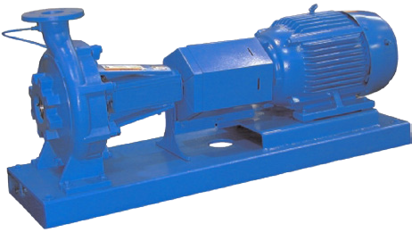
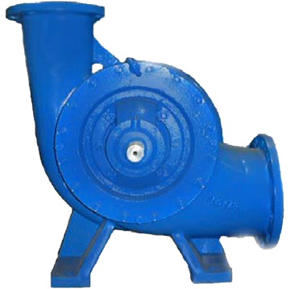
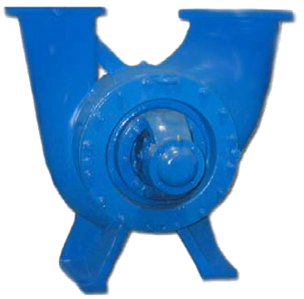
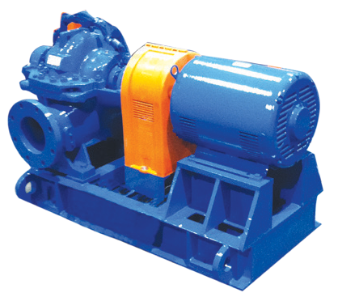
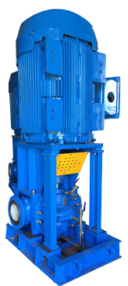
VERTICAL IN-LINE PUMPS + HORIZONTAL BASE MOUNTED + CLOSED COUPLED
SPLIT CASE DOUBLE SUCTION PUMPS
SERIES | 880 | 1000/1004 | 2000 | 2300 / 2600
SIMILAR TO | 80 / VL / 4380 | 1530 / 1532 / CM / C LCS / 4280 | LF / F / 4030 / 1510 / FM | LF / F / 4030 / 1510 / FM
TYPE | Compact In-Line Centrifugal | End Suction, Close Coupled | Radially Split Bearing Frame Pump Mounted With Flexible Coupling Back Pull Out Design | Radially Split Bearing Frame Pump Mounted With Flexible Coupling Back Pull Out Design
CAPACITIES | up to 3000 USGPM (680 m³/hr) | up to 1900 USGPM (431 m³/hr) | up to 1900 USGPM (431 m³/hr) | from 1900 to 6500 USGPM (432 to 1476 m³/hr)
HEAD | up to 650 ft. (198 m) | up to 43 ft. (14 m) | up to 120 ft. (37 m) | up to 410 ft. (125 m)
PRESSURE | up to 250 PSI (1724 kPa) | up to 175 PSI (1206 kPa) | up to 175 PSI (1206 kPa) with 125# flanges | up to 400 PSI (1206 kPa) with 400# flanges
HORSEPOWER | up to 200 HP (149 kW) | up to 200 HP (149 kW) | up to 200 HP (149 kW) | up to 500 HP (373 kW)
DRIVES | JM Electric Motors | JM Electric Motors | T Frame Electric Motors or Diesel Engines | T Frame Electric Motors or Diesel Engines
APPLICATIONS | Water / Glycol | Water / Glycol | Water / Glycol | Water / Glycol
TEMPERATURE | up to 300°F (149 °C) | up to 300°F (149 °C) | up to 300°F (149 °C) | up to 300°F (149 °C)
CONSTRUCTION MATERIAL | Cast Iron, Bronze Fitted as Stan- dard, Other Materials Also Available | Cast Iron, Bronze Fitted as Stan- dard, Other Materials Also Available | Cast Iron, Bronze Fitted as Stan- dard, Other Materials Also Available | Cast Iron, Bronze Fitted as Stan- dard, Other Materials Also Available
SERIES | 4800L | 4800U | 4800/4800H/4900 | 4800V
SIMILAR TO | VSX / TS | VSX | HSC / 4600 / KPGT / HS | KPV
TYPE | Single Stage, Double Suction Split Case | Single Stage, Double Suction Split Case | Horizontally Mounted, Single Stage, Double Suction Split Case | Vertically Mounted, Single Stage, Double Suction Split Case
CAPACITIES | up to 12000 USGPM (2725 m³/hr) | up to 12000 USGPM (2725 m³/hr) | up to 12700 USGPM (2884 m³/hr) | up to 12700 USGPM (2884 m³/hr)
HEAD | up to 750 ft. (227 m) | up to 750 ft. (227 m) | up to 625 ft. (190 m) | up to 625 ft. (190 m)
PRESSURE | up to 600 PSI (4136 kPa) | up to 600 PSI (4136 kPa) | up to 600 PSI (4136 kPa) | up to 600 PSI (4136 kPa)
HORSEPOWER | up to 800 HP (597 kW) | up to 800 HP (597 kW) | up to 1750 HP (1305 kW) | up to 1750 HP (1305 kW)
DRIVES | Electric Motors, Diesel Engines, Steam Turbines | Electric Motors, Diesel Engines, Steam Turbines | Electric Motors, Diesel Engines, Steam Turbines | Electric Motors, Diesel Engines, R.A.G.D
APPLICATIONS | Water / Glycol | Water / Glycol | Water / Glycol | Water / Glycol
TEMPERATURE | up to 300°F (149°C) | up to 300°F (149°C) | up to 300°F (149°C) | up to 300°F (149°C)
CONSTRUCTION MATERIAL | Cast Iron, Bronze Fitted as Standard, Other Materials Also Available | Cast Iron, Bronze Fitted as Standard, Other Materials Also Available | Cast Iron, Bronze Fitted as Standard, Other Materials Also Available | Cast Iron, Bronze Fitted as Standard, Other Materials Also Available

Slide 23

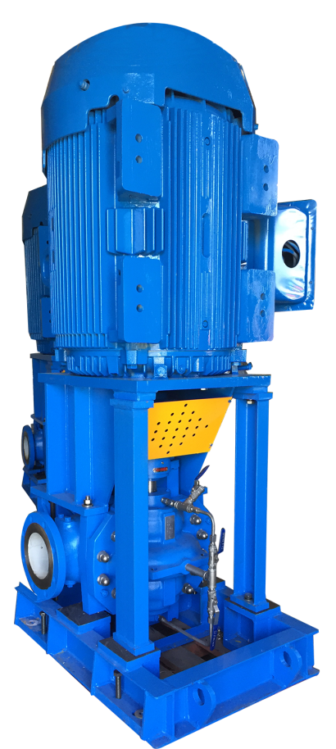
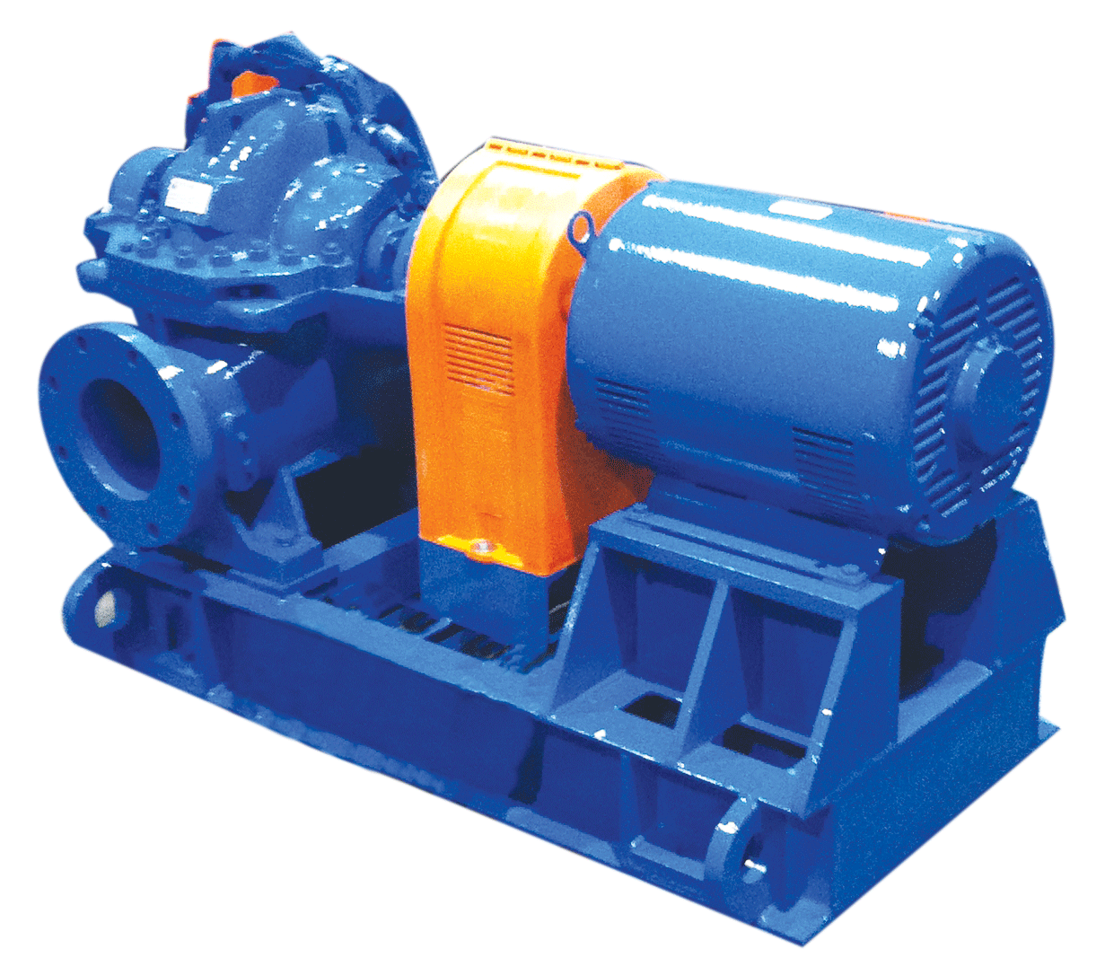
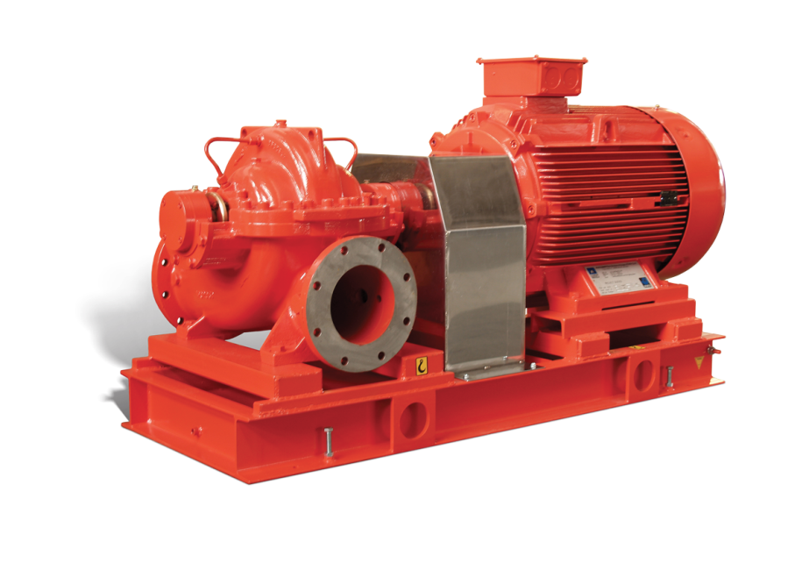

Flo Fab’s Double Suction Split Case
Series 4800/4800V/4800H/4900
Type: Horizontally Mounted, Single Stage, Double Suction Split Case,
Capacities: up to 12700 USGPM(2884 m3/hr),
^{Head: up to 625 ft.(190 m),}
^{Pressure: up to 600 PSI} ^{(4136 kpa),}
^{Horsepower:} ^{up to 1750 HP(1305 KW)}
^{Drives:} Electric Motors, Diesel Engines, Steam Turbines
^{Applications:} ^{Water / Glycol}
^{Temperature:} ^{up to 300°F (149°C)}
Constr. Materials: Cast Iron, Bronze Fitted as Standard, Other
^{Materials Also Available}
Horizontal
Available in fire

Slide 24
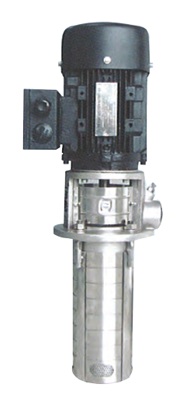
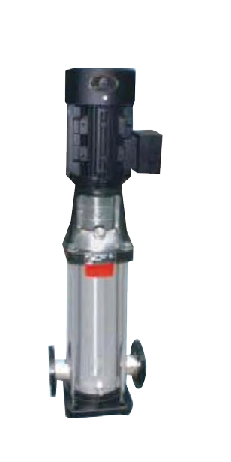
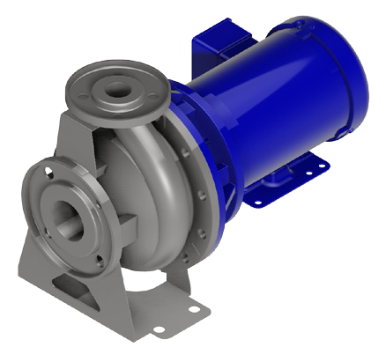
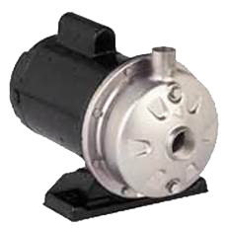
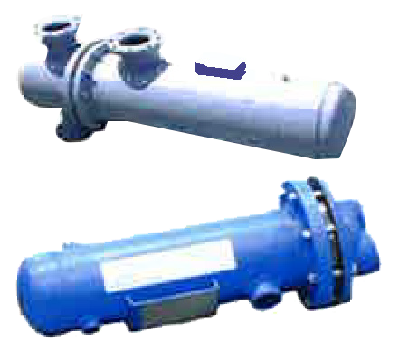
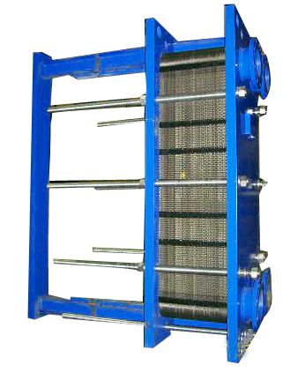
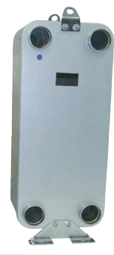
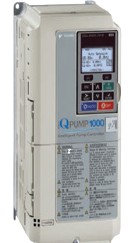
MULTISTAGE, CLOSED COUPLED STAINLESS STEEL PUMPS
SHELL AND TUBE, PLATE AND FRAME, BRAZED TYPE HEAT EXCHANGERS
SERIES | PSMCF | PSM | PSF | PST
SIMILAR TO |  | 1535 / 4700 / CR |  | SCX / 1700
TYPE | Vertical Multistage | Vertical Multistage | Flanged Close Coupled Centrifugal | NPT Close Coupled Centrifugal
CAPACITIES | up to 250 USGPM (56 m³/hr) | up to 792 USGPM (180 m³/hr) | 13 to 380 USGPM (3 to 86 m³/hr) | up to 52 USGPM (12m³/hr)
HEAD | up to 930 ft. (283 m) | up to 930 ft. (283 m) | up to 150 ft. (46 m) | up to 150 ft. (46 m)
PRESSURE | up to 430 PSI (2964 kPa) | up to 430 PSI (2964 kPa) | up to 145 PSI (1000 kPa) | up to 115 PSI (793 kPa)
HORSEPOWER | up to 50 HP (37 kW) | up to 100 HP (75 kW) | up to 15 HP (11 kW) | up to 3 HP (2.2 kW)
DRIVES | Vertical Electrical Motor | Vertical Electrical Motor | Electric Close Coupled Motors | Vertical Electrical Motor
APPLICATIONS | Water and Clear Liquids | Water and Clear Liquids | Water and Clear Liquids | Water and Clear Liquids
TEMPERATURE | 5°F(-15°C) to 248°F (120°) | 5°F(-15°C) to 248°F (120°) | up to 225°F (107°C) | up to 225°F (107°C)
CONSTRUCTION MATERIAL | #304 Stainless Steel Optional #316 S/S | Cast Iron as Standard, or Stainless Steel #304 & #316 | #304 Stainless Steel | #304 Stainless Steel
 | Shell and Tube Heat Exchangers |  | Plate and Frame Heat Exchangers | Brazed Heat Exchangers
SERIES | ‘‘W’’ | ‘‘S’’ | ‘‘FFW’’ AHRI | ‘‘BR’’ | IQP1000 / ACH550
TYPE | Water to Water / Glycol to Water | Steam to Water | Steam to Water Water to Water Glycol to Water | Steam to Water Water to Water Glycol to Water | VFD Flo Fab’s Prefered* 200-240V / 3-Phase 380-480V / 3-Phase 500-600V / 3-Phase
CAPACITIES | up to 3000 USGPM 681 m³/hr up to 250 PSI (1724 kpa) Steam |  | up to 10000 USGPM 2271 m³/hr up to 250 PSI (1724 kpa) Steam | up to 400 USGPM 91 m³/hr up to 150 lbs Steam | 150% for 60 sec. (HD), 120% for 60 sec. (ND)
PRESSURE | 150 PSI (1034 kPa) 250 PSI (1724 kPa) |  | 300 PSI (2068 kPa) | 300 PSI (up to 2068 kPa)
APPLICATIONS | Water, Glycol or Steam |  | Water, Glycol or Steam | Water, Glycol or Steam
TEMPERATURE | up to 300°F (144°C) |  | up to 300°F (144°C) | up to 300°F (144°C)
CONSTRUCTION MATERIAL | Carbon Steel or Stainless Steel with Stainless Steel Tubes |  | Carbon Steel, Titanium and Stainless Steel. Other Materials available | Titanium and Stainless Steel. Other Materials available

Slide 25
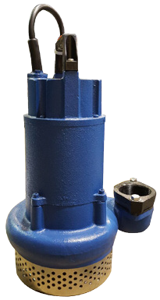
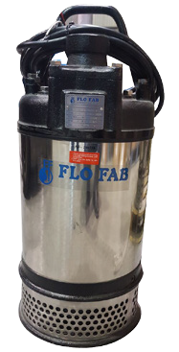
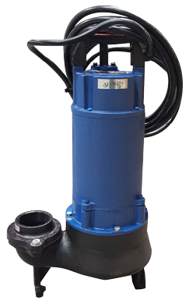
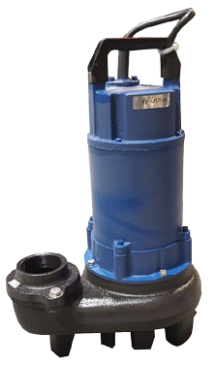
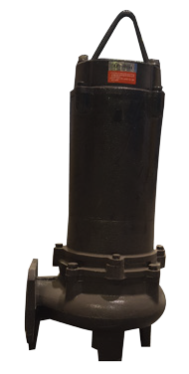
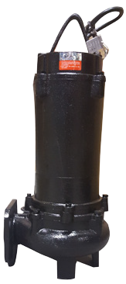
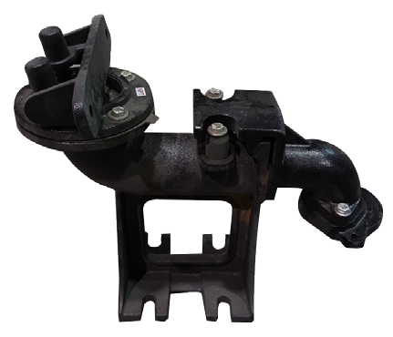
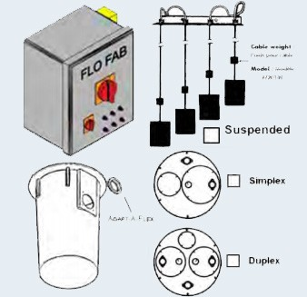
SUBMERSIBLE PUMPS
PLUMBING
SERIES | LB-25, 40,75, 215 & 315 | FS-237, 337 & 437, 475, 675, 4110, 6110, 8110 | LBV-40 | LBV-75, 215 & 315 | LBK-75 | LBK-215 & 315
TYPE | Effluent Pump | Multi-Purpose Drainage Pump | Effluent & Sewage Vortex Pump |  | Effluent | Sewage Non Clog Pump
CAPACITIES | up to 175 USGPM (40 m³/hr) | up to 1400 USGPM (317 m³/hr) | up to 159 USGPM (36 m³/hr) |  | up to 185 USGPM (42 m³/hr)
HEAD | 8 to 72 ft. (2.4 to 21.5 m) | 10 to 163 ft. (3 to 49 m) | 4 to 59 ft. (1.2 to 18m) |  | 10 to 59 ft. (3 to 18m)
PRESSURE | 3/8″ (9 mm) | 3/4″ (19 mm) | 3/4″ (19mm) | 2″ (50mm) | 3/4″ (19mm) | 2″ (50mm)
HORSEPOWER | up to 1 HP (0.75 kW) | up to 30 HP (22 kW) | up to 1 HP (0.75 kW) |  | up to 1 HP (0.75 kW)
DRIVES | Air Filled Electrical Motors Explosion Proof | Air Filled Electrical Motors Explosion Proof | Air Filled Electrical Motors Explosion Proof |  | Air Filled Electrical Motors Explosion Proof
APPLICATIONS | Water | Water | Water, Sewage & Waste Liquids |  | Water | Water & Waste Liquids
TEMPERATURE | up to 200°F (94 °C) | up to 200°F (94 °C) | up to 200°F (94 °C) |  | up to 200°F (94 °C)
CONSTRUCTION MATERIALS | Cast Iron | Cast Iron and Stainless Steel | Cast Iron |  | Cast Iron
SERIES | FBV-332 | FBV-337 & 437 | FGC-015 / FGC-022 | BAF | Sub Accessories
 |  |  | FGC-037 / FGC-055
TYPE | Sewage Non Clog Pump |  | Sewage Grinder Pump | Break Away Fitting
CAPACITIES | up to 317 USGPM 72 m³/hr |  | up to 61 USGPM 14 m³/hr
HEAD | 8 to 66ft (2.4 to 20 m) |  | 17 to 105ft (5.2 to 32 m)
PRESSURE | 2″ (50 mm) | 3″ (80 mm) | 3/4″ (19 mm)
HORSEPOWER | up to 5 HP (3.7 kW) |  | up to 5 HP (3.7 kW)
DRIVES | Air Filled Electrical Motors Explosion Proof |  | Air Filled Electrical Motor Explosion Proof
APPLICATIONS | Water, Sewage & Waste Liquids |  | Water, Sewage & Waste Liquids
TEMPERATURE | up to 200°F (94°C) |  | up to 200°F (94°C)
CONSTRUCTION MATERIAL | Cast Iron |  | Cast Iron | Cast Iron

Slide 26
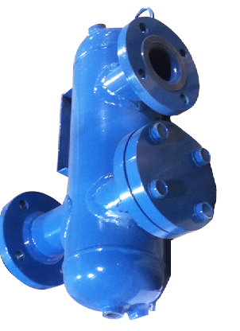
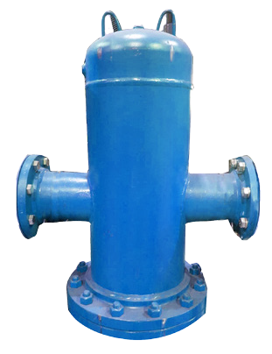
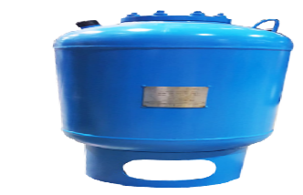

ASME TANKS & AIR SEPARATORS
SERIES | SEP | ADSR/AD | RDT/BT | RLU / RWU | RSE
SIMILAR TO | RL | 4900 | RDT: AX / OT / NTA / CAX / D BT: AL / NLA / CA / B / ST-DHW
TYPE | Vortex - Tangential Air Separator (With or Without Strainer) | In-Line Air/Dirt Sepa- rator (With Strainer) | Non Replaceable Bladder Expansion Tank | Hot Water Storage Tank with Heater | Hot Water Storage Tank
 |  |  | Replaceable Bladder Exp. Tank (with bottom system connection)
CAPACITIES | 56 to 67000 USGPM (13 to 15217 m³/hr) | 69 to 12100 USGPM (16 to 2748 m³/hr) | 3 to 3962 Gallons (11 to 15000 liters) | 100 to 15000 Gallons (379 to 56781 liters)
CONNECTIONS | 2″ to 36″ Diameter (50 mm to 914 mm) | 2″ to 36″ Diameter (50 mm to 914 mm) | 1″ to 3″ 25 mm to 75 mm | As Requested
PRESSURE | up to 250PSI (1724 kPa) | up to 250PSI (1724 kPa) | up to 250PSI (1724 kPa) | up to 250PSI (1724 kPa)
TEMPERATURE | up to 550°F (288°C) | up to 550°F (288°C) | up to 240°F (115°C) | up to 550°F (288°C)
CONSTRUCTION MATERIAL | Carbon Steel or Stainless Steel | Carbon Steel or Stainless Steel | Carbon Steel EPDM | Carbon Steel or Stainless Steel
  Heating and Cooling Systems
  Module HC will be composed of two pumps, control panel VFD, expansion tank, air separator, chemical pot Feeder, and glycol fill sys- tem (optional), balancing valves, isolation valves, air vents and drain connections, multifunction valves, suction diffusers or Y strainers, interconnecting black steel schedule 40 piping. All package compo- nents are mounted on a structural steel base with lifting lugs.
.

Slide 27














HYDRONIC ACCESSORIES
FLEXIBLE - ST
Material: Steel and Stainless Steel Pressure : 475 PSIG at 850°F with water Size Range : 1/2″ to 2″
Connections: Threaded
AIR VENT - MV
Material: Cast Iron
Pressure: MV15 150 PSIG at 345°F
MV15 300 PSIG at 400°F
Size Range : 3/4″
Connections : Threaded
PRESSURE AND OR TEMPERATURE PORTS
Material : Bronze
Pressure : 1000 PSIG at 140°F
Size Range : 1/4″
Connections: SS2501 :Threaded
SS2511 : Threaded Extended
UNION ARCH FLEXIBLE - DUT
Material : Steel Union and EPDM
Pressure : 214 PSIG at 250°F with water
Size Range : 1/2″ to 12″
Connections: Threaded Double
AIR VENT - AA
WAFER CHECK VALVE - LSDDB
Material: Cast Iron Body, Stainless Steel
Disc, EPDM Seat Pressure: 175 PSIG at 225°F up to 12″
150 PSIG at 250°F
from 14″ to 24″ Size Range : 2″ to 24″ Body Style : Wafer
Material: Brass
Pressure: 150 PSIG at 200°F Size Range : 1/8″ and 1/4″ Connections : Threaded
STANDARD FLANGED CONNECTOR - SM
Material: Steel and Stainless Steel Pressure: 125 PSIG at 450°F wih water Size Range : 2″ to 16″
Body Style : Flanged
BUTTERFLY VALVE - BFVZ - L
Material: Cast Iron Body, Stainless Steel
Disc, EPDM Seat Pressure : 175 PSIG at 225°F up to 12″
150 PSIG at 250°F
from 14″ to 24″ Size Range : 2″ to 24″ Body Style : Lug
SUCTION DIFFUSER - ASDFF
Material: Cast Iron Body, Stainless Steel Sceen Pressure: 175 PSIG at 250°F with water
200 PSIG at 150°F with steem
Size Range : 2″ to 20″
Connections : Flanged
SINGLE ARCH FLEXIBLE - SSP & DSP
Material: Steel Flanged and EPDM Pressure: 214 PSIG at 240°F with water Size Range : 1 1/2″ to 14″
Connections: SSP Flanged Single
DSP Flanged Double
MULTIFUNCTION VALVE - MFV
Material: Ductile Iron and Stainless Steel Disc Pressure: 150 PSIG at 225°F
Size Range : 2″ to 18″
Connections: MFV-F: Flanged
2000 - FIXED BLADDER EXPANSION TANK
Capacities: 2 to 132 Gallons (8 to 528 liters) Pressure: up to 150PSI (1034kpa) Temperature : up to 200°F (93°C)
Materials: Carbon Steel, Butyl
9

Slide 28







Quotation Requirements for Skid Package
What we need ?
1.1 System PID
1.2 Pumps, Tanks and Heat Exchangers Schedule
1.3 Cut sheets for non Flo Fab parts like
ex. Boilers, Chillers, etc...
1.4 Skids footprint
1.5 Mechanical room footprint
1.6 Details sequence of control
Quality Control
All pumps are factory tested and certified performance
test is available when requested by the consultant.
Test facilities up to 400 HP with 27,000 gallon test
bench with calibrated instruments...
2.1 Heating and Cooling Systems
2.2 Module HC will be composed of two pumps, control panel VFD, expansion tank, air separator, chemical pot Feeder, and glycol fill system (optional), balancing valves, isolation valves, air vents and drain connections, multifunction valves, suction diffusers or Y strainers, interconnecting black steel schedule 40 piping. All package components are mounted on a structural steel base with lifting lugs....

Slide 29
Explanation Videos…
https://youtu.be/rEgjRUsB8jM Miami Hospital
https://youtu.be/1pRTIxS817g Shop
https://youtu.be/ZNccm-E3Ras Skid Lifting

Slide 30



Slide 31


Slide 32


Slide 33

.

Slide 34
Skid Advantages
- Solution for both : New construction and Retrofit.
- Easily add more modules for future expansion.
- One single point of Responsibility / Contact .
- One single submittal for approval Vs. Individual ^{submittals for each component.}
- Financial : Cost reduction, Effectively reduce total cost of ownership for all project stake holders (Contractor / Consultant Engineer / End User)
- Financial : Space saving due to optimized space utilization.
- Financial : Time (Cost) saving : Skid built in parallel during building construction, also .
^{- Financial : : Cash flow} management: One single invoice / payment for all ^{works}
- Financial :: Overhead saving including project management, logistical
coordination, insurance expense, ...etc.
- Financial : No surplus or extra components left after
^{fabrication by contractor.}
- Time (Cost) saving : No construction delay due to
missing one single component order, wrong delivery
^{or defective component.}
- Quality: Assembly within controlled environment by
certified technicians / welders using approved work
^{methods / procedures.}
- Quality / Financial : Factory wired and tested = site
^{plug & play}
- Safety: Avoid unpleasant site safety incidents and
lost days as we tremendously minimize job site
^{man-hours.}

Slide 35









Modularized Packaged Chilling System
Produced within Controlled Environment :
    Manufactured, Not Constructed
    Proven Engineered Design and Fabrication Standards
    Strict Quality Control
    Controlled Environment with High Safety Standards
    Established Knowledgeable Skilled Workforce
    Job Site Progress / Conditions Irrelevant to Production
Notes:
35

Slide 36


Multiple Chillers

Slide 37




Maintenance Enhancements :
Chiller Tube Service Access
Notes:
37

Slide 38

Overhead Gantry and Chain Pulley Block
Maintenance Enhancements :
Pump removal Design
Notes:
38

Slide 39

How it look like in the field inside the building ?

Slide 40


High Profile Jobs

Slide 41


Slide 42

How it look like inside a shelter ?

Slide 43

How it look like in the field outside the building ?
* How it look in the field outside the building.

Slide 44



Packaged
Systems
BOI
Boiler
Package
D-CPS-HT Duplex
Constant Pressure
System
CHI
Chiller
Package

Slide 45



Packaged
Systems
LCOO Large Cooling Package
HCE Heating
Cooling with Enclosure

Slide 46



Enclosures

Slide 47

Video: https://mail.google.com/mail/u/0/#inbox?projector=1

Slide 48
Industry leading – 25-year Warranty
Exclusive FiberBeam™ and
FiberWrap ™ Technology
Built to highest standards
Superior responsiveness and attention
to detail in all phases of a project.

Slide 49

Enclosure installation on skid package

Slide 50

Complete assembly with Shelter Works enclosure

Slide 51

How to rig equipment

Slide 52

Special package delivery

Slide 53



Slide 54


Slide 55


Slide 56

World trade center Nyc

Slide 57


Slide 58


















Modular packaged Chilling Systems
- Solutions to Suit Every Application
Apartment units
Lodging
Schools
Colleges & Universities
Hospitals
High Technology
Homes
Retail
Shopping Malls
Government
Life Sciences
Airports
High-rise Apartments
Medical Clinics
Small Commercial
Large Commercial
Arenas/Convention Centers
Residential Mid Market Complex

Slide 59



OTHERS !!!!!! Middle East Project List
(Sep 2012)
# | Year | Project / Client | Application | Type of Plant | Country | Qty | Total Tons | Voltage
1 | 2005 | Empower-1 | District Cooling | Mobile Temporary Plant | UAE | 7 | 12,300 | 3300 / 400
2 | 2005 | Tabreed | District Cooling | Mobile Temporary Plant | Bahrain | 2 | 2,400 | 400
3 | 2005 | Dubai Festival City | District Cooling | Permanent Plant | UAE | 10 | 50,000 | 11000 / 400
4 | 2006 | Dubai Investment Park | District Cooling | Permanent Plant + ETS | UAE | 3 | 12,000 | 11000 / 400
5 | 2006 | Deira City Centre | Shopping Mall | Replacement Permanent Plant | UAE | 2 | 2,600 | 11000 / 400
6 | 2007 | Dubai World Trade Centre | Residential Bldgs | Mobile Temporary Plant | UAE | 2 | 2,400 | 11000 / 400
7 | 2007 | Empower-2 | District Cooling | Mobile Temporary Plant | UAE | 8 | 20,000 | 11000 / 400
8 | 2007 | Emicool | District Cooling | Mobile Temporary Plant | UAE | 4 | 4,800 | 11000 / 400
9 | 2008 | Al Naboodah | Villa Complex | Permanent Plant (Screw Chlrs) | UAE | 1 | 1,200 | 400
10 | 2008 | Empower-3 | District Cooling | Mobile Temporary Plant | UAE | 9 | 22,000 | 3300 / 400
11 | 2008 | Empower-4 | District Cooling | Mobile Temporary Plant | UAE | 1 | 2,000 | 3300 / 400
12 | 2008 | Al Naboodah Extension | Office Bldg | Permanent Plant (Screw Chlr) | UAE | 1 | 400 | 400
13 | 2009 | Dubai World Trade Centre | Exhibition Hall | Long Term Temporary Plant | UAE | 2 | 4,000 | 11000 / 400
14 | 2009 | Saudi ARAMCO | Office Bldg | Permanent Plant | Saudi | 1 | 4,000 | 4160 / 460
15 | 2010 | Al Rayyana / Sorouh | Residential Bldgs | Permanent Plant | UAE | 1 | 7,200 | 11000 / 400
16 | 2011 | Malaiha Camp / Tabreed | Military Camp | Permanent Plant | UAE | 2 | 10,000 | 11/3.3kV/400
17 | 2011 | Capitala Rihan Heights | Residential Bldgs | Permanent Plant | UAE | 1 | 4,000 | 11000 / 400
18 | 2011 | Sh. Zayed University | University Campus | Permanent Plant | UAE | 2 | 9,450 | 11000 / 400
19 | 2011 | GASCO (OilCo) | Indl. Refrigeration | Replacement Permanent Plant | UAE | 1 | 1,300 | 3300 / 400
20 | 2012 | Empower-5 | District Cooling | Mobile Temporary Plant | UAE | 8 | 20,000 | 11000 / 400
21 | 2012 | Emirates Hangars | Hangar Cooling | Permanent Plant | UAE | 1 | 3,080 | 400
 |  |  |  |  | Total | 69 | 195,130
Regional Medical Center
Muskogee, OK, USA
The Gazette
Montréal, QC, CA
Research and Medical Clinic
Tulsa, OK, USA

Slide 60






More Jobs
Canadian National
Montreal QC, CA
Montreal’s Archives
Montreal, QC, CA
Muskogee Regional
Medical Center
Muskogee, OK, USA
The Gazette
Montréal, QC, CA
Wawanesa
Mont-Royal, QC, CA
Research and Medical Clinic
Tulsa, OK, USA

Slide 61

More Jobs

Slide 62


Slide 63
Thank You for
Your participation!
Visit our Website
www.flofab.com

