Slide 1



Slide 2


History
Flo Fab was established in 1981 by Denis Gauvreau who created and developed
the products line and constantly being perfected by Marc Gauvreau, as well as by
a team of professional engineers and designers. It’s a combination of existing designs from several renowned products and the innovative ideas of a new generation professionals.
Through the years, Flo Fab has acquired several companies and service entities including : AQUA-PROFAB (ASME Tanks manufacturer), MÉNARD, LÉONARD ÉLECTRIQUE, PMA. , Furthermore Flo Fab purchased equipment, fabrication designs and patterns from IDEALCO, a manufacturer of shell and tube type heat exchangers.
The after sales services, sales, engineering, R&D, production, quality control, accounting and administration departments of all the above companies share the same location.
In December 2014, Marc Gauvreau, son of the founder, acquired all shares of The company. Flo Fab and is constantly investing in new state of the art innovations new product like the XRI series and Prefab Skid for Hydronic Hearing 8 cooling system, pumping systems. This has allowed Flo Fab to retain competent and experienced staff of professionals with varied and specialized abilities that constantly work on improving our existing products and add new engineered solutions that exceeding customer’s expectations .
Flo Fab has grown quite rapidly and now proudly offers of a wide range of products available directly from one manufacturer. This includes pumps & pump packages, tanks, heat exchangers & hydronic accessories. This allows each project stakeholders to enjoy economical savings, peace of mind, best value for their investment and optimized total cost of ownership.

Slide 3
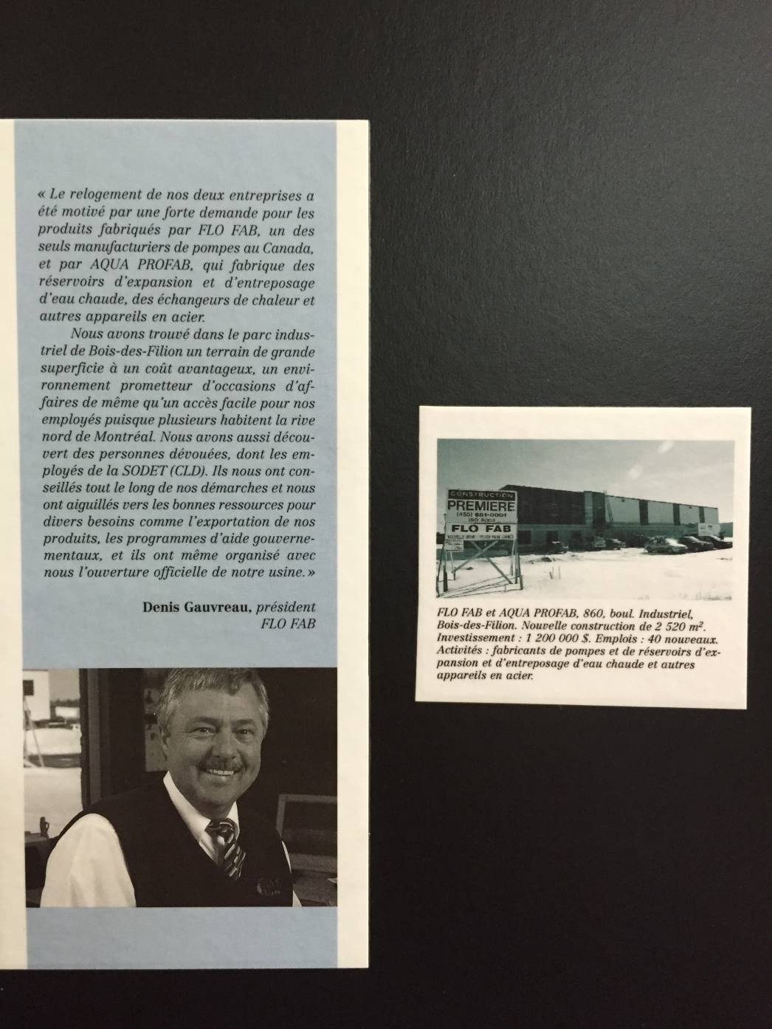
New facility 2001 Local Newspapers Annoucement

Slide 4

Denis sold the FLO FAB to Marc on DEC 2014

Slide 5
Flo Fab Pumps
Flo Fab Pumps
Overview: Design philosophy, common features, etc…
Vertical Inline
  Circulators, closed-coupled, spacer-coupled
Base-mounted
  End suction, closed-coupled, spacer-coupled,
  split case, double-suction, unique configurations
Submersibles
  Sewage, effluent, column, stainless steel, duplex,
  panels, accessories

Slide 6


Reliability & Durability
All pumps are with both casing & impeller wearing rings as standard.
Seals are Viton® with silicon carbide hard faces (NOT Carbon ceramic) for additional heat and chemical resistance.
All seals are rated up to 300ºF as standard.
Standard Motors, Seals, Bearings and couplings.
Heavy industrial class pump casing as it is poured to withstand 300 psi (Flange std.=150psi)
Higher efficiency due to smooth surfaces enhancing fluid mechanics as pump casting molds made from resin pattern NOT wood.
Notes:
John Crane Type 21 Mechanical seal !!! Features
The drive band's "dent and groove" design eliminates overstressing of the elastomer bellows to prevent bellows slip and protect the shaft and sleeve from wear.
Non-clogging, single-coil spring provides greater dependability than multiple spring designs and will not foul due to fluid contact.
Flexible elastomer bellows automatically compensates for abnormal shaft-end play, run-out, primary ring wear and equipment tolerances.
Parameters
Temperature Limits-40°F to 400°F/-40°C to 205°C (depending on materials used)
Pressure Limits150 psi(g)/10 bar(g)
Speed LimitsUp to 2500fpm/13m/s, depending on configuration and shaft size

Slide 7
Quality Control
All 600, 840SC, 880, 880RI, XRI, PSM series pumps are factory tested
Test facilities up to 400 HP with 27,000 gallons test bench with calibrated instruments
Factory designs using Inventor, Revit Files and CAD drawings
Upgraded factory limited warranty 5/8 Years

Slide 8
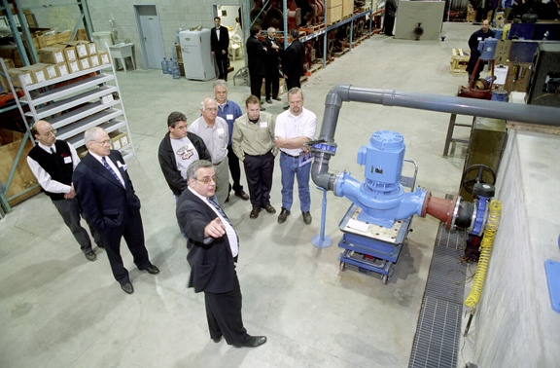
Facility Test Bench up to 400Hp

Slide 9
More than 60% of US projects at the bid phase originate with MASTERSPEC
Proud approved supplier for MASTERSPEC

Slide 10
Web capability’s of www.flofab.com
Pump Selections
Expansion Tank Selections
Plate and Frame Heat Exchanger Selections
Hot Water Storage Selections
Make your own quotes
Make your own customer quotes
www.flofab.com

Slide 11

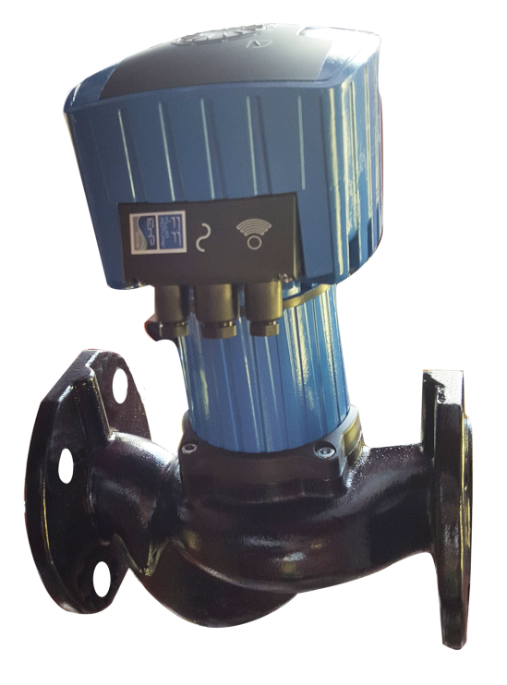
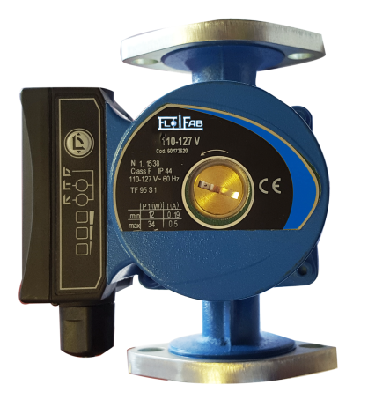
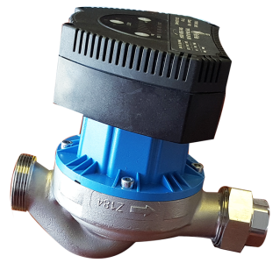
Circulating Pump - Flo Fab Pumps
Series 500
^{Type: Circulating Pump}
^{Capacities: up to 234 USGPM,} ^{54 m3/hr}
^{Head: up to 43 ft.(14 m)}
^{Pressure: up to 145 PSI} ^{(999 kpa)}
^{Horsepower:} ^{up to 2/5 HP(280 kW)}
^{Drives:} ^{ECM Motor,} ^{ERP Ready}
^{Applications:} ^{Water / Glycol}
^{Temperature:} ^{up to 220°F (104°C)}
Constr. Materials: Cast Iron, Stainless, ^{Bronze}

Slide 12
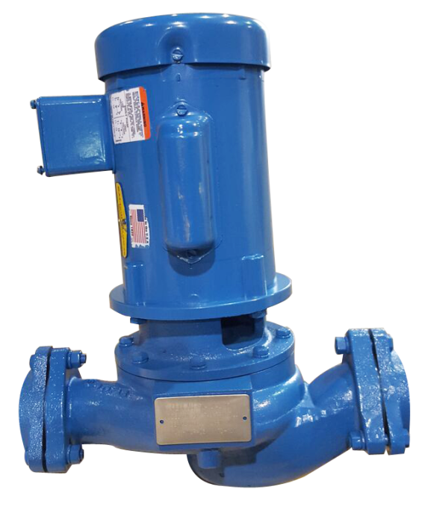
Inline Circulator - Flo Fab Pumps
Series 600
^{Type: In-Line Circulator}
^{Capacities: up to 290 USGPM,} ^{61 m3/hr}
^{Head: up to 120 ft. (37 m)}
^{Pressure: up to 250 PSI} ^{(1724 kpa)}
^{Horsepower:} ^{up to 10 HP} ^{(7.5 kW)}
^{Drives:} ^{56C Electric Motors}
^{Applications:} ^{Water / Glycol}
^{Temperature:} ^{up to 250°F (121°C)}
Constr. Materials: Cast Iron, Bronze Fitted or All Bronze

Slide 13

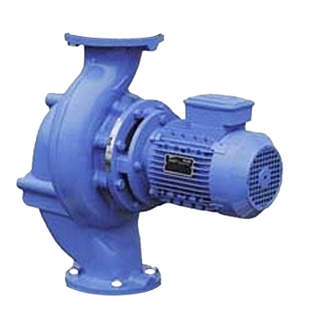
Vertical Inline - Flo Fab Pumps
Series 880
^{Type: Compact In-Line} ^{Centrifugal}
^{Capacities: up to 3000 USGPM} ^{(680 m3/hr)}
^{Head: up to 650 ft. (198 m)}
^{Pressure: up to 250 PSI} ^{(1724 kpa)}
^{Horsepower:} ^{up to 200 HP(149kW)}
^{Drives:} ^{JM Electric Motors}
^{Applications:} ^{Water / Glycol}
^{Temperature:} ^{up to 300°F (149°C)}
Constr. Materials: Cast Iron, Bronze Fitted as Standard, Other Materials Also Available

Slide 14
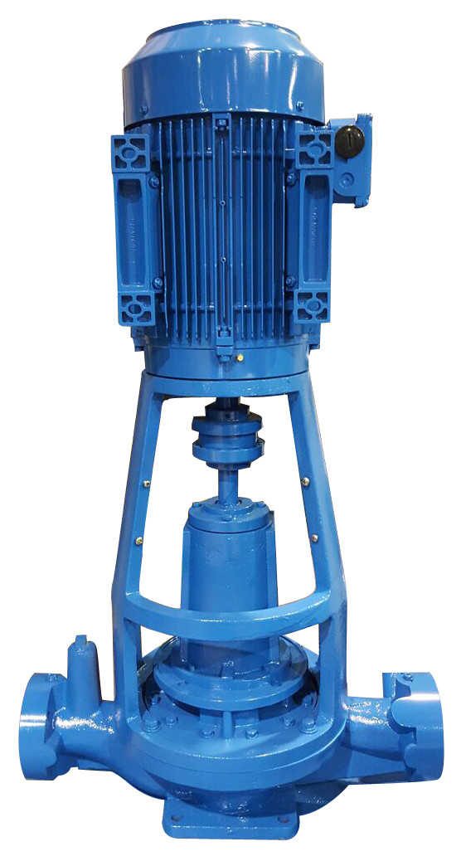
Vertical Inline - Flo Fab Pumps
Series 880RI
Type: Vertical In-Line Centrifugal Split Coupling
^{Capacities: up to 3000 USGPM} ^{(680 m3/hr)}
^{Head: up to 650 ft. (198 m)}
^{Pressure: up to 250 PSI} ^{(1724 kpa)}
^{Horsepower:} ^{up to 200 HP(149kW)}
^{Drives:} ^{TC Electric Motors}
^{Applications:} ^{Water / Glycol}
^{Temperature:} ^{up to 300°F (149°C)}
Constr. Materials: Cast Iron, Bronze Fitted as Standard, Other Materials Also Available

Slide 15
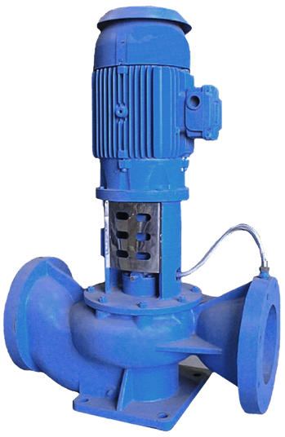
Vertical Inline - Flo Fab Pumps
Series 840SC
Type: Vertical In-Line Centrifugal Split Coupling
^{Capacities: 454 to 8000 USGPM,} ^{1816 m3/hr}
^{Head: up to 410 ft.} ^{(125 m)}
^{Pressure: up to 600 PSI} ^{(4136 kpa)}
^{Horsepower:} ^{up to 400 HP} ^{(298 kW)}
^{Drives:} ^{TC Electric Motors}
^{Applications:} ^{Water / Glycol}
^{Temperature:} ^{up to 300°F (149°C)}
Constr. Materials: Cast Iron, Bronze Fitted as Standard, Other Materials Also Available

Slide 16
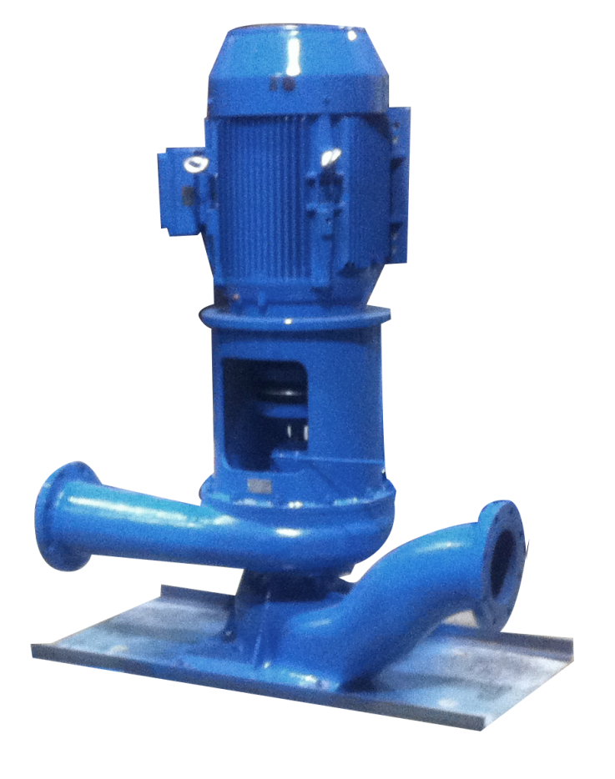
Vertical Inline - Flo Fab Pumps
Series XRI
^{Type: Universal 10 positions} ^{Vertical / Horizontal} Centrifugal Pump with removable Impeller Capacities: up to 15850 USGPM, ^{3600 m3/hr}
^{Head: up to 655ft} ^{(200m)}
^{Pressure: up to 600 PSI} ^{(4136 kpa)}
^{Horsepower:} ^{up to 1000HP} ^{(746kW)}
^{Drives:} ^{TC Electric Motors}
^{Applications:} ^{Water / Glycol}
^{Temperature:} ^{up to 300°F (149°C)}
Constr. Materials: Cast Iron, Bronze Fitted as Standard, Other Materials Also Available

Slide 17
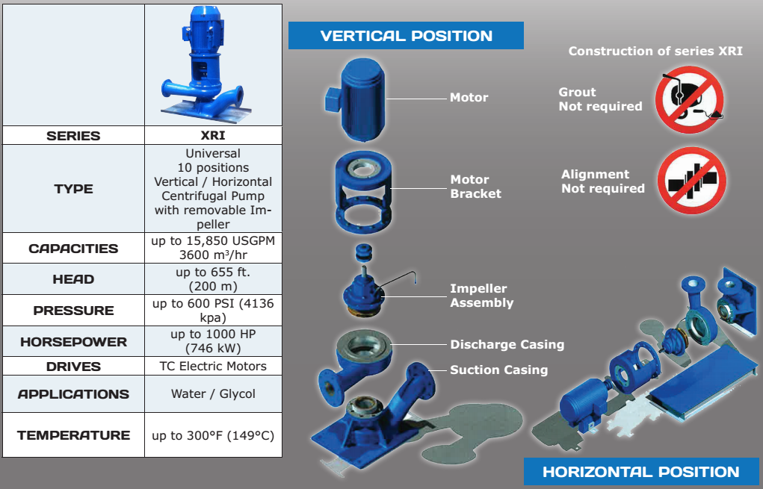
Unique XRI Pump Design & Benefits

Slide 18
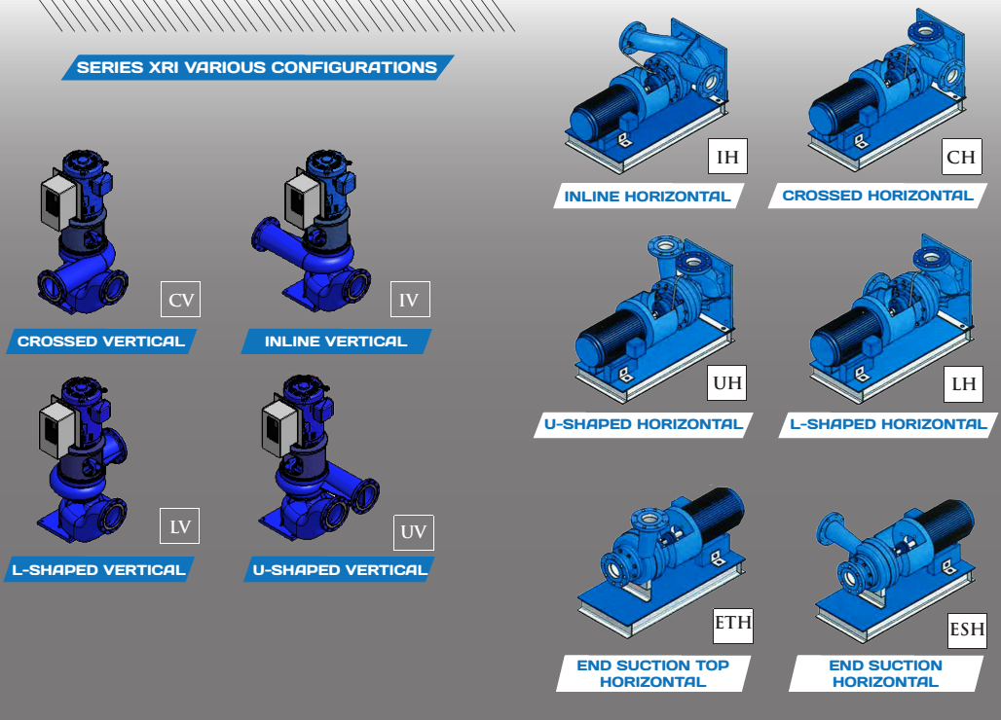
XRI Multiple Positions

Slide 19
XRI Pump Video…
https://www.youtube.com/watch?v=WVYCGdltj-o

Slide 20
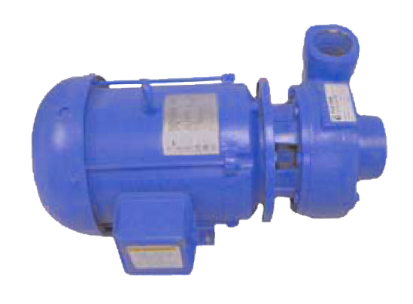
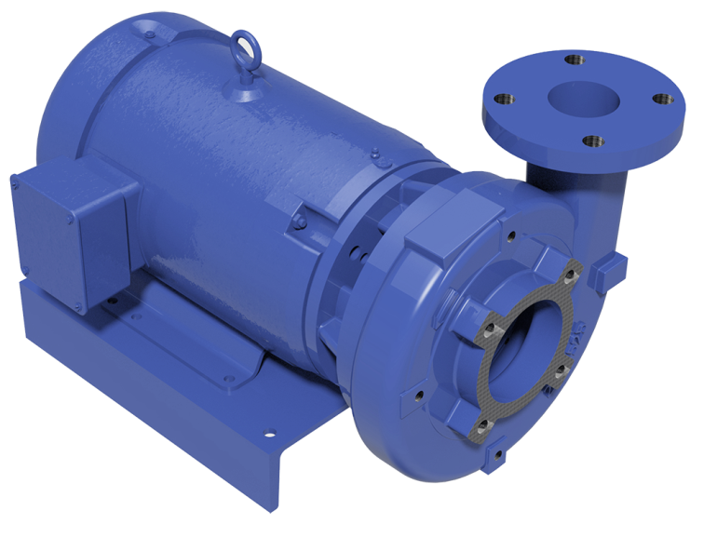
Flo Fab’s Closed Coupled Pump
Series 1000
^{Type: Universal 10 positions} ^{Vertical / Horizontal} Centrifugal Pump with removable Impeller Capacities: up to 15850 USGPM, ^{3600 m3/hr}
^{Head: up to 655ft} ^{(200m)}
^{Pressure: up to 600 PSI} ^{(4136 kpa)}
^{Horsepower:} ^{up to 1000HP} ^{(746kW)}
^{Drives:} ^{TC Electric Motors}
^{Applications:} ^{Water / Glycol}
^{Temperature:} ^{up to 300°F (149°C)}
Constr. Materials: Cast Iron, Bronze Fitted as Standard, Other Materials Also Available

Slide 21
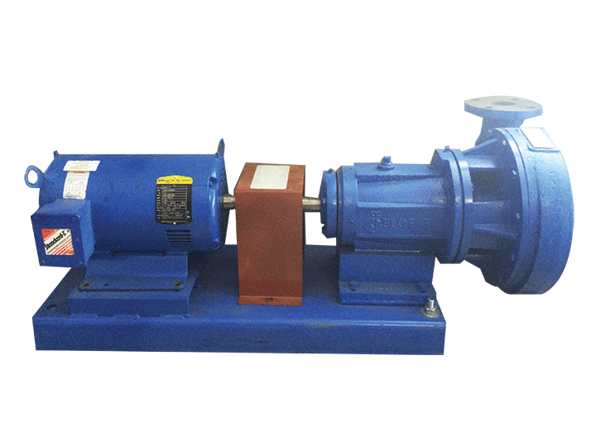
Flo Fab’s Base Mounted Pump
Series 2000
Type: Radially Split Bearing Frame Pump Mounted With Flexible Coupling ^{Back Pull Out Design}
^{Capacities: up to 1900 USGPM} ^{(431 m3/hr)}
^{Head: up to 120 ft.} ^{(37 m)}
^{Pressure: up to 175 PSI} ^{(1206 kpa) with 125# flanges}
^{Horsepower:} ^{up to 200 HP} ^{(149kW)}
^{Drives:} T Frame Electric Motors or Diesel Engines
^{Applications:} ^{Water / Glycol}
^{Temperature:} ^{up to 300°F (149°C)}
Constr. Materials: Cast Iron, Bronze Fitted as Standard, Other Materials Also Available

Slide 22
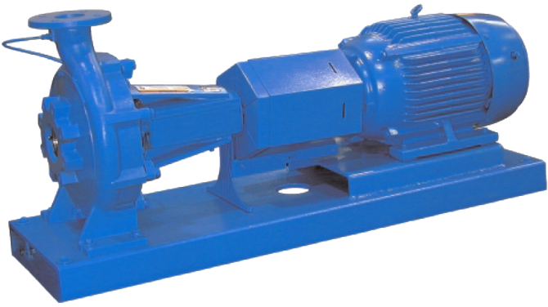
Flo Fab’s Base Mounted Pump
Series 2300/2600
Type: Radially Split Bearing Frame Pump Mounted With Flexible Coupling Back Pull Out Design
Capacities: from 1900 to 6500 USGPM ^{(432 to 1476 m3/hr)}
^{Head: up to 410 ft. (125 m)}
Pressure: up to 400 PSI (1206 kpa) with 400# flanges
^{Horsepower:} ^{up to 500 HP} ^{(373kW)}
^{Drives:} T Frame Electric Motors or Diesel Engines
^{Applications:} ^{Water / Glycol}
^{Temperature:} ^{up to 300°F (149°C)}
Constr. Materials: Cast Iron, Bronze Fitted as Standard, Other Materials Also Available

Slide 23
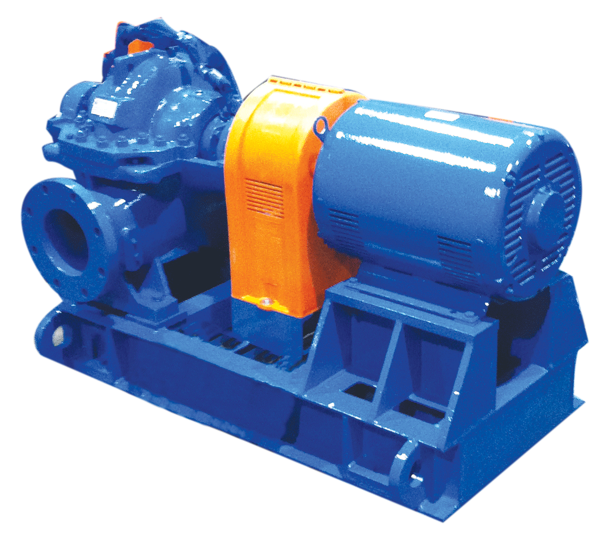
Flo Fab’s Base Mounted Pump
Series 4800/4900
Type: Horizontally Mounted, Single Stage, Double Suction Split Case
Capacities: up to 12700 USGPM (2884 m3/hr)
^{Head: up to 625 ft.(190 m)}
^{Pressure: up to 600 PSI} ^{(4136 kpa)}
^{Horsepower:} ^{up to 1750 HP} ^{(1305 KW)}
^{Drives:} Electric Motors, Diesel Engines, Steam Turbines
^{Applications:} ^{Water / Glycol}
^{Temperature:} ^{up to 300°F (149°C)}
Constr. Materials: Cast Iron, Bronze Fitted as Standard, Other Materials Also Available

Slide 24
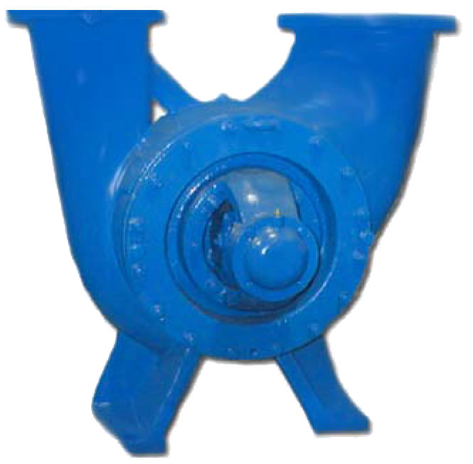
Flo Fab’s Base Mounted Pump
Series 4800U
Type: Single Stage, Double Suction Split Case
^{Capacities: up to 12000 USGPM} ^{(2725 m3/hr)}
^{Head:up to 750 ft.} ^{(227 m)}
^{Pressure: up to 600 PSI} ^{(4136 kpa)}
^{Horsepower:} ^{up to 800 HP} ^{(597 KW)}
^{Drives:} Electric Motors, Diesel Engines, Steam Turbines
^{Applications:} ^{Water / Glycol}
^{Temperature:} ^{up to 300°F (149°C)}
Constr. Materials: Cast Iron, Bronze Fitted as Standard, Other ^{Materials Also Available}

Slide 25
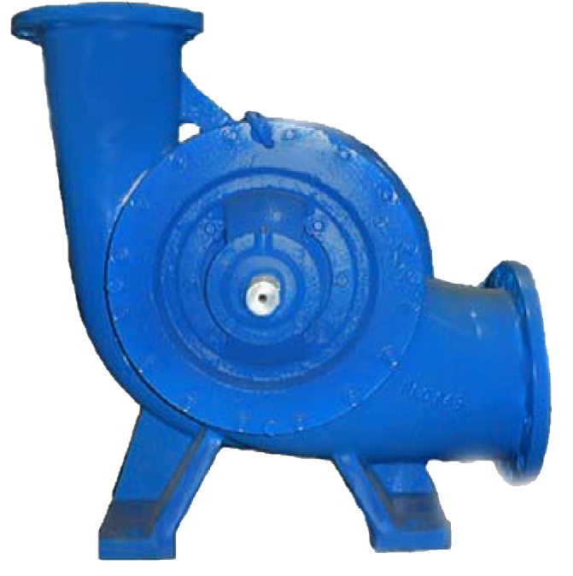
Flo Fab’s Base Mounted Pump
Series 4800L
Type: Single Stage, Double Suction Split Case
^{Capacities: up to 12000 USGPM} ^{(2725 m3/hr)}
^{Head:up to 750 ft.} ^{(227 m)}
^{Pressure: up to 600 PSI} ^{(4136 kpa)}
^{Horsepower:} ^{up to 800 HP} ^{(597 KW)}
^{Drives:} Electric Motors, Diesel Engines, Steam Turbines
^{Applications:} ^{Water / Glycol}
^{Temperature:} ^{up to 300°F (149°C)}
Constr. Materials: Cast Iron, Bronze Fitted as Standard, Other ^{Materials Also Available}

Slide 26
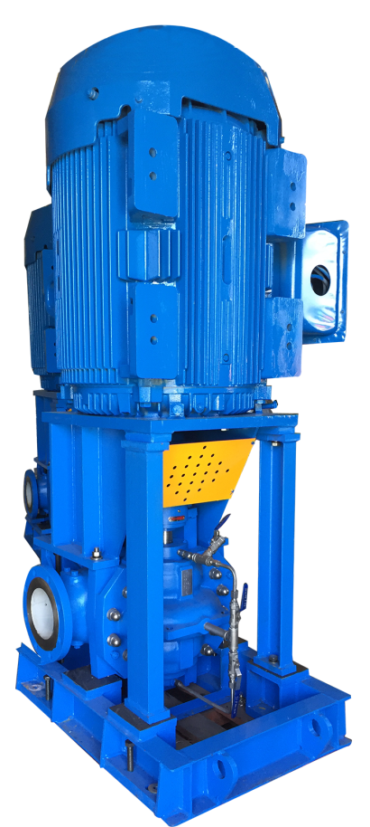
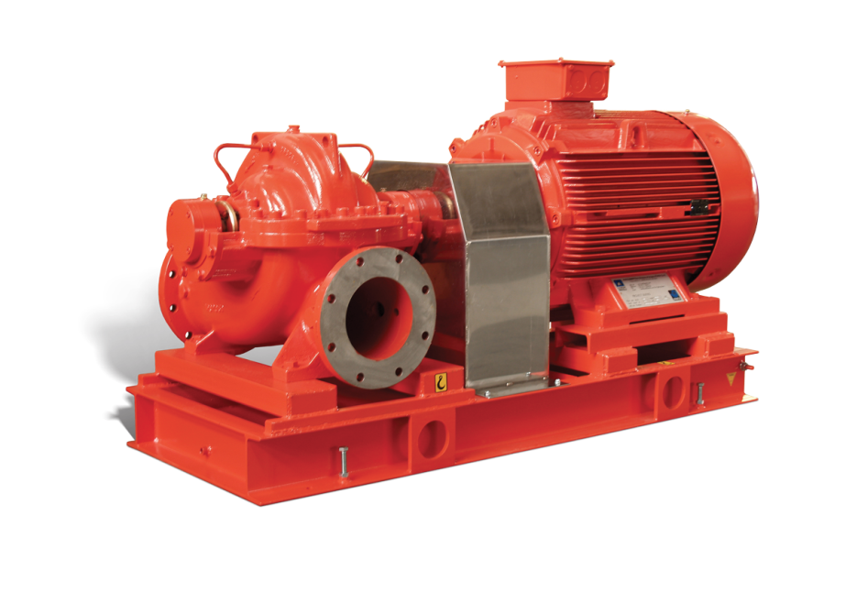

Flo Fab’s Double Suction Split Case
Series 4800/4800V/4800H/4900
Type: Horizontally Mounted, Single Stage, Double Suction Split Case,
Capacities: up to 12700 USGPM(2884 m3/hr),
^{Head: up to 625 ft.(190 m),}
^{Pressure: up to 600 PSI} ^{(4136 kpa),}
^{Horsepower:} ^{up to 1750 HP(1305 KW)}
^{Drives:} Electric Motors, Diesel Engines, Steam Turbines
^{Applications:} ^{Water / Glycol}
^{Temperature:} ^{up to 300°F (149°C)}
Constr. Materials: Cast Iron, Bronze Fitted as Standard, Other
^{Materials Also Available}
Horizontal
Available in fire

Slide 27
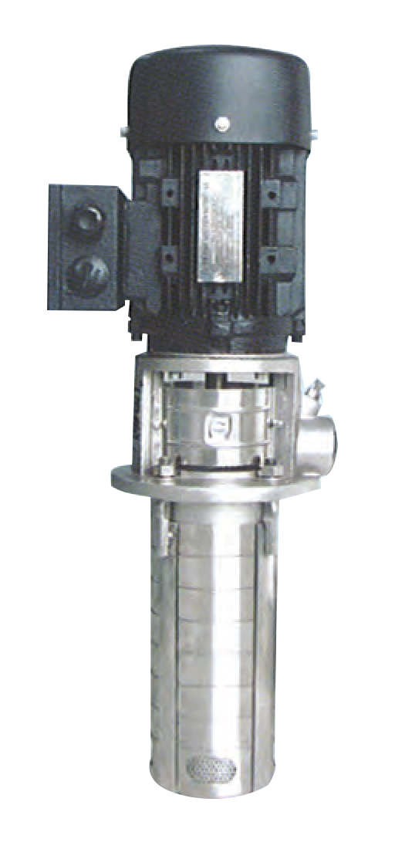
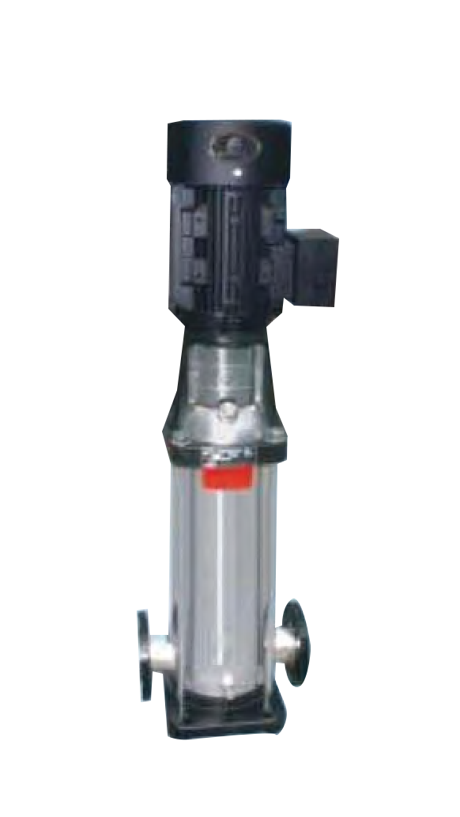
Series PSMCF/PSM
^{Type:} ^{Vertical Multistage}
^{Capacities: up to 250 USGPM} ^{(56 m3/hr)}
^{Head: up to 930 ft.(283 m)}
Pressure: up to 430 PSI(2964 kpa)
^{Horsepower: up to 50 HP} ^{(37 KW)}
Drives: Vertical Electrical Motor
Applications: Water and Clear Liquids
Temperature: 5°F(-15°C) to 248°F (120°)
Constr. Materials: #304 Stainless Steel, ^{Optional #316 S/S}
^{Vertical Multistage}
^{up to 792 USGPM} ^{(180 m3/hr)}
^{up to 930 ft.(283 m)}
^{up to 430 PSI(2964 kpa)}
^{up to 100 HP(75 KW)}
^{Vertical Electrical Motor}
^{Water and Clear Liquids}
^{5°F(-15°C) to 248°F (120°)} ^{Cast Iron as Standard, or} ^{Stainless Steel#304 & #316}

Slide 28
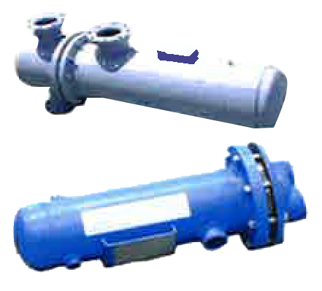
Shell and Tube
Heat Exchanger
Series: ‘‘W’’ & ^{‘‘S’’}
Type: Water to Water /Glycol to Water Steam to Water
^{Capacities:} ^{up to 3000 USGPM,} ^{up to 250 PSI} ^{(1724 kpa) Steam}
^{Pressure: 150 PSI (1034 kpa)} ^{250 PSI (1724 kpa)}
Applications: Water, Glycol or Steam
^{Temperature:} ^{up to 300°F (144°C)}
^{Constr. Materials:} Carbon Steel or Stainless Steel
^{with Stainless Steel Tubes}

Slide 29
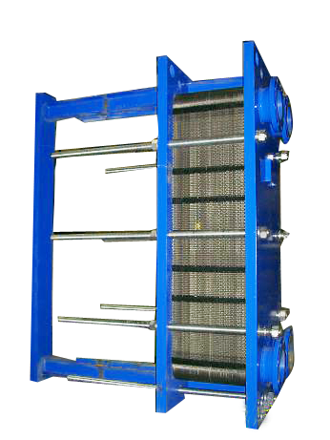
Plate and Frame
Heat Exchanger
^{Series:} ^{‘‘FF’’ AHRI}
Type: Steam to Water/Water to Water/Glycol to Water
Capacities: up to 14000 USGPM, up to 250 PSI ^{(1724 kpa) Steam}
^{Pressure: 300 PSI (2068 kpa)}
^{Applications:} ^{Water, Glycol or Steam}
Temperature: up to 300°F (144°C)
Constr. Materials: Carbon Steel, Titanium and ^{Stainless Steel.}
^{Other Materials available}

Slide 30
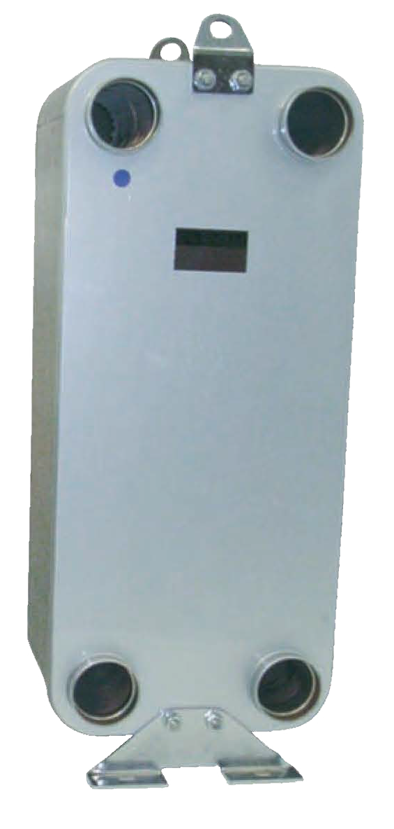
Brazed
Heat Exchanger
^{Series:} ^{‘‘BR’’}
^{Type: Steam to Water/} ^{Water to Water/} ^{Glycol to Water}
Capacities: up to 400 USGPM up to 150 lbs Steam
^{Pressure:} ^{up to 300 PSI (up to 2068 kpa)}
Applications: Water, Glycol or Steam
Temperature: up to 300°F (144°C)
Constr. Materials: Titanium and ^{Stainless Steel.}
^{Other Materials available}

Slide 31
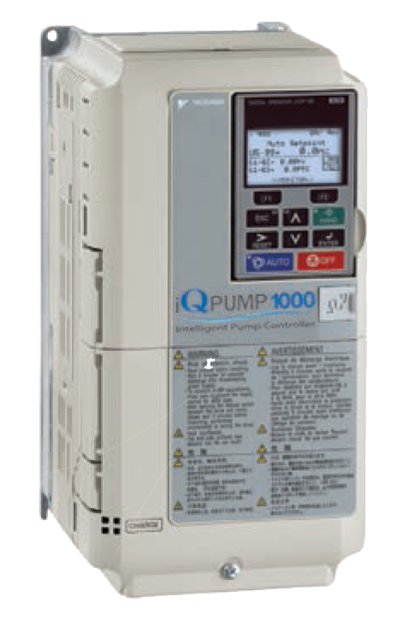
IQP100/ACH550
^{Type:} ^{VFD -} ^{Flo Fab’s Prefered*}
200-240V / 3-Phase -- 380-480V / 3-Phase -- ^{500-600V / 3-Phase}
Capacities: 150% for 60 sec. (HD), 120% for 60 sec. (ND)

Slide 32
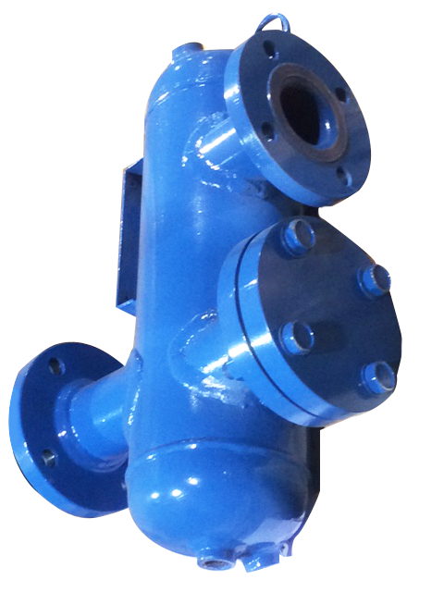
SEP Series
^{Type:} ^{Vortex - In-Line,} Air Separator (With or Without Strainer)
^{Capacities:} 56 to 67000 USGPM(13 to 15217 m3/hr)
^{Connections:} 2″ to 36″ Diameter (50 mm to 914 mm)
^{Pressure: up to 250PSI} ^{(1724 kpa)}
^{Temperature:} ^{up to 550°F (288°C)}
Constr. Materials: Carbon Steel or Stainless Steel

Slide 33
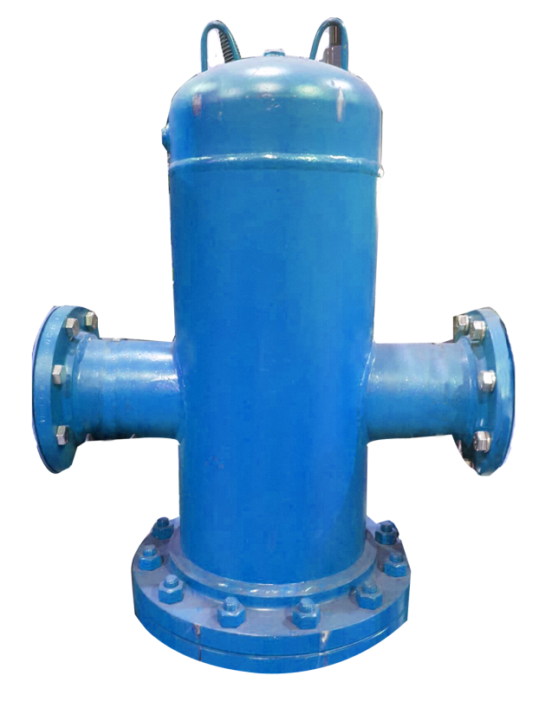
ADSR/AD
Type: In-Line Air/Dirt Separator (With or Without Strainer)
Capacities: 69 to 12100 USGPM(16 to 2748 m3/hr)
Connections: 2″ to 36″ Diameter (50 mm to 914 mm)
^{Pressure: up to 250PSI} ^{(1724 kpa)}
Temperature: up to 550°F (288°C)
^{Constr. Materials:} Carbon Steel or Stainless Steel

Slide 34
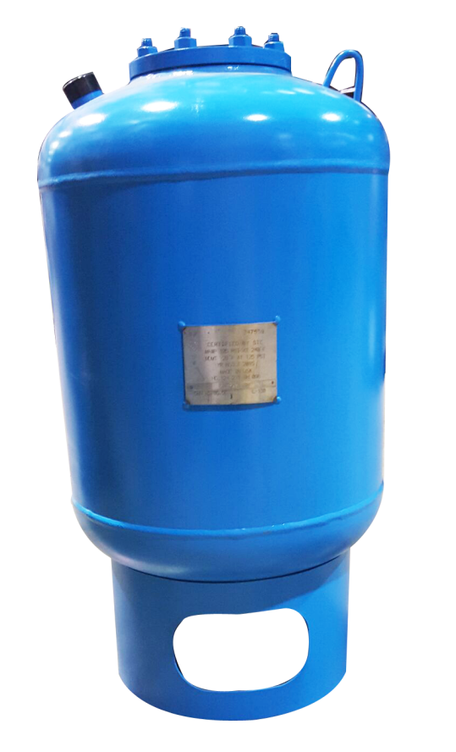
BT
^{Type:} Replaceable Bladder Expansion Tank (with bottom system connection)
^{Capacities: 3 to 3962 Gallons} ^{(11 to 15000 liters)}
Connections: 1″ to 3″, 25 mm to 75 mm
^{Pressure: up to 250PSI} ^{(1724kpa)}
^{Temperature:} ^{up to 240°F (115°C)}
Constr. Materials: Carbon Steel, ^{EPDM}

Slide 35
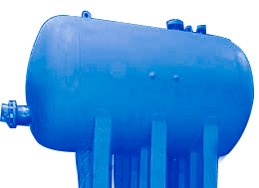
RLU/RWU & RSE
RLU / RWU RSE
Hot Water Storage Tank with Heater Hot Water Storage Tank
Capacities: 100 to 15000 Gallons(379 to 56781 liters)
^{Connections: As Requested}
^{Pressure: up to 250PSI,} ^{1724kpa}
Temperature : up to 550°F (288°C)
^{Constr. Materials:} Carbon Steel or Stainless Steel

Slide 36
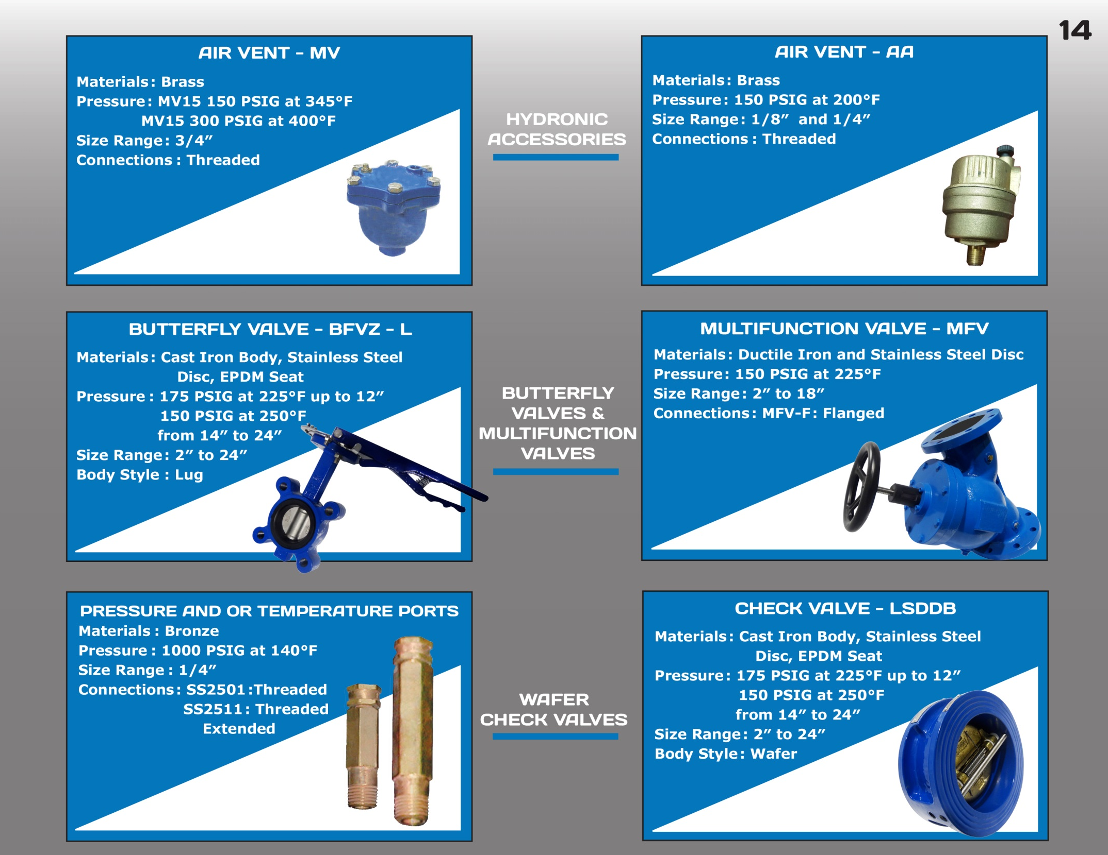

Accessories

Slide 37
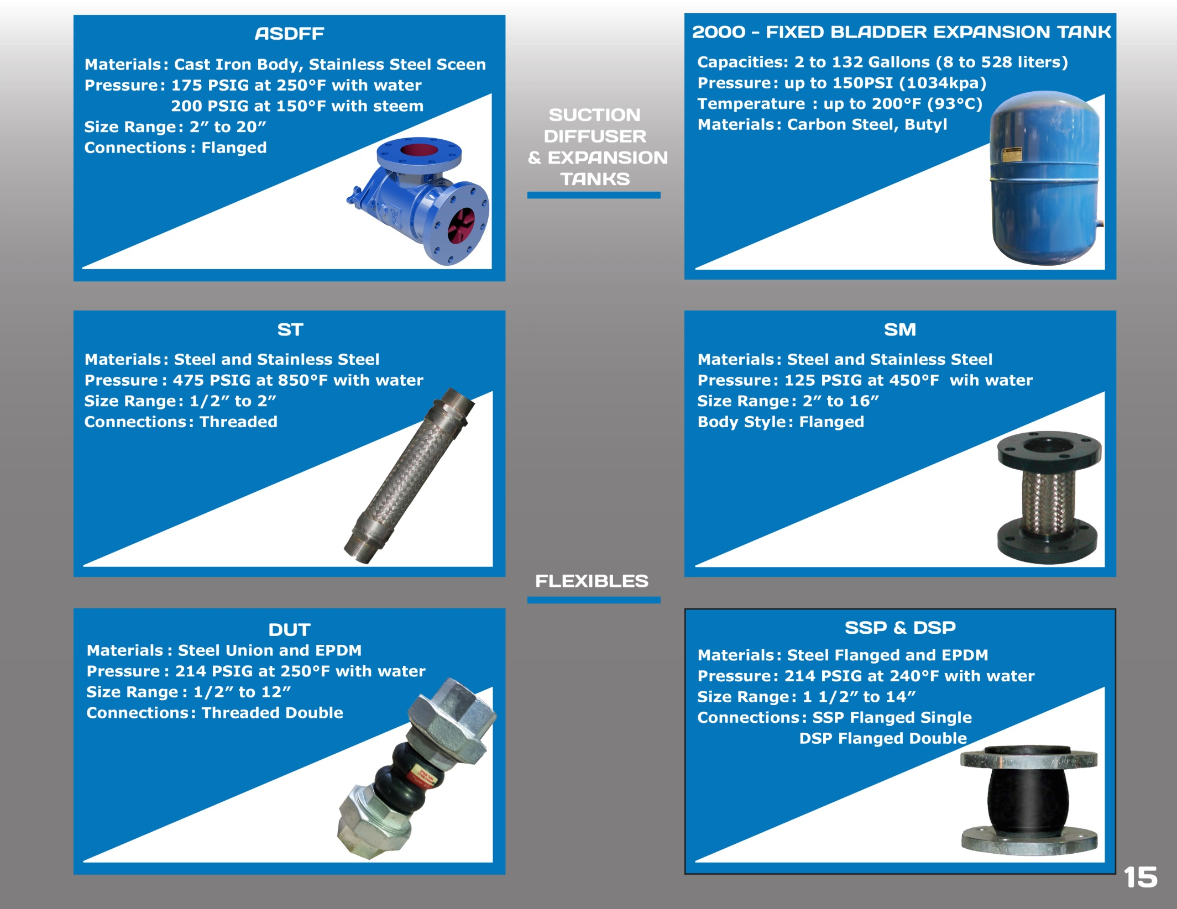

Accessories

Slide 38
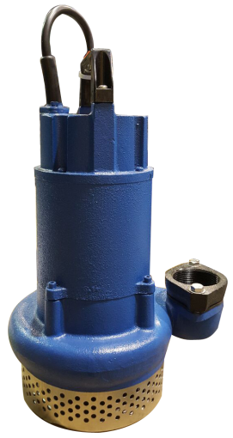
Submersible Pumps
Plumbings
Series: LB-25, 40,75, 215 & 315
^{Type: Effluent Pump}
^{Capacities: up to 175 USGPM} ^{(40 m3/hr)}
^{Head: 8 to 72 ft.} ^{(2.4 to 21.5 m)}
^{Pressure: 3/8″} ^{(9 mm)}
^{Horsepower: up to 1 HP} ^{(0.75 kW)}
^{Drives :Air Filled,} ^{Electrical Motors,} ^{Explosion Proof}
^{Applications: Water}
^{Temperature:} ^{up to 200°F (94 °C)}
^{Constr. Materials: Cast Iron}

Slide 39
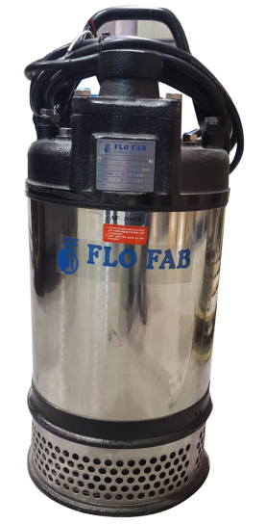
Submersible Pumps
Plumbings
Series: FS-237, 337 & 437, 475, 675, 4110, 6110, 8110
Type: Multi-Purpose Drainage Pump
^{Capacities: up to 1400 USGPM} ^{(317 m3/hr)}
^{Head: 10 to 163 ft.} ^{(3 to 49 m)}
^{Pressure: 3/4″(19 mm)}
^{Horsepower: up to 30HP} ^{(22 kW)}
Drives : Air Filled Electrical Motors, ^{Explosion Proof}
^{Applications: Water}
^{Temperature:} ^{up to 200°F (94 °C)}
Constr. Materials: Cast Iron and Stainless Steel

Slide 40
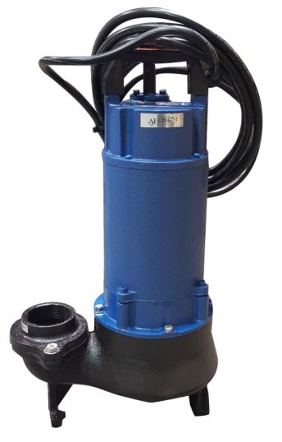
Submersible Pumps
Plumbings
^{Series: LBV-40} ^{LBV-75,} ^{215 & 315}
Type: Effluent & Sewage Vortex Pump
^{Capacities: up to 159 USGPM} ^{(36 m3/hr)}
^{Head: 4 to 59 ft.} ^{(1.2 to 18m)}
Pressure: 3/4″(19 mm) 2″(50mm)
^{Horsepower: up to 1 HP} ^{(0.75kW)}
Drives : Air Filled Electrical Motors, ^{Explosion Proof}
Applications: Water, Sewage & Waste Liquids
^{Temperature:} ^{up to 200°F (94 °C)}
Constr. Materials: Cast Iron and Stainless Steel

Slide 41
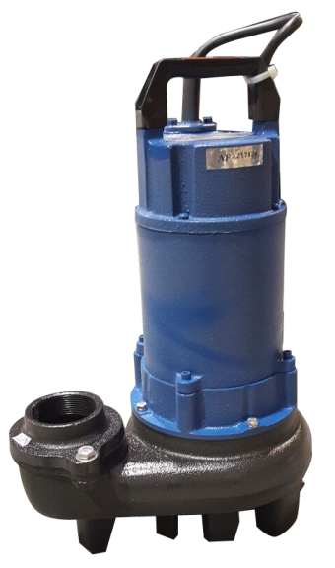
Submersible Pumps
Plumbings
^{Series: LBK-75} ^{LBK-215 & 315}
Type: Effluent Sewage Non Clog Pump
^{Capacities: up to 185 USGPM} ^{(42 m3/hr)}
^{Head: 10 to 59 ft.} ^{(3 to 18m)}
Pressure: 3/4″(19 mm) 2″(50mm)
^{Horsepower: up to 1 HP} ^{(0.75kW)}
Drives : Air Filled Electrical Motors, ^{Explosion Proof}
Applications: Water, Water, Sewage & Waste Liquids
^{Temperature:} ^{up to 200°F (94 °C)}
^{Constr. Materials: Cast Iron}

Slide 42
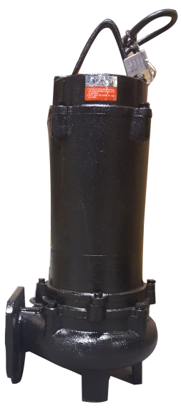
Submersible Pumps
Plumbings
^{Series: FBV-332} ^{FBV-337 & 437}
^{Type:} ^{Sewage Non Clog Pump}
^{Capacities: up to 317 USGPM} ^{72 m3/hr}
^{Head: 8 to 66ft} ^{(2.4 to 20 m)}
Pressure: 2″ (50 mm) 3″(80mm)
^{Horsepower: up to 5HP(3.7 kW)}
Drives : Air Filled Electrical Motors, ^{Explosion Proof}
Applications: Water, Sewage & Waste Liquids
^{Temperature:} ^{up to 200°F (94 °C)}
^{Constr. Materials: Cast Iron}

Slide 43
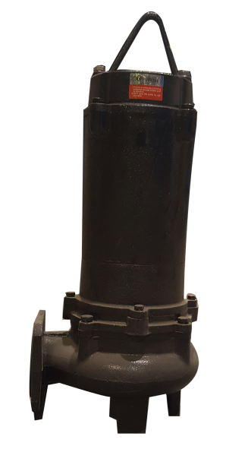
Submersible Pumps
Plumbings
^{Series: FGC-015 / FGC-022} ^{FGC-037 / FGC-055}
^{Type:} ^{Sewage Grinder Pump}
^{Capacities: up to 61 USGPM,} ^{14 m3/hr}
^{Head: 17 to 105ft} ^{(5.2 to 32 m)}
^{Pressure: 3/4″(19 mm)}
^{Horsepower: up to 5HP(3.7 kW)}
Drives : Air Filled Electrical Motors, ^{Explosion Proof}
Applications: Water, Sewage & Waste Liquids
^{Temperature:} ^{up to 200°F (94 °C)}
^{Constr. Materials: Cast Iron}

Slide 44


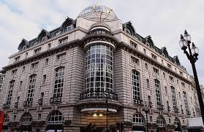
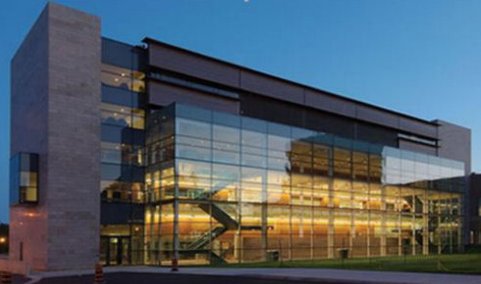

High Profile Jobs
The New World Trade Center, NY, USA
520 Park Avenue, NY, USA
The Exchange Tower of New York, USA
The Hilton Millennium, NYC, NY, USA
Cogir Jazz of Montreal, CA
The Criterion of New York, USA
Concord Garden in Richmond, CB, CA
Fort Bliss Hospital in Texas, USA
Brock University of Ontario, CA
and more…

Slide 45

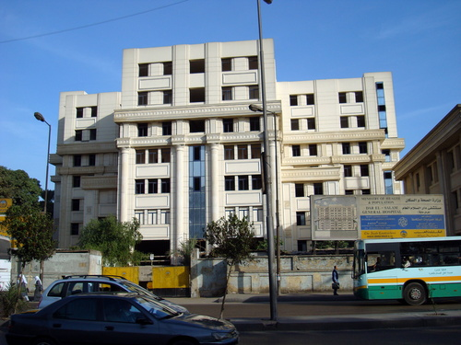

Middle East High
Profile Reference list
Qatar Pearl
Saudi Arabia Ministry of Interior Emergency power fuel oil package
(more than 200 sites)
Egypt Dar Al Salam Hospital
Egypt National organization for potable
water & sanitary drainage pumping stations.
Saudi Arabia Jeddah Port.

Slide 46
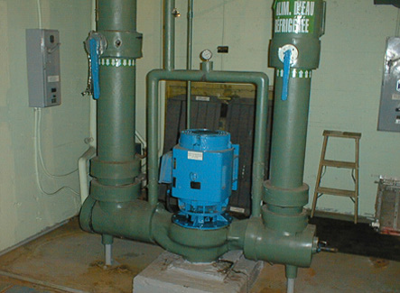
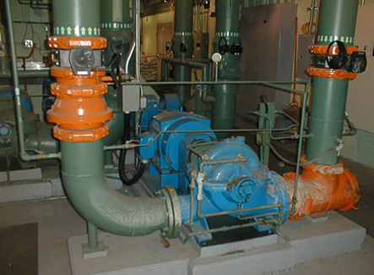
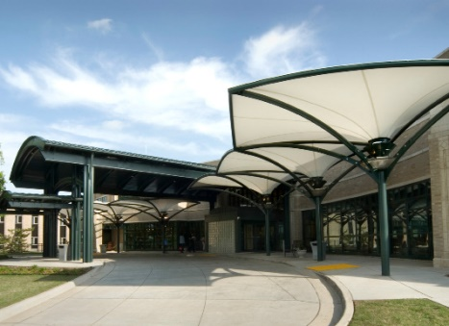
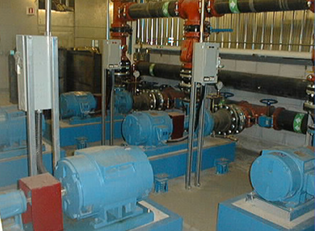
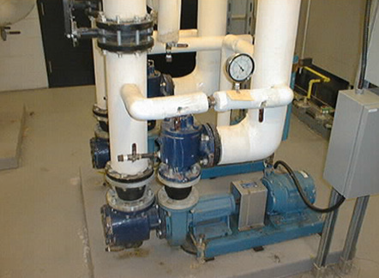
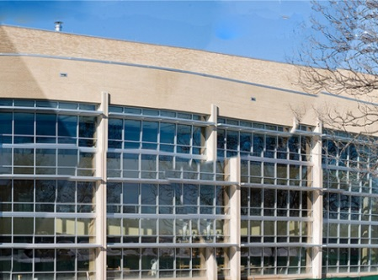
More Jobs
Canadian National
Montreal QC, CA
Montreal’s Archives
Montreal, QC, CA
Muskogee Regional
Medical Center
Muskogee, OK, USA
The Gazette
Montréal, QC, CA
Wawanesa
Mont-Royal, QC, CA
Research and Medical Clinic
Tulsa, OK, USA

Slide 47
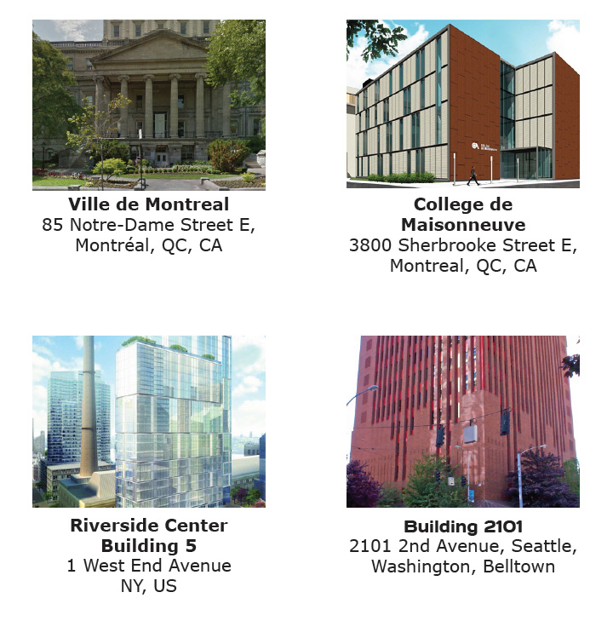
More Jobs

Slide 48


Slide 49
Thank You for
Your participation!
Visit our Website
www.flofab.com

